Slide 1
Fresno County Rural Transit (FCRTA) Electric Bus/Rail Connector Project
By Joseph Oldham,
Director, CALSTART San Joaquin Valley Clean Transportation Center
510 W. Kearney Blvd., Suite 105
Fresno, CA 93706
Ph # (559) 797-6034
Email joldham@calstart.org

Slide 2
Project Goals
First deployment of battery electric buses on intercity rural transit service in the San Joaquin Valley! First use of solar-powered DC Fast Chargers to provide electric power for electric buses in rural transit service.
Validate electric transit buses for use in rural transit service.
Increase and improve connection for residents in rural Fresno County cities with passenger rail services.
Eliminate electric grid issues for deployment of electric transit buses by using renewable solar power.
Provide increased transit service without increasing vehicle emissions.

Slide 3
Project Overview
Purchase four (4) BYD K9S zero-emission, battery electric transit buses and four (4) Enivision Solar “Solar Tree DCFC” units for use on new Express Bus/Rail Connector service from Firebaugh, Coalinga, Kingsburg, and Orange Cove to the Amtrak Station and multi-modal facility in Downtown Fresno.
Deploy the Solar Tree DCFC units at the point of origination for each route to provide renewable electric power for the electric transit buses used in the new service.
The electric buses would make one round trip each day, Monday through Friday, leaving the origination cities in the morning and returning in the evening.
The buses will leave the origination cities fully charged by the Solar Trees and return to be recharged in the evening. It is possible that the Coalinga bus may have to have mid-route charging done at the FCRTA maintenance yard during its morning to afternoon lay-over time.
Total project cost is estimated at $5,076,581.
New express routes will save time and add new service without adding new vehicle emissions.
Project time line to completion is estimated at 21 months from Notice to Proceed.

Slide 4
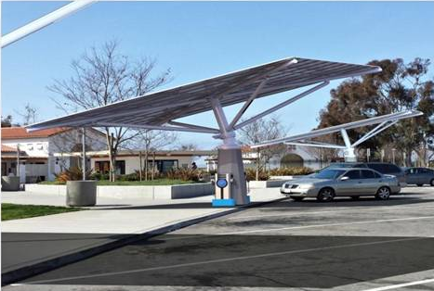
Project Technology
BYD Model K9S, 35 foot, battery electric transit bus. Estimated range = 145 miles per charge. 32 passenger capacity.
Envision Solar “Solar Tree DCFC”. 250 kWh energy storage in pedestal. Solar panels track the sun to provide maximum power for system.

Slide 5
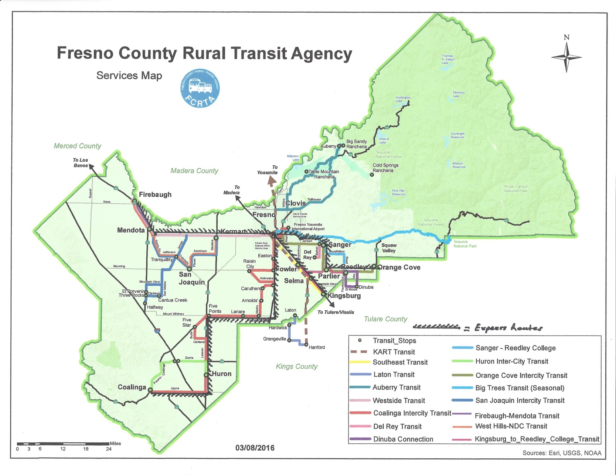
Express Routes Map

Slide 6
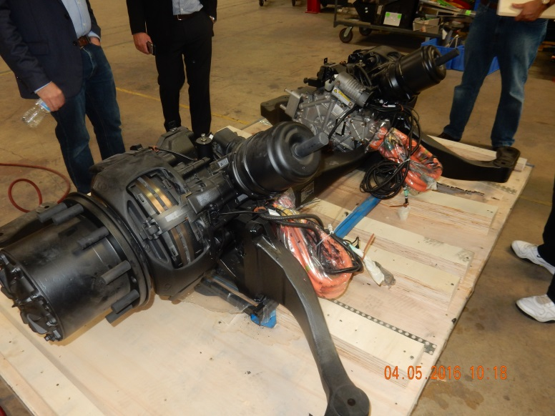
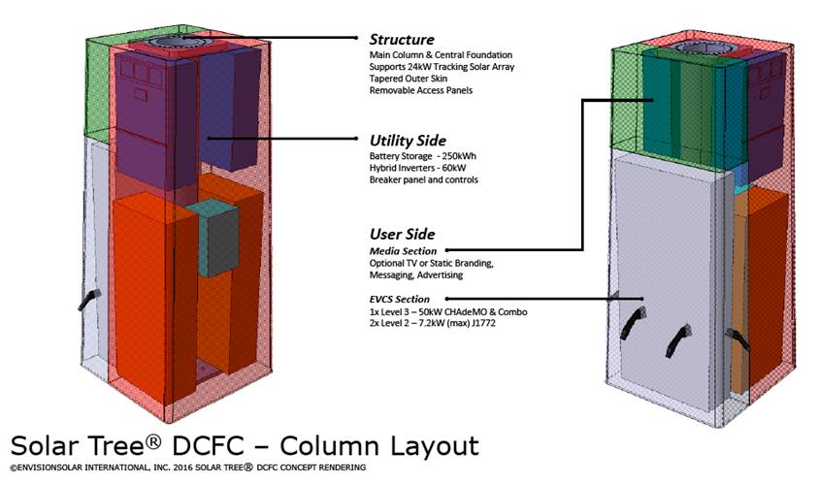
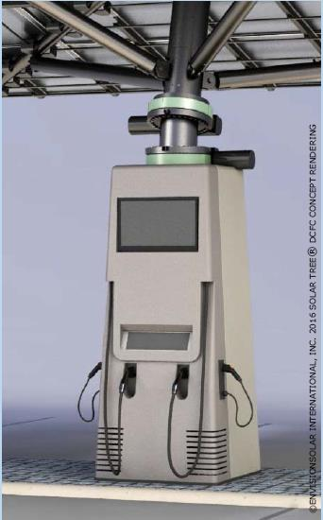
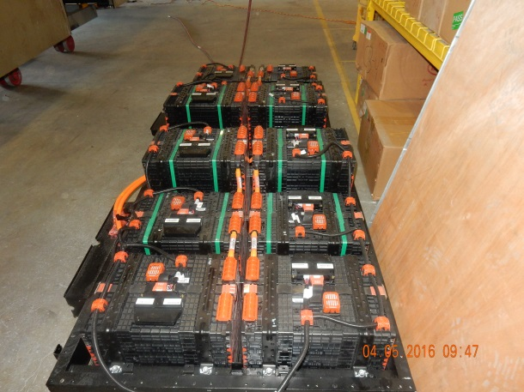
Bus and Solar Tree Features
Electric drive motors integrated into the rear axle assembly.
Envision Solar “Solar Tree DCFC” units have 250 kWh storage built within the pedestal base. This is only 20 kWh hours less than the bus battery system and should supply enough electrical power to fully re-charge the buses each day after their routes.
Advanced iron-phosphate battery packs with 270 kWh capacity

Slide 7
Performance & Emission Savings
32 passenger or 27 passenger with two (2) wheelchairs .
60 mph maximum speed.
28,660 lb. gross weight.
145 miles on a charge.
Two (2) 100 kW electric drive motors per bus.
270 kWh iron-phosphate battery pack.
3-4 hours charging time.
Cost per mile for electricity and maintenance= $0.22
Reduce NOx by 0.138 tons and CO2 by 246.8 tons annually.

Slide 8
Project Direct Public Benefit
Provide new bus/rail connector service without adding vehicle emissions.
Provide more transit service to rural Fresno County city residents.
Shorten the time required for residents using transit to travel between rural Fresno County cities and Fresno.

Slide 9
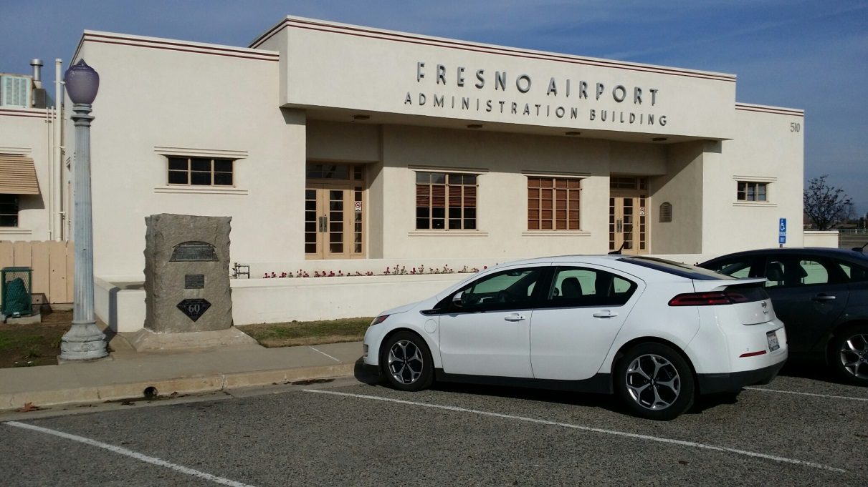
Questions?
Joseph Oldham, Director
CALSTART San Joaquin Valley Clean Transportation Center
510 W. Kearney Blvd., Suite 105
Fresno, CA 93706
Ph # (559) 797-6034
Email joldham@calstart.org

