Slide 1
The Sustainable Aviation Project
By Joseph Oldham,
Director, CALSTART San Joaquin Valley Clean Transportation Center
510 W. Kearney Blvd., Suite 105
Fresno, CA 93706
Ph # (559) 797-6034
Email joldham@calstart.org

Slide 2
Goals for the Project
First deployment of production electric aircraft in flight training operations in the United States and First network of airports to support electric aircraft operations in the World!
Validate electric propulsion for aircraft and pave the way for aerial Personal Rapid Transit technology.
Lower cost of flight training to reduce cost barrier for people interested in aviation career.
Improve safety for pilots and the public through the elimination of gasoline in training aircraft.
Eliminate toxic air emissions from flight training activity around airports.

Slide 3
Project Overview
Purchase four (4) Pipistrel Alpha Electro battery electric training aircraft.
Deploy network of electric aircraft chargers at four (4) Fresno County regional airports to support county-wide electric aircraft operation; Fresno Chandler Executive Airport (KFCH); Reedley Municipal Airport (KO32); Mendota Municipal Airport (KM90); and Fresno-Yosemite International Airport (KFAT).
The electric aircraft would be operated by Mazzei Flying Service in support of the new Reedley College Flight Science program to provide primary flight training for veterans and youth from disadvantaged communities in Fresno County.
The aircraft would be stored at new hangars in Mendota and at existing hangars at Reedley and Fresno Yosemite International.
Total project cost is estimated at $2,837,000; $1,071,000 in grant funding is being requested for the project.
Budget includes $90,000 for flight training assistance grants for low income youth.
Project time line is 10 years and 7,000 hours of operation per aircraft.

Slide 4
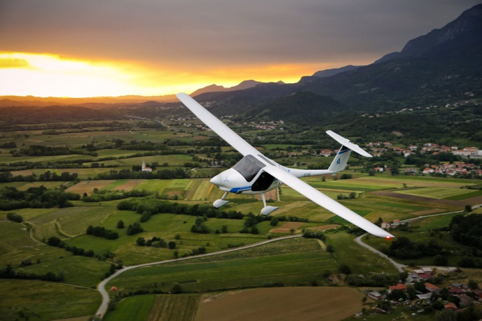
Pipistrel Alpha Electro in Flight

Slide 5
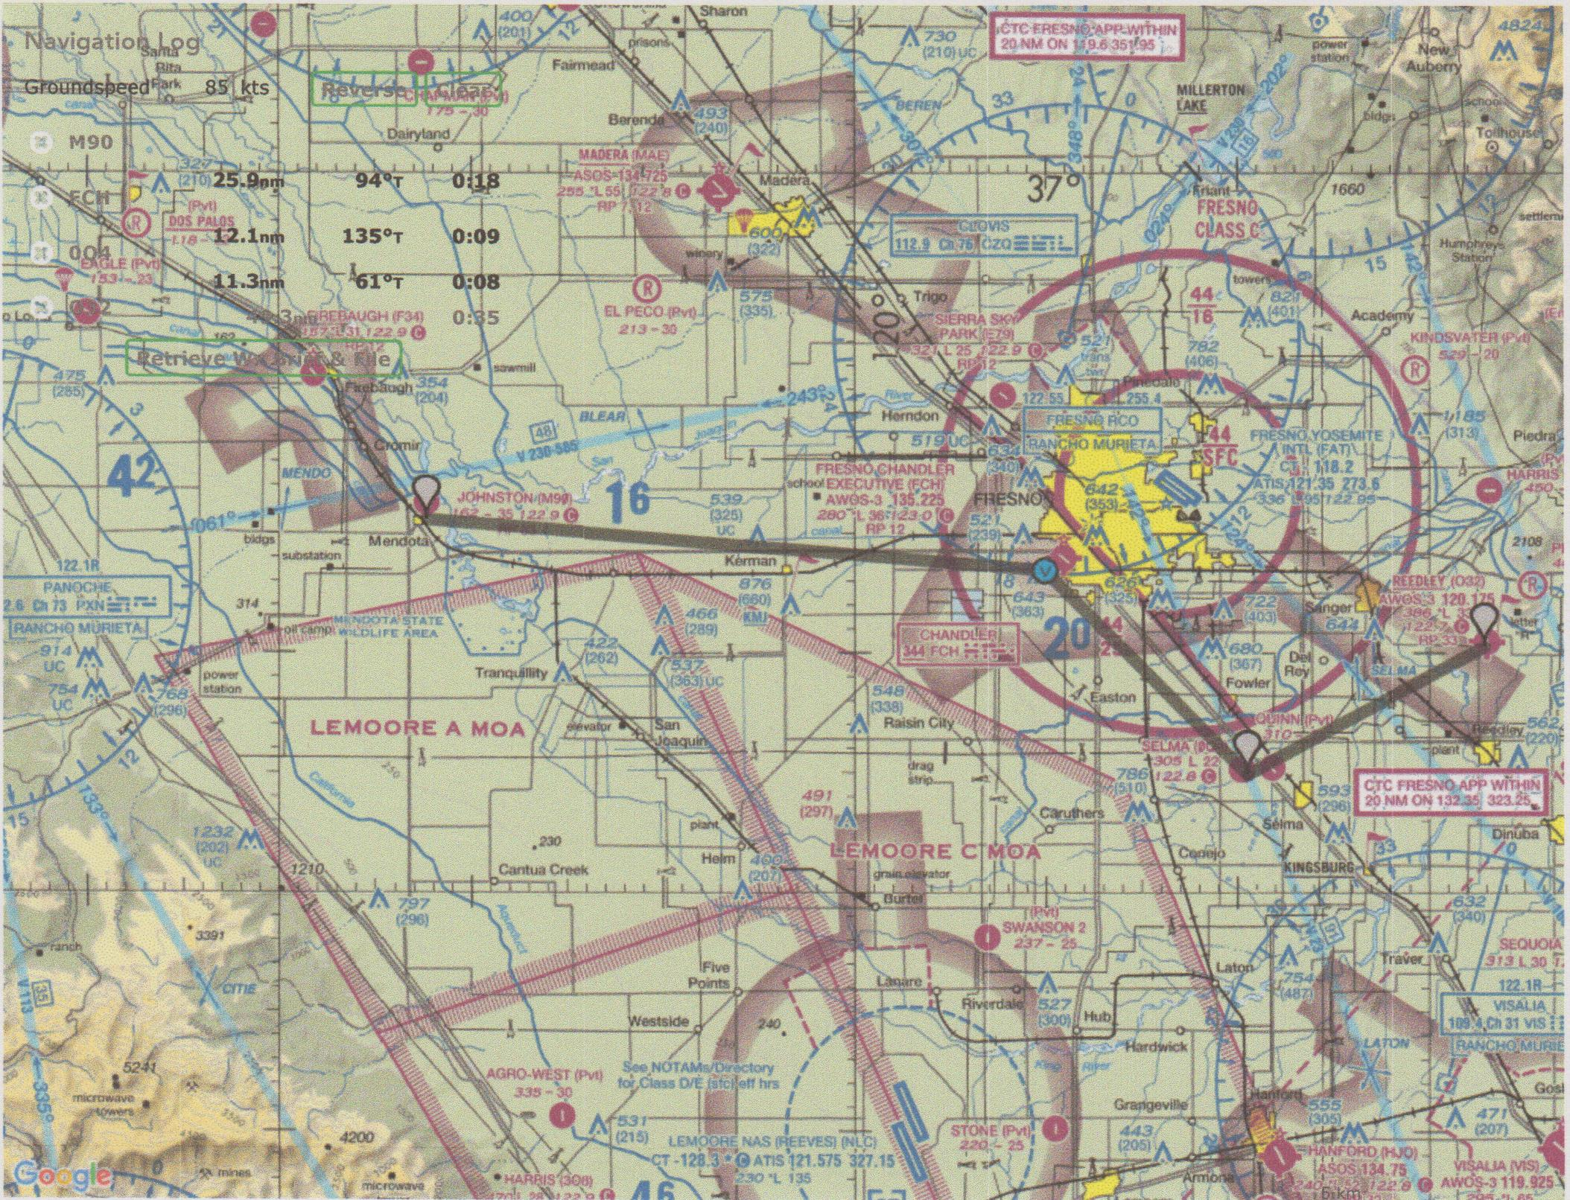
Typical Flight Operations

Slide 6
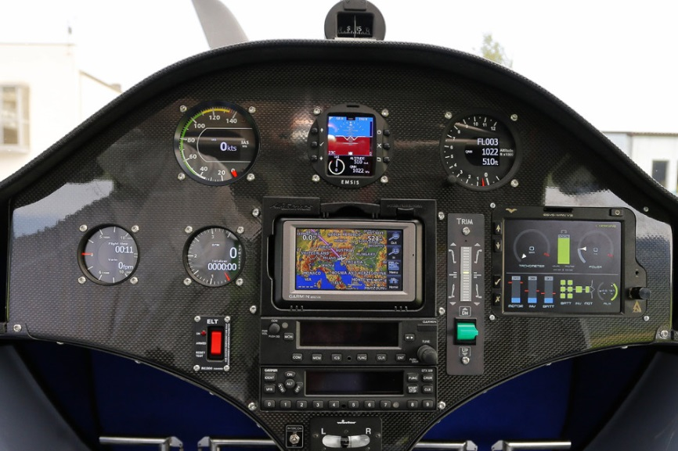
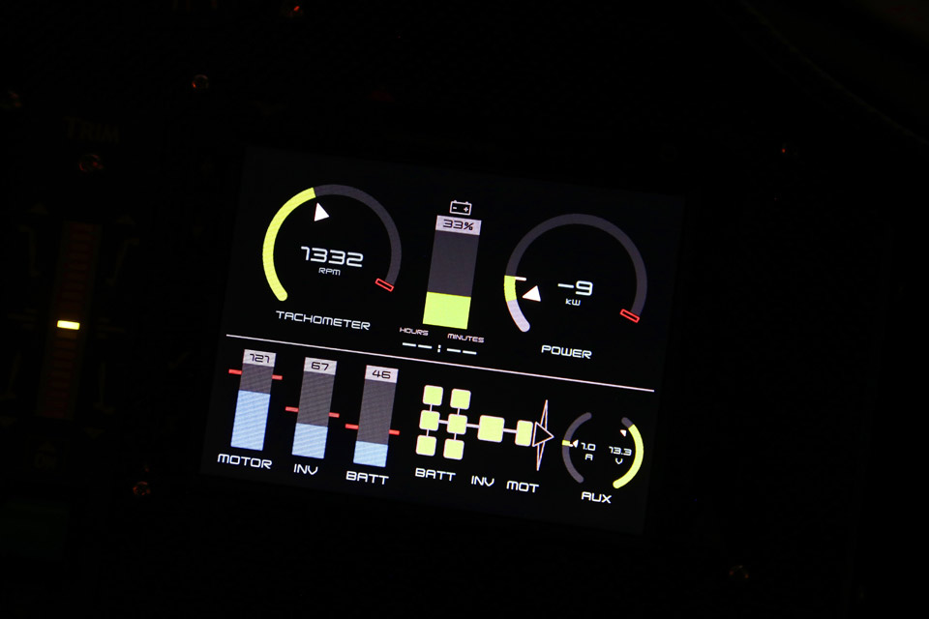
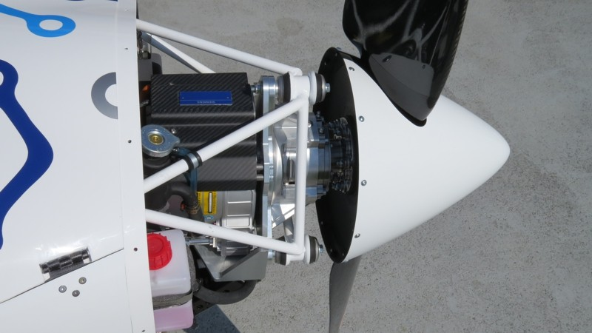
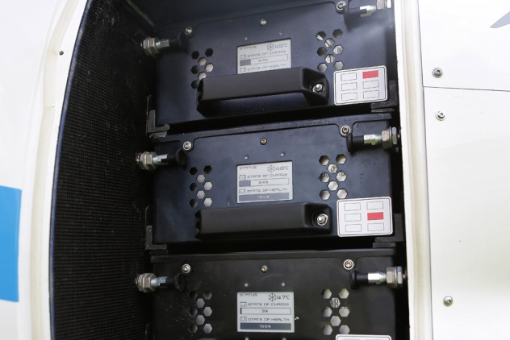
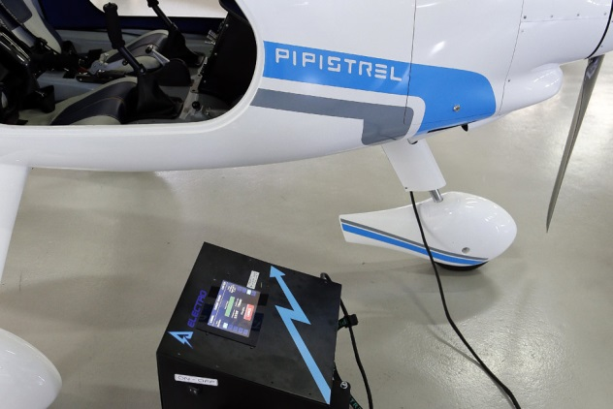
Alpha Electro Features
Lithium ion battery pack
Siemens 60 kW electric motor

Slide 7
Performance & Emission Savings
1.5 hours of flight time per charge.
85 kts or 98 mph cruising speed.
1,210 lb. gross weight.
739 lb. empty weight.
476 lb. payload.
1,000 ft./min. rate of climb.
17 kWh battery capacity.
45 min. charge time using Pipistrel 20 kW charger.
Cost per hour of flight time for electricity = $1.70
Reduce NOx by 0.989 tons and CO2 by 92 tons annually.

Slide 8
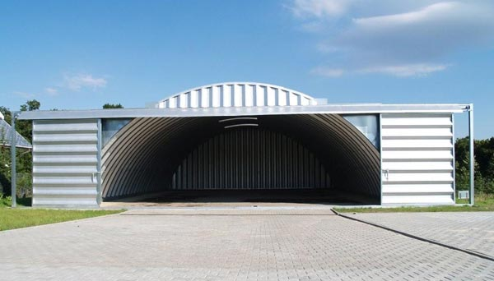
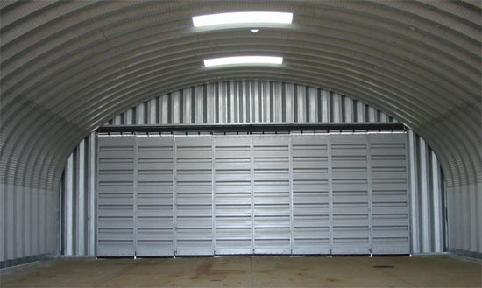
New Hangars for Mendota
Two new hangars are being proposed for construction in Mendota to house the electric aircraft and their charger.
Proposed flight operations would use fully charged aircraft from FAT or Chandler to fly to Reedley or Mendota where they would be exchanged for waiting freshly charged aircraft in the hangars. Outbound aircraft would then be left for charging until the next flight.

Slide 9
Project Direct Public Benefit
Validate electric propulsion systems, increase acceptance of clean, zero emission electric vehicles, and pave the way for electric aerial Personal Rapid Transit vehicles.
Provide new career opportunities for youth and veterans in disadvantaged communities within Fresno County.
Revitalize the City of Mendota and City of Reedley municipal airports.
Remove emissions and increase safety by eliminating aviation gasoline from flight training operations.
Showcase Fresno County as a center for innovation that will attract future investment and job creation.

Slide 10
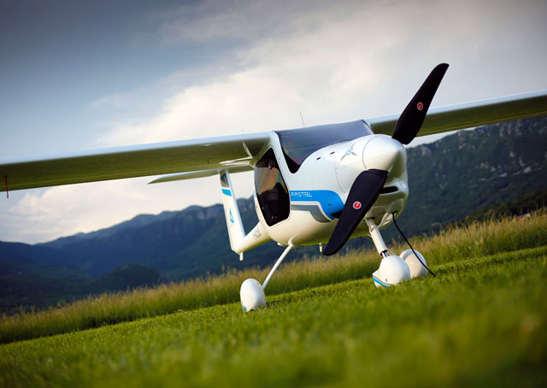
Questions?

