Slide 1
Workshop goals
Generate feedback, interest, and support for the final plan
Provide a workshop format that is accessible for both technical and community WG members
Ensure that Spanish speakers can meaningfully engage
Notes:
Brooke

Slide 2
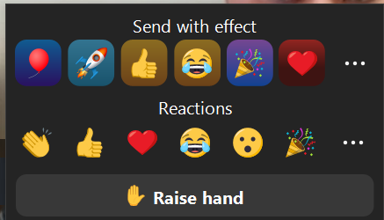
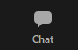

Interpretation Instructions
Instrucciones para interpretación en español
Click on the globe icon / haz clic en el icono de interpretación que parece a un mundo
Select your language / seleccione su lenguaje y silenciar el audio original
If you are using Zoom on your phone or table, select the three dots to see more options / Si está usando Zoom en un teléfono o tableta, seleccionará los tres puntos para las opciones de interpretación
This meeting will be recorded in both English and Spanish / se grabará la reunión en ambos idiomas
To ask questions or comment, use the chat or raise your hand with the “react” icon / para hacer preguntas o dar comentarios, utilice el chat o levanta la mano con el icono de reacciones

Slide 3
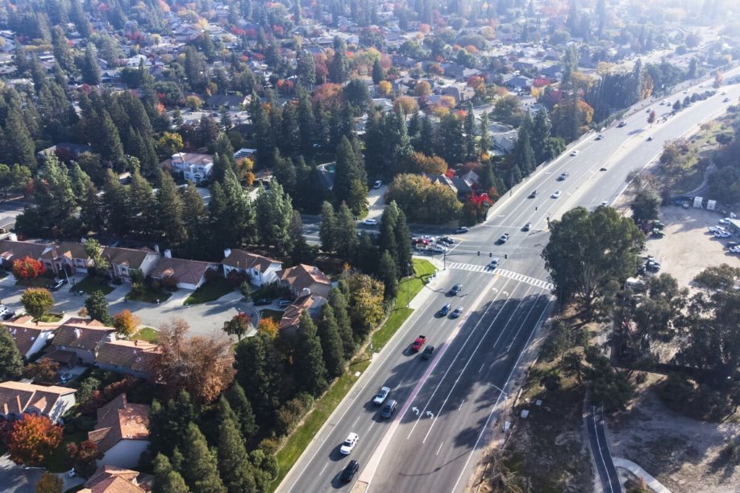


Technical & Community Working Group Meeting
Fresno County Climate Resiliency Plan for Transportation
April 23rd 10 am – 11:30 am
Notes:
Paul

Slide 4
Agenda
10:00 a.m.-11:30 a.m.
Introductions & Overview (10 min)
Climate Risk Assessment (10 min)
Stakeholder Engagement (10 min)
Project Recommendations (30 min)
Final Plan Report (15 min)
Q&A (15 min)
Notes:
Welcome & Introduction (5 mins)
Project Review (30 mins)
Project overview
Methodology
Findings
Community Engagement Review (20 mins)
Fresno County Climate Resiliency Plan (10 mins)
Review timeline
Next steps
Questions (20 mins)

Slide 5
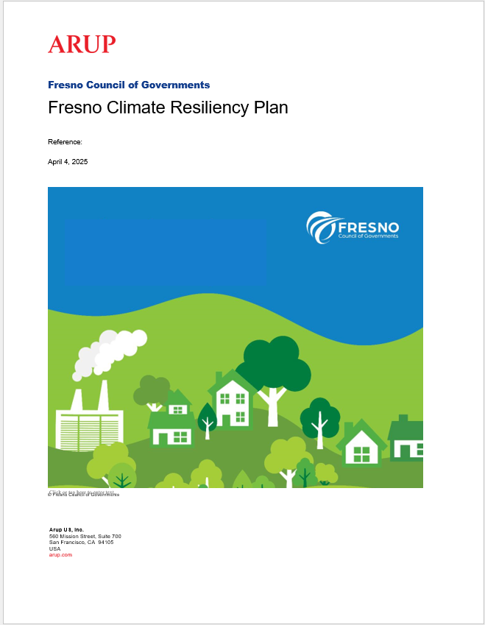
WELCOME!
Please type your name and organization in the chat
Presenting for the Arup Project Team
Brooke DuBose
Karen Barns
Maggie Messerschmidt
Sheila Hakimipour
Notes:
Brooke

Slide 6
Project Overview
Notes:
Brooke
Acknowledge that for the TWG the content will be familiar but for the CWG this will be the first time they’ll see a lot of this information

Slide 7
Project Overview
Objectives:
Develop the Fresno Countywide Climate Resiliency Plan that reflects local & regional needs
Identify a list of projects that will become candidate projects for the 2026 Regional Transportation Plan/Sustainable Community Strategy
Advance a set of implementable projects that demonstrably reduce risk to the transportation network and its users
Plans and Policy Review
Risk Assessment
Priority Project Selection and Assessment
Develop Resiliency Plan
Identification of Project Opportunities
1
2
3
4
5
Stakeholder & Community Engagement
Notes:
Brooke

Slide 8
Schedule
TASK | JUNE | JULY | AUG | SEPT | OCT | NOV | DEC | JAN | FEB | MAR | APR | MAY | JUN
Task 1. Plan & Policy review
Task 2. Update Weather & Climate Projections
Task 3. Risk Analysis & Project Identification
Task 5. Draft Project List
Task 6. Cost Estimates
Task 7. Priority Projects for Risk Assessments
Task 8. Draft Plan
Task 9. Final Plan & Board Adoption
Task 4. Collaboration & Outreach
Outreach Plan
Technical Working Group Meetings |  |  | M1 |  |  | M2 |  | M3 |  |  | M4
Community Working Group Meetings |  |  |  |  |  |  | M1 |  |  |  | M2
Public Outreach
We are here
Notes:
Brooke

Slide 9
Climate Risk Assessment
Notes:
Karen
First part cover today is the results of the climate risk assessment. For those that attended the second TWG meeting in November or the CBO workshop in December, this will be a bit of a recap of the work we shared then.

Slide 10
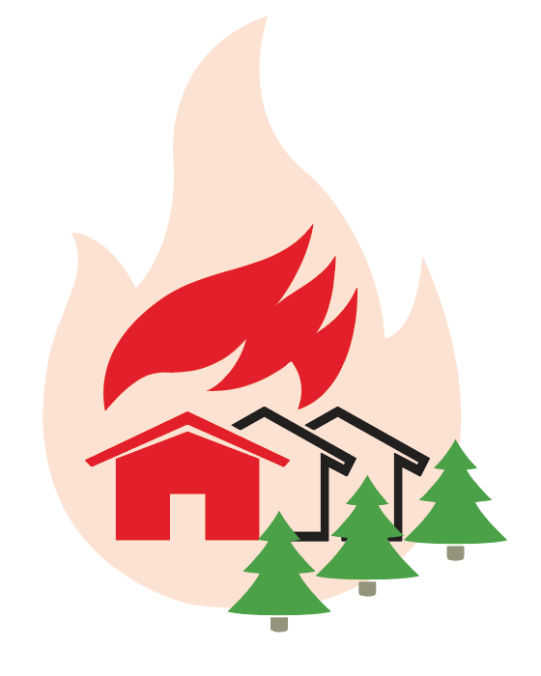

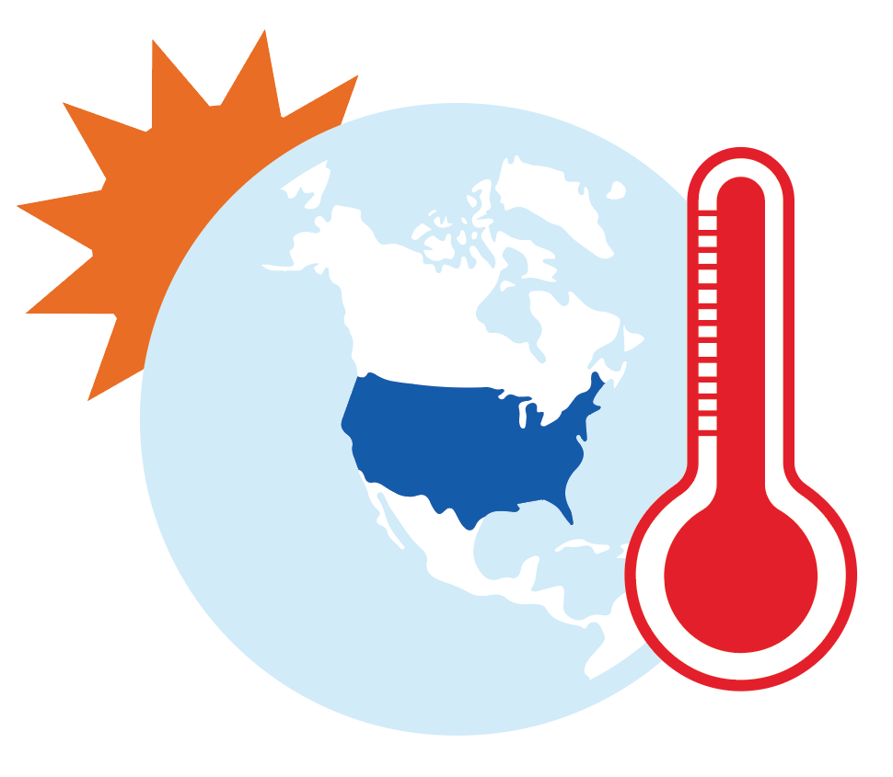
Climate Projections + Risk
Key Findings
Flooding
Particularly impacts Fresno, Clovis & western Fresno County.
Increased rainfall will make
flooding more frequent.
Extreme Heat
Is already a serious concern,
and it will get even hotter.
Heat affects people walking, bicycling, & taking transit, many of whom are low income.
Wildfire
Impacts rural & mountainous regions, many of which are also isolated.
Likelihood & severity is expected to increase with climate change.
Notes:
This study looked at how flooding, extreme heat and wildfire occur now, and how they are expected to change in the future.
Flooding is an issue in multiple locations across the county, though certain areas are more prone to extreme flooding such as the cities of Fresno, Clovis and western Fresno County. In the future, extreme rainfall events are projected to become more frequent.
Heat, you all know, is already a concern. Temperatures are anticipated to increase, The county’s heat index (the feels like temperature) is projected to rise on average by 5°F to 11°F by mid and end of century, respectively.
Wildfires predominantly impact rural and mountainous regions in the county due to the availability of wildland fuel (trees, brush, etc.). Some projections show that the chance of a wildfire occurring in heavily forested areas of the county will triple by end of century.

Slide 11
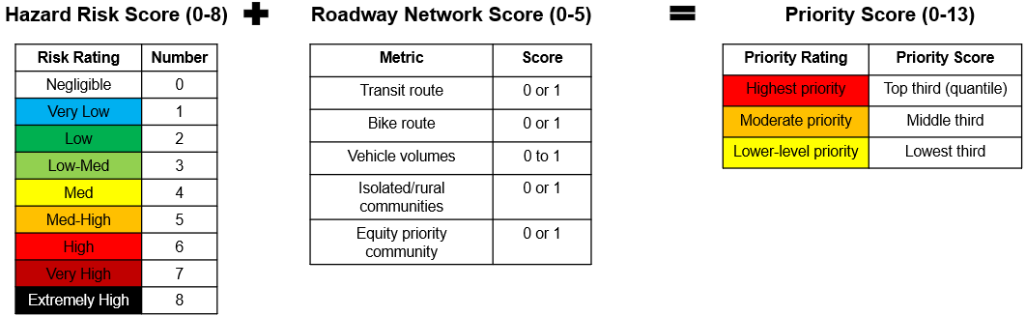
Climate Risk Assessment
Risk = likelihood x consequence
Notes:
Floods, extreme heat events, and wildfires happen with different frequencies. To be able to compare the impacts we used the framework you can see here. On the left hand side we have the likelihood of an event, and then on the top we have the consequence, so how badly does the flood impact a bus yard for example.
So if we had an unlikely event – this could be the 100-yr flood, and it has catastrophic impacts, such as closes the bus yard for months, then it would get a high risk rating
On the right hand side you can see how these ratings map to scores, something that will come up again a little bit later.
This allows us to compare different events that will have different impacts.

Slide 12
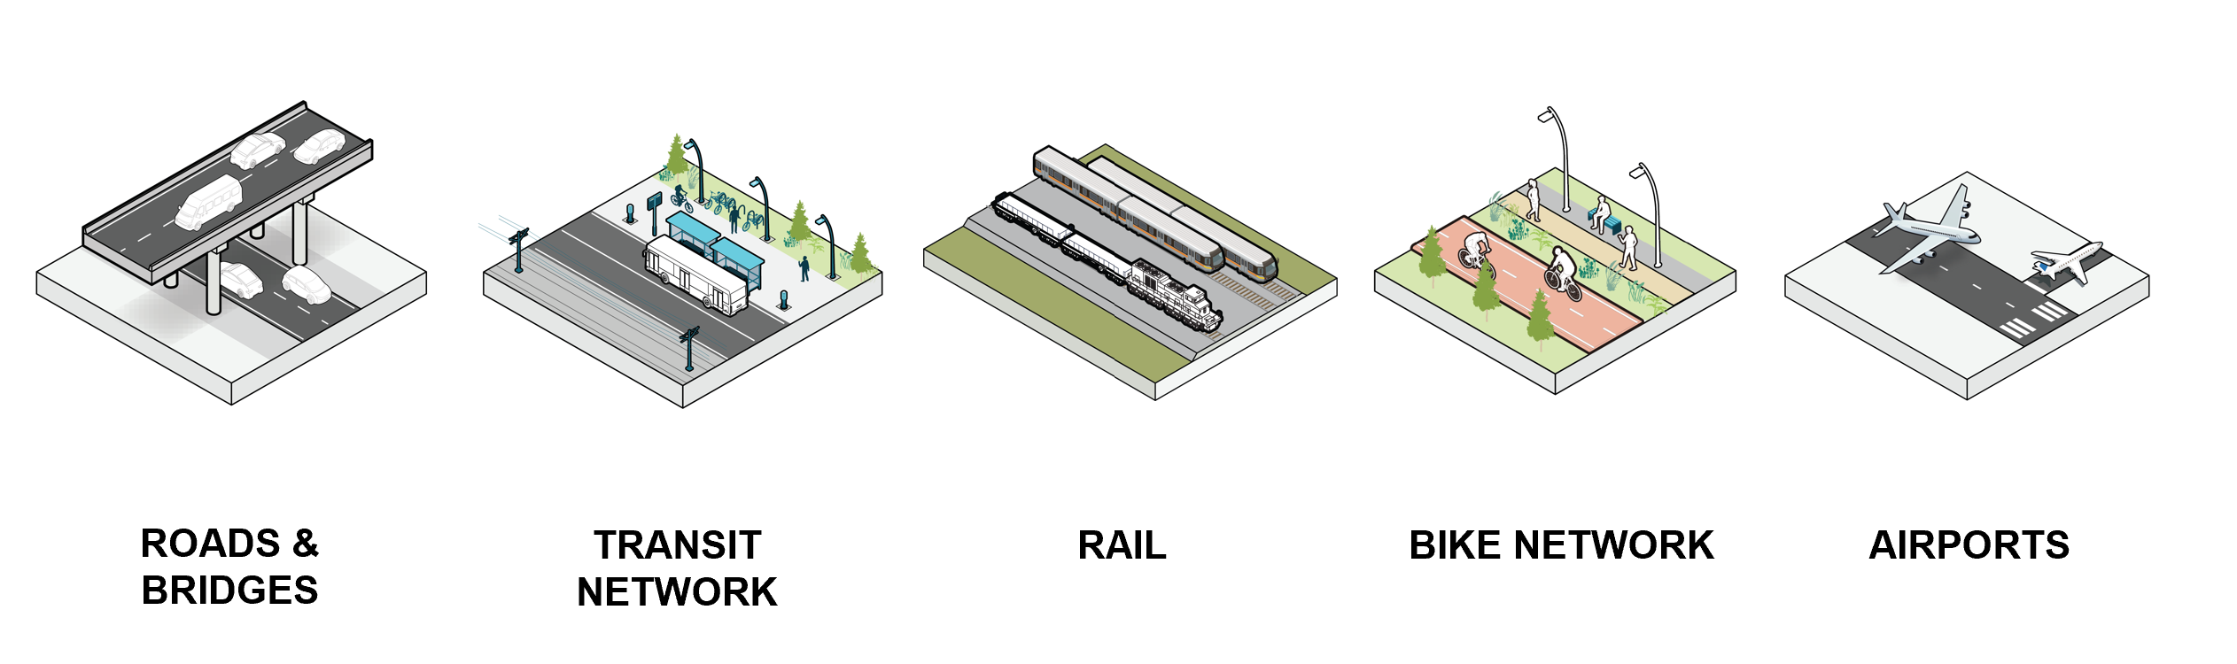
Transportation Assets
TRANSIT NETWORK & BUS YARDS
RAIL NETWORK
Notes:
This study is focused on the transportation assets in Fresno County, and we included the following…..
Moving onto the key findings

Slide 13
Risks to Transportation Assets
Roads & Bridges
Wildfire and landslides impact mountainous roads
Flooding impacts the inland valley
Transit network
Flooding primarily impacts urban transit service served by FAX (i.e. routes 1, 28, 38)
Rural transit service (i.e. Coalinga Intercity Transit & Westside Transit Routes) is susceptible to wildfire risk.
Bus yards
Flooding has the potential to impact ~25% of bus yards, with the highest risk at Firebaugh Bus Yard 1, Coalinga Bus Yard, and Orange Cove Bus Yard.
TRANSIT NETWORK AND BUS YARDS
Notes:
The goal of the risk assessment was to identify which assets and which hazards are the priority to address now.
The key takeaways are shown here:
Roads and bridges
Transit network
Bus yards

Slide 14
Risks to Transportation Assets
Flood and wildfire have the potential to impact parts of the bike network.
Extreme heat is the main concern for cyclists.
BIKE NETWORK
Flood impacts are concentrated along the main lines through the City of Fresno and the branch lines in western Fresno County.
RAIL NETWORK
Flooding could impact 5 of 9 airports studied in the county. These include Fresno Yosemite International, Fresno Chandler Executive, Selma, Mendota, & Firebaugh
Wildfire does not impact any airports.
AIRPORTS
Notes:
Bike network
Rail network
Airports
These results are summarized in the plan that was shared with you and there is a separate report that details these results that will be made available at the end of the project.
This was what the data told us, but we wanted to understand whether this reflected your lived experience and those that live in Fresno County. So Sheila will discuss how we went about getting that input.

Slide 15
Community Engagement
Notes:
Sheila

Slide 16
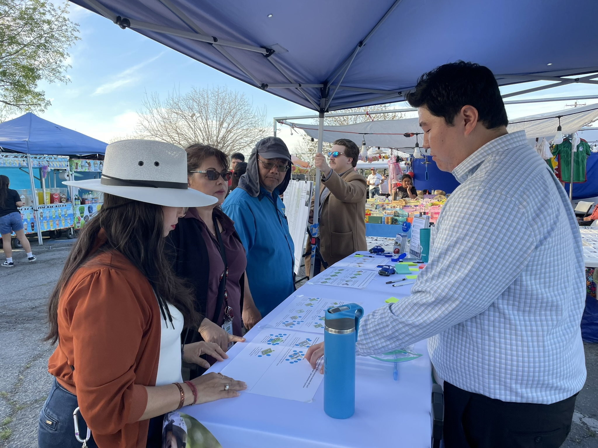
Community Engagement Activities
November
December
March
April
Online survey (Nov – Jan)
Held virtual workshop with community stakeholders
Six pop-up events focused on top five projects
Public review of Draft Plan
Notes:
Brooke
Virtual workshop purposes:
to understand CBO/tribal interests
identify engagement practices that will be appropriate in potential project sites at pop ups, etc.
present initial findings and seek reactions on risks to gain more lived experience related to wildfire, flooding, landslides, etc.

Slide 17
What we heard from Community Based Organizations
Emergency preparedness and response to hazards requires redundancy and more planning
Maintaining access for safety during climate events is priority
Particular concern for farm workers, people with asthma, and people who might become stranded by wildfire or floods
Providing comfort during transit journeys is important
Language and broadband access are major concerns related to communication during emergency response
Transportation resilience projects should also support community resilience to hazards
Notes:
Lastly from me, we shared this information with our TWG right before Thanksgiving and we wanted to share some of the key points that came out of that discussion….
There was discussion about communities that may become isolated if the main routes in and out are impacted, talking about the rural areas. How this can impact emergency response, and that coordination with first responders is really important. We also heard about the importance of not only considering how many people a project might serve as this would likely disadvantage rural communities.
We heard that there are existing issues with degraded pavement across that county.
Providing shade at transit stops is something that has come up a lot for transit riders
Again related to transit, that bus yards are critical facilities to prioritize investment for transit
And then lastly, that there are opportunities to streamline permitting for proposed projects that will help to reduce costs and accelerate implementation.
Hopefully some of this resonates with you and we can talk more about that in a minute, but we just wanted to share with all you all some of things that we’ve been hearing throughout the course of this project.
In a minute we’ll have the opportunity to deep dive into these findings and to hear from you, but I wanted to pause here and see if there are any questions about the project, the scope, or what we’ve shared so far.

Slide 18
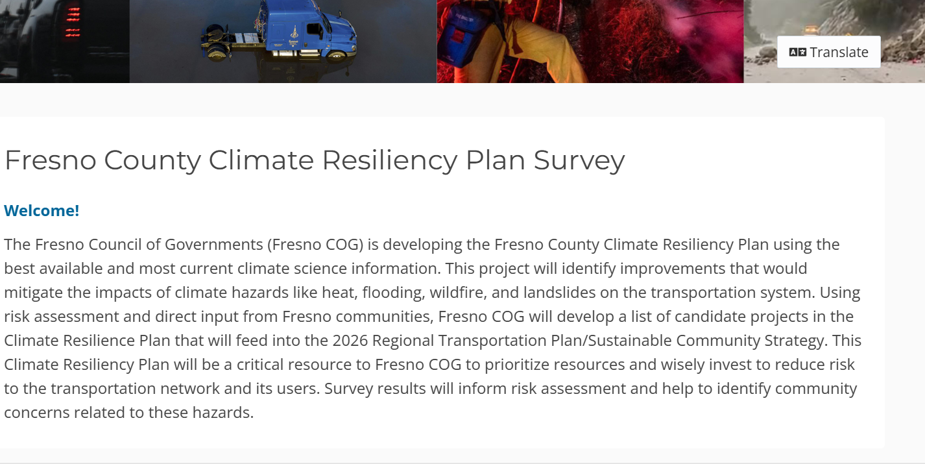
Online Survey
Community Priorities
Continuous access is important (keep roads open)
Landslides limiting route access are a concern (esp. West Fresno)
2. Ingress/egress planning & redundancy during wildfire and flooding
      Highways 99, 180, 168, and Freeway 41
      Access out of Fresno foothills and Southwest Fresno
      Flooding in Metro Fresno
3. Managing thermal comfort for pedestrians & transit riders

Slide 19
What we heard at pop-up events
Urban Fresno
West Fresno
East Fresno
Fresno Disaster Prep Workshop
Mar 8, engaged 55 people
Mendota Open Market
Mar 26, engaged 60-65 people
Community concerns:
Flooding along Hwy 180 disrupts traffic access
Farm workers have limited transportation options
Street Eats (Reedley)
Feb 28, engaged 40-50 people
Auberry Earth Day
Apr 12, 15-20 people
Community concerns:
Wildfire & flooding impacts to roads; less concerned w/ transit & heat
Community wildfire preparedness
Hoover High School Regional Family Engagement
March 19, 200-225 people
Southeast Family Fair
March 15, 50-60 people
Community concerns:
road flooding & transit heat impacts
Hazard hot spots & voting on solutions

Slide 20
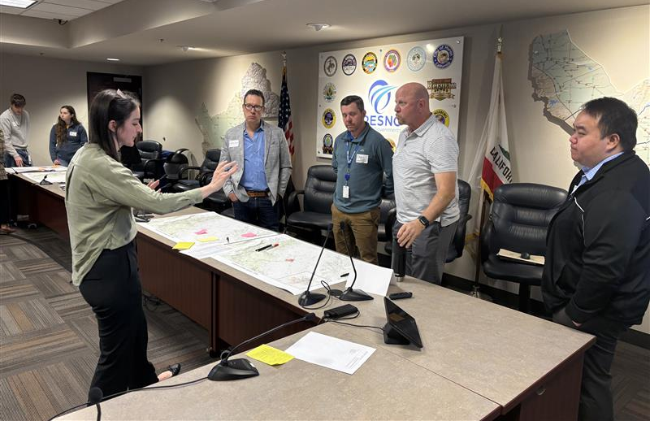
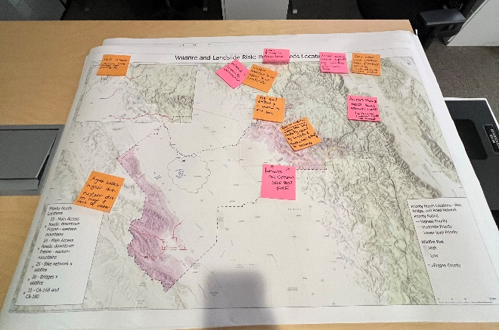
Technical Working Group (TWG)
TWG Member Organizations
CA Department of Transportation
City of Firebaugh
Selma Airport
City of Selma
Clovis Transit
Fresno Area Express
Fresno County Department of Public Health
Fresno County Emergency Management
Fresno County League of Women Voters
Fresno County Public Works & Planning
Fresno County Rural Transit Agency
Kings River Conservation District
Leadership Counsel for Justice & Accountability
San Joaquin Valley Air Pollution Control District
Notes:
Karen
In addition to the community outreach, we convened a technical working group, which a number of you here today have been a part of. You can see the member organizations on the screen, with representatives from Caltrans, FCRTA, FAX, Clovis Transit, dept of public health and emergency management and others.
Today is our fourth and final meeting with this group. Thank you for being a part of this working group.
The TWG provided input at key milestones in the project, at the beginning to steer project direction, reviewing the risk assessment results, and providing input on the identified projects.

Slide 21
What we heard from the TWG
Coordination with first responders is essential for reducing impacts to isolated populations
Road conditions, isolation, and limited access worsen impacts in rural areas
There are existing challenges with degraded pavement across the county
Providing shade at transit stops is the number one priority for transit riders
Bus yards are critical facilities to prioritize investment for transit service
Project prioritization should consider more than # of people affected, since rural populations face multiple challenges
Streamlined permitting for proposed projects will help to reduce costs and accelerate implementation
Notes:
Here are some of the key things we heard from you all… :
Rural communities: concern about isolation and how road conditions can limit access, also the importance of coordinating with first responders, as well as not weighting projects solely on the number of people served as this would disadvantage rural areas.
For transit: criticality of bus yards, as well as the need for shade at transit stops
County wide issues: degraded pavement and the need to streamline permitting processes to help accelerate implementation
This feedback was so valuable in helping direct the focus and make sure that we weren’t missing anything. The technical work and the feedback from the engagement activities fed into…

Slide 22
Identifying Project Opportunities
Notes:
Karen
the identification of project opportunities… which was the next step

Slide 23
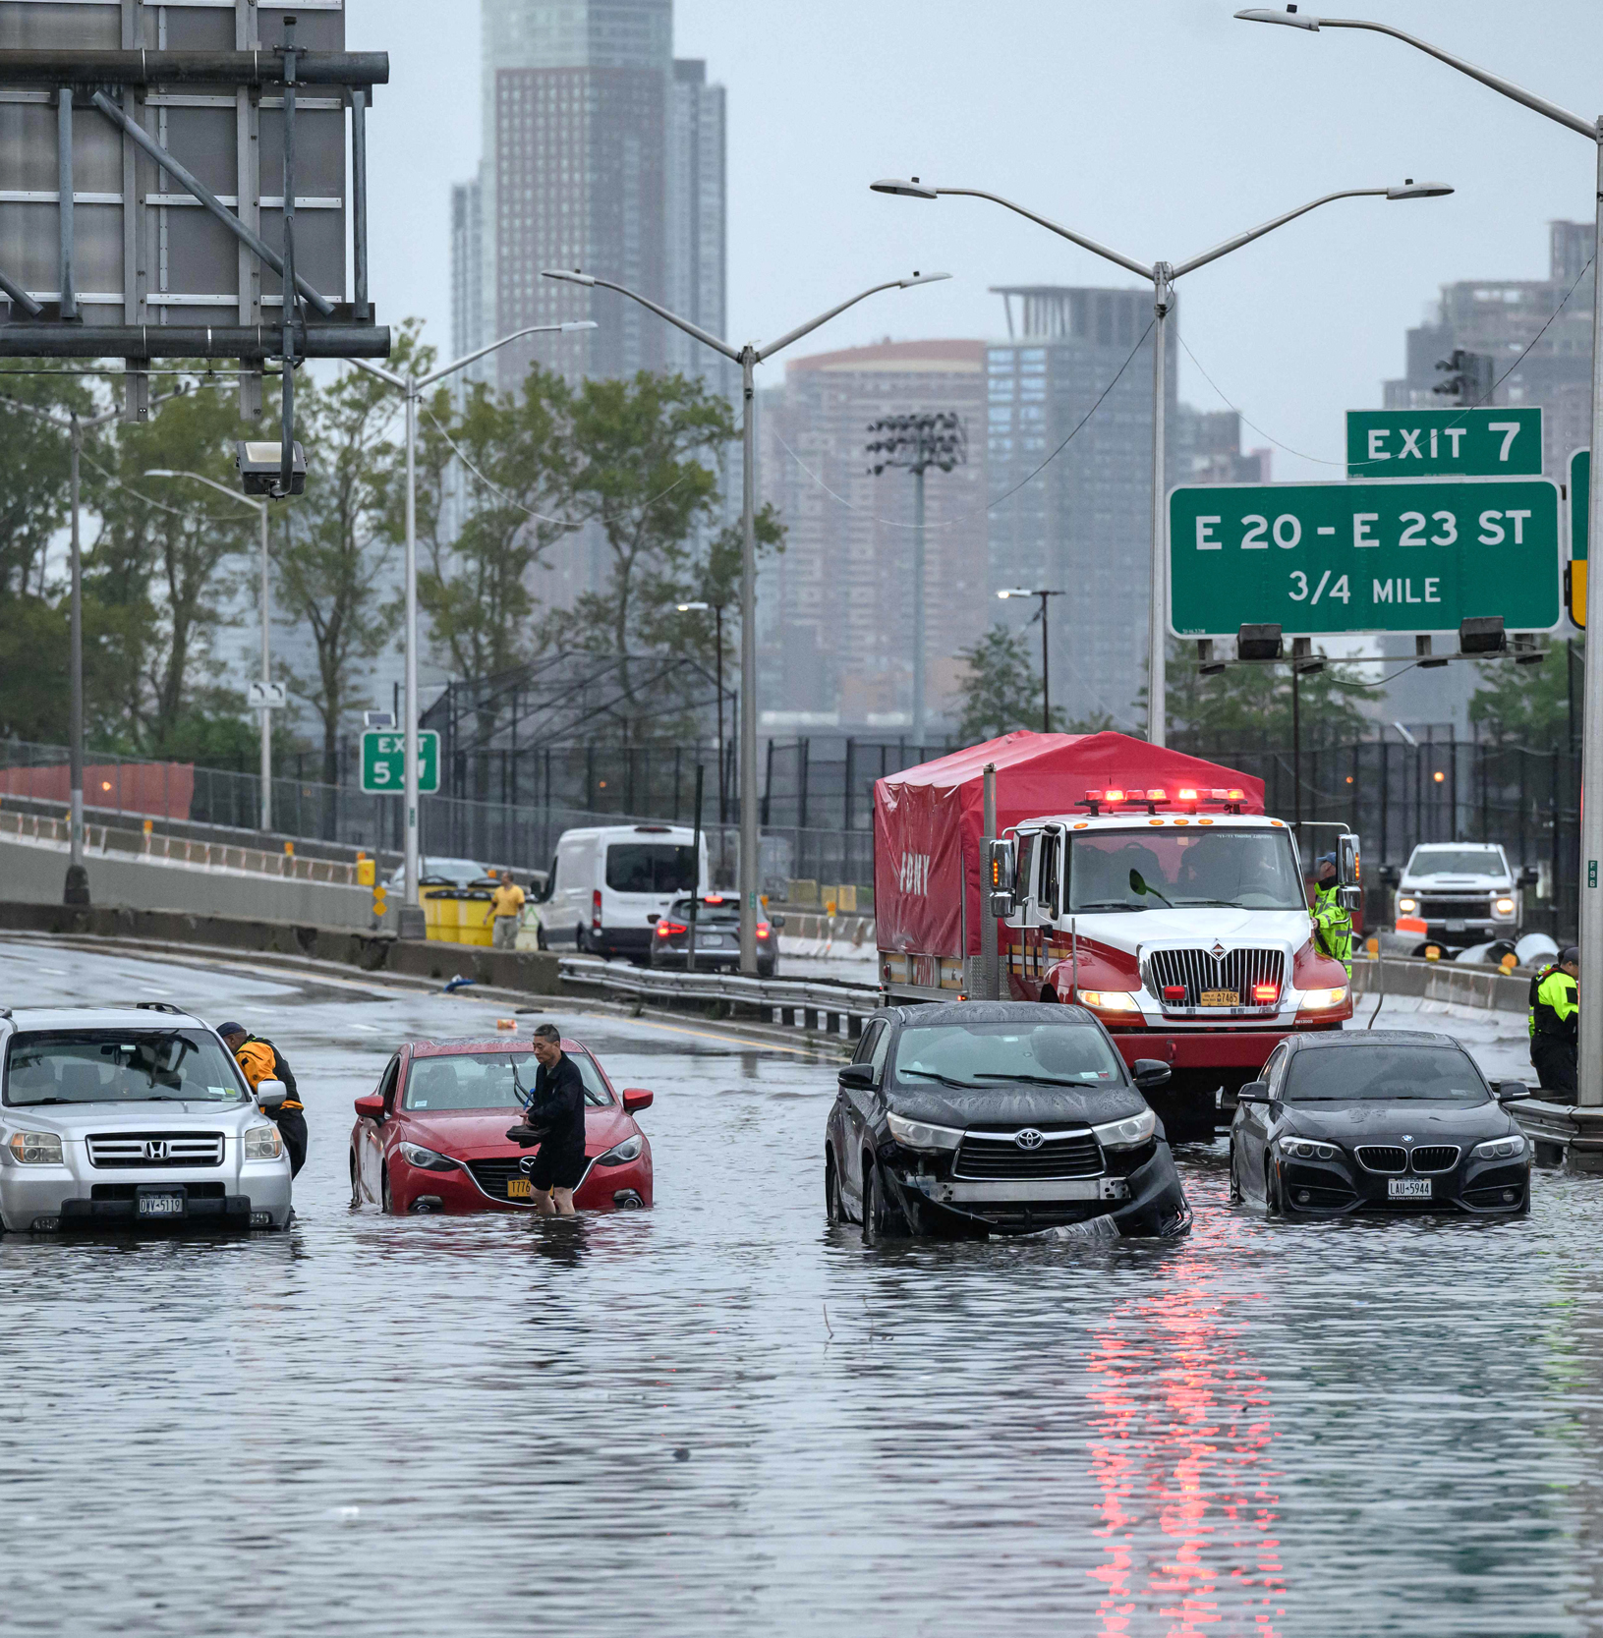
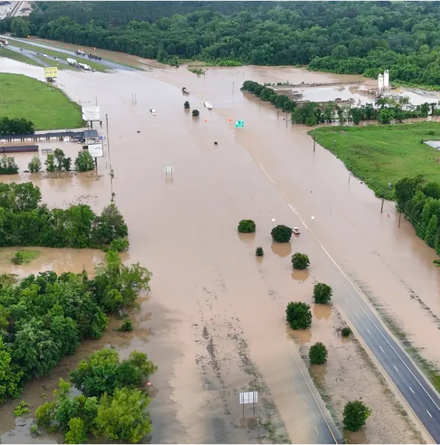
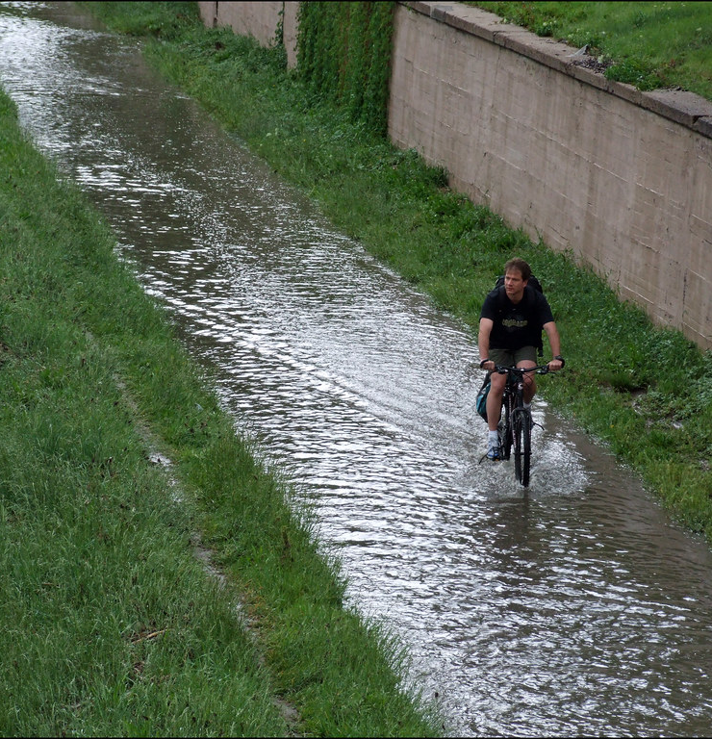
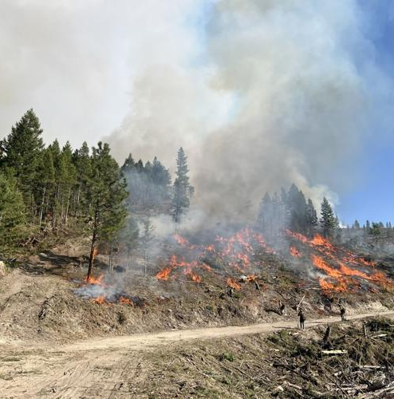
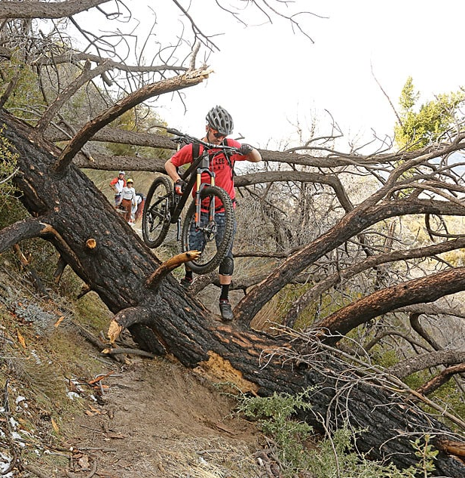
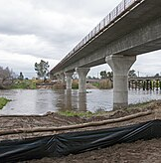
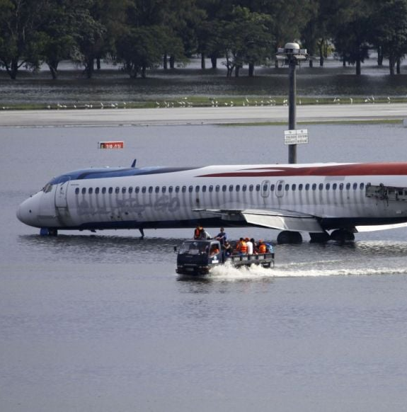
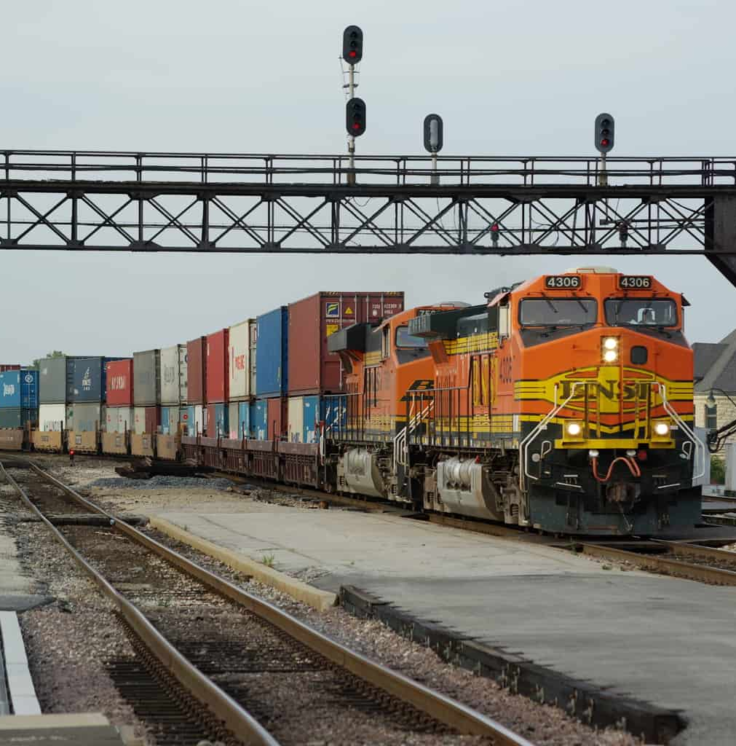
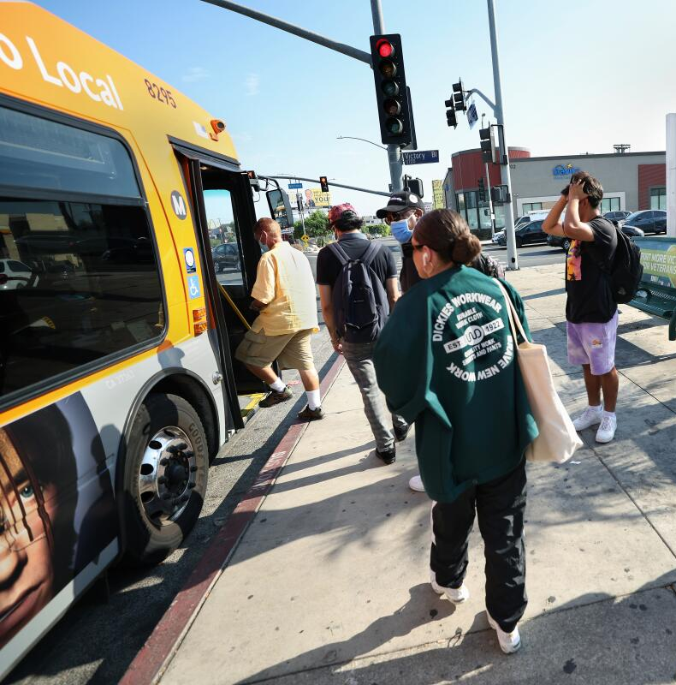
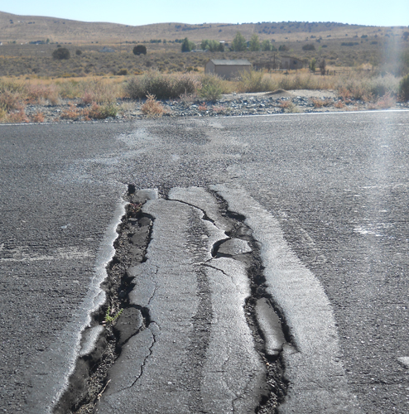
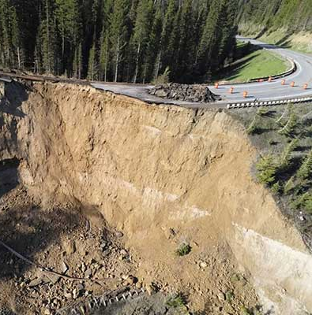
Project Typologies
By Hazard
D
E
F
Flood
Wildfire
A
B
Flood-prone urban Corridors
Wildfire-vulnerable mountain passes & bridges
G
Rural roads
susceptible to flooding
Shared use paths susceptible to flooding
Shared use paths susceptible to wildfire
Heat
Landslides
J
L
H
Bridge Infrastructure over major waterways
Airport runways and critical access roads susceptible to flooding
Mainline rail lines susceptible to flooding
Extreme heat impact on pedestrians, bicyclists & transit riders
Heat-vulnerable pavement of roads
Landslide and slope failure of roads & bridges
Notes:
Using the information we just presented, we created project typologies, to capture the different types of projects that could be developed across the county to address climate risks.
For flooding, we have differentiated between urban corridors and rural roads as they would have different solutions
We also looked at airports vs rail for flooding
For wildfire: we looked at mountain passes vs shared use paths
Heat: how do we address heat for pedestrians, cyclists and transit riders vs addressing impact of heat to roads
We also looked at landslide and its impact to roads

Slide 24
Scoring and Prioritization
Methodology
Notes:
[definitions of scores]
Fresno county is a large area and we’re talking about miles and miles of road, rail, transit routes etc. so we needed a way to prioritize our efforts and where to focus.
We used the approach shown here. On the left hand side, we have the risk score that I explained earlier,
In the middle we have the roadway network score – factored in if the road was part of a transit or bike route, the vehicle volumes, whether it was an important connector for rural communities and whether it was in an equity priority community.
These two elements combined to create a priority score, which we then sorted into high, moderate and lower level priorities.

Slide 25
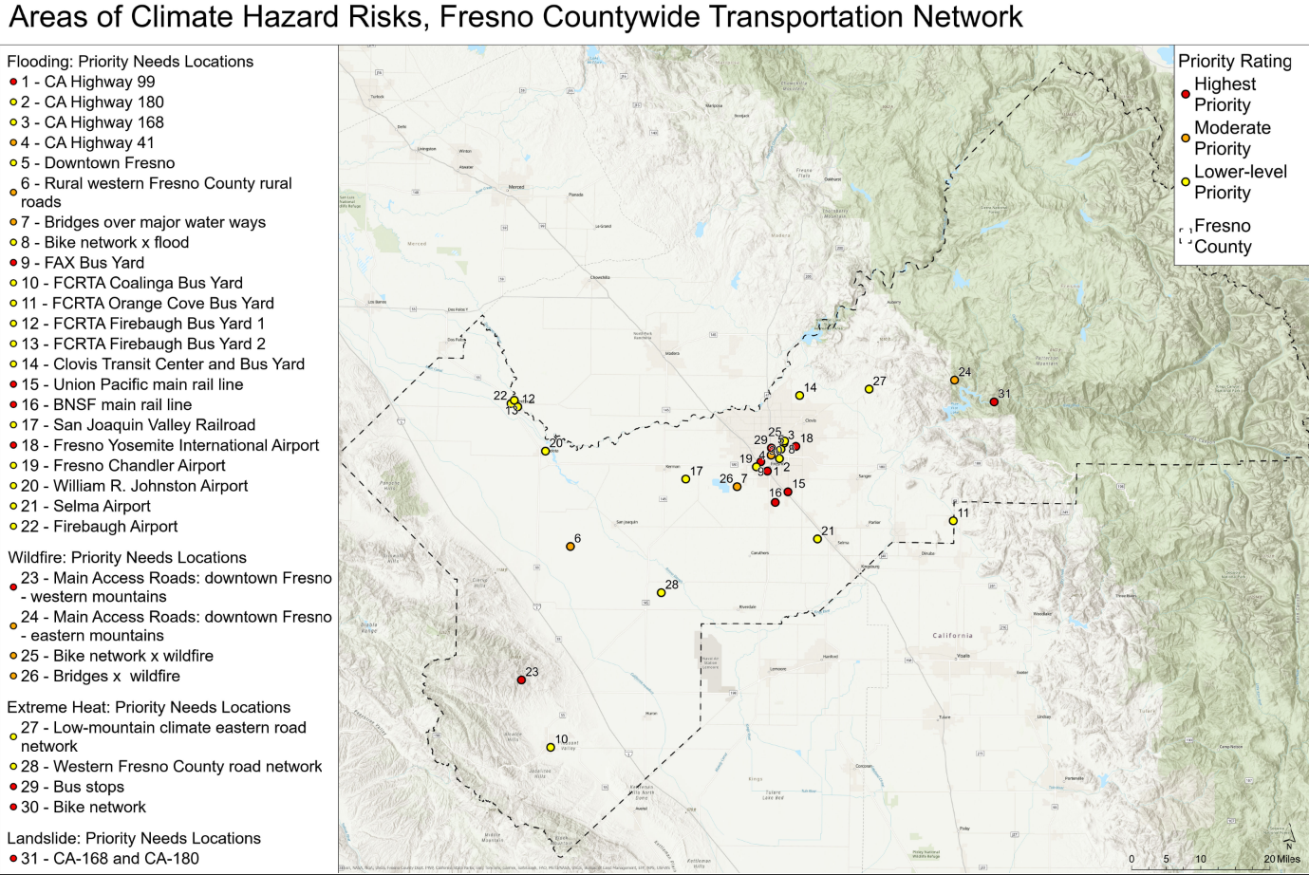
Project Opportunities
31 Priority Needs Locations
Notes:
Using that approach, we developed this list of 31 project opportunities – specific locations where a hazard, like flood or wildfire, impact an asset like a road or a bus yard.
22 projects that address flooding
4 that address wildfire
4 that address extreme heat
1 for landslide
The priority ratings were based on the scores I explained but also adjusted to account for feedback received from the different activities.
Might be hard to see here but this is in the plan.

Slide 26
Priority Projects
Descriptions
1
Mitigate flooding along SR-99
2
Mitigate wildfire impact to Fresno County’s mountain road network
3
Mitigate extreme heat at urban transit stops
4
Mitigate extreme heat at FCRTA transit stops
5
Mitigate landslides along SR-168 and SR-180
Notes:
From the list of 31, we narrowed that down to the top 5 which you can see here.
1…
We took the projects with the top scores, and then reviewed them to ensure there was a spread across different hazards, across different parts of the county, and across the different types of transportation assets.
On the next slide you can see them on the map…
Description
Mitigate flooding along CA-99 through stormwater infrastructure improvements and effective flood management to reduce the impacts of stormwater runoff.
Mitigate the impact of countywide wildfires on the county’s mountain road network through partnering with other agencies to clear ground fuels from forested areas along the high wildfire risk road network, supporting innovative financing approaches for healthy forest management, and enhancing evacuation planning.
Identify urban bus stops served by FAX, Clovis Transit, and FCRTA throughout Fresno and Clovis that need bus shelters, better shading, and tree canopies to provide critical health benefits to those who are transit dependent.
Identify rural bus stops served by FCRTA transit stops that need bus shelters, better shading, and tree canopies to provide critical health benefits to those who are transit dependent.
Mitigate landslide risk along 112 road miles of CA-168 and CA-180 through interventions like landslide retention measures, erosion stabilization, and road realignment if needed. CA-168 is specifically a priority as it serves as a vital FCRTA transit route serving Auberry and other isolated mountain communities.​

Slide 27
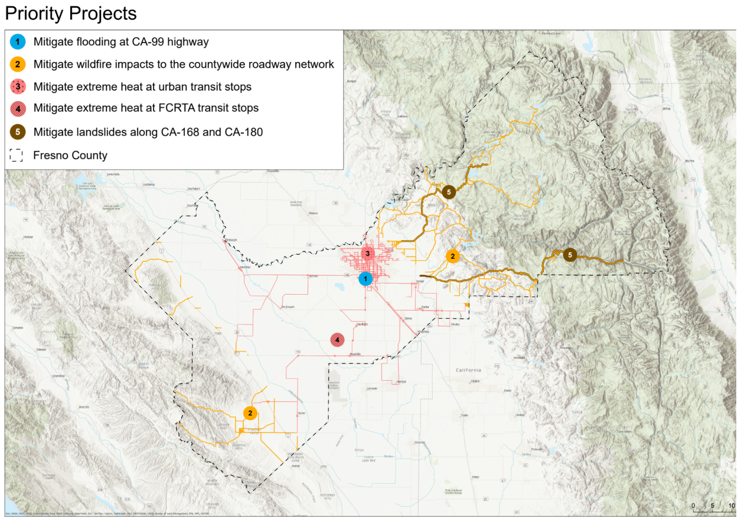
Notes:
2 projects focused on the urban areas, 1 flooding and 1 extreme heat at transit stops
3 projects focused on more rural areas:
Extreme heat at FCRTA transit stops
Wildfire eastern and western mountainous areas
Landslide in the eastern part of the county
I’ll hand to Maggie to talk to these in more detail

Slide 28
Priority Projects
Notes:
Maggie

Slide 29
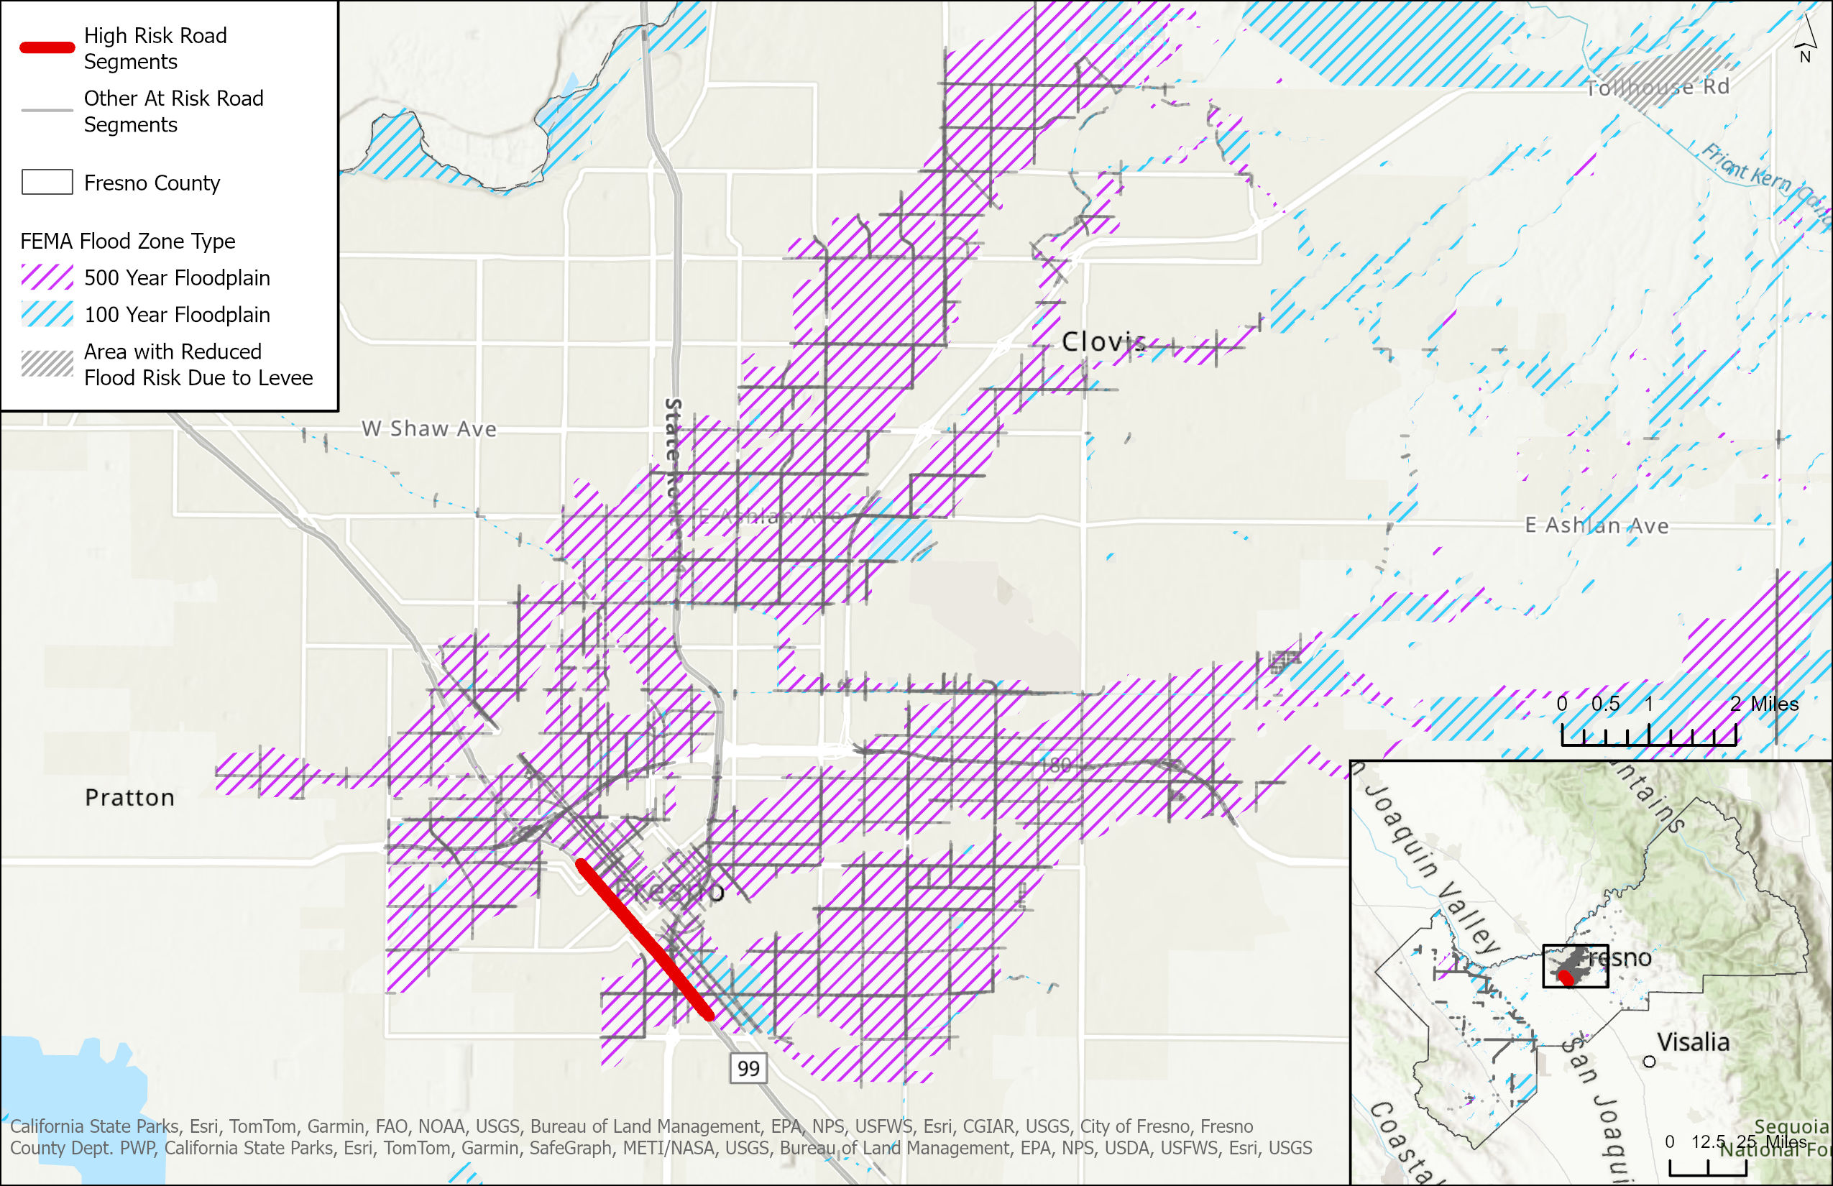
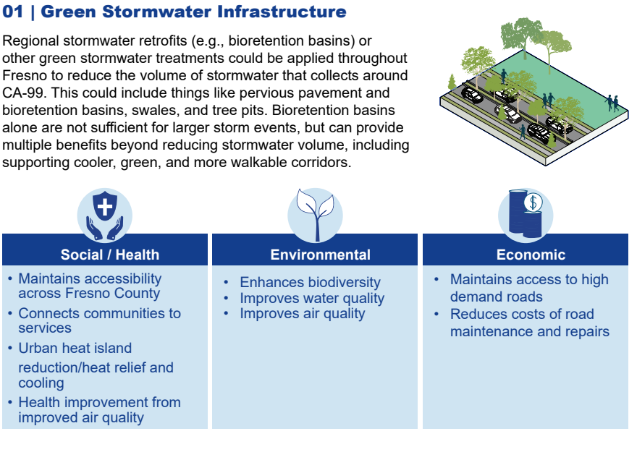
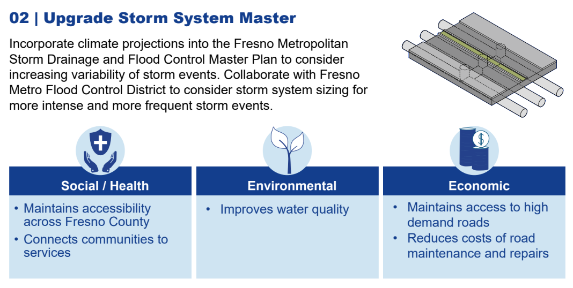
Priority Project 1
Mitigate Flooding at SR-99 Highway
Green Stormwater Infrastructure
Upgrade Storm System Master Plan
Notes:
Clarify what is the 100 year flood plain and why flooding can occur more frequently than once every 100 years

Slide 30
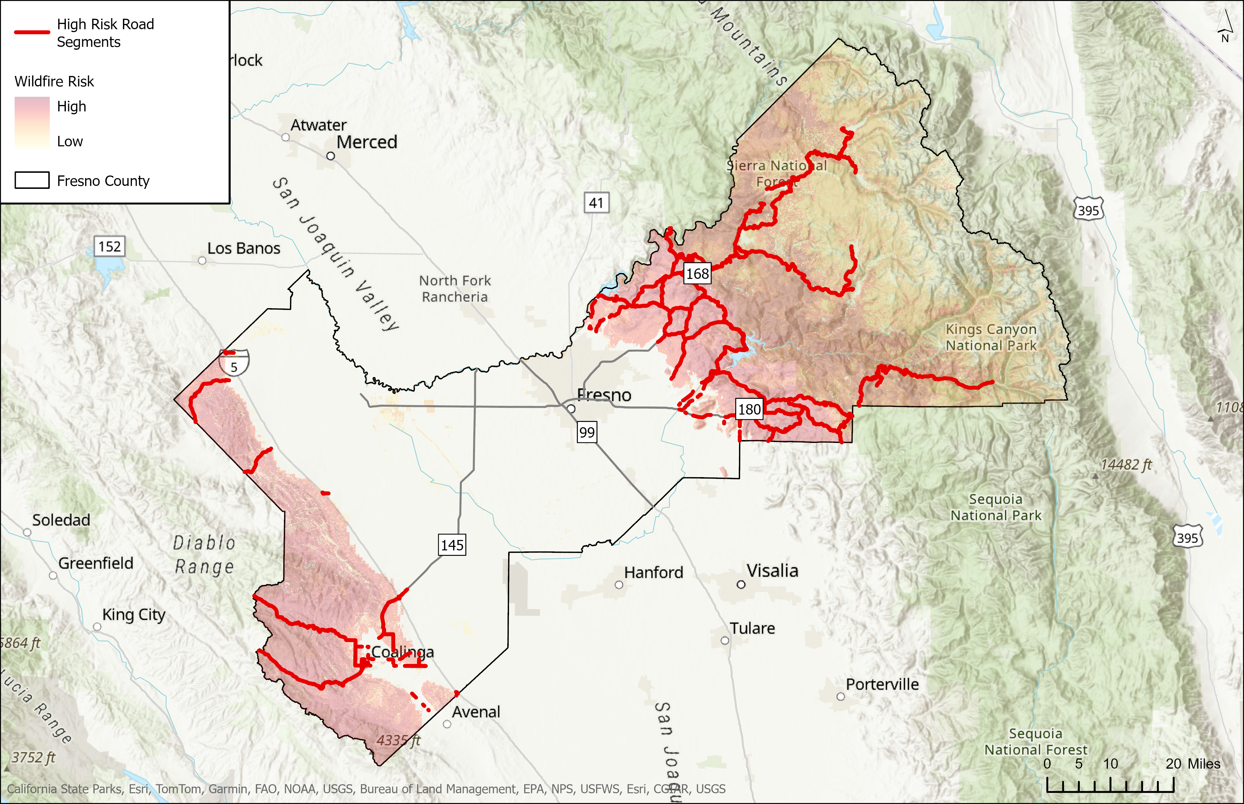
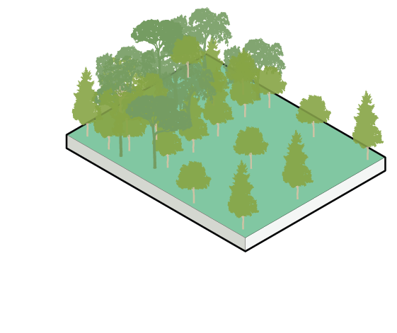
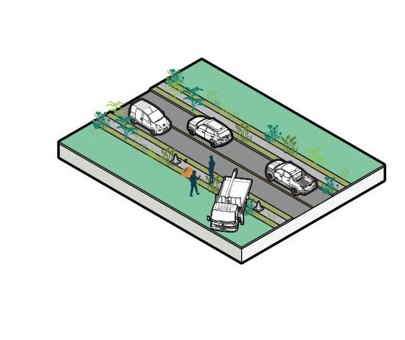
Priority Project 2
Mitigate Wildfire Impacts to the Countywide Road Network
Complement Projects to Clear Ground Fuels
Support Unfunded Priority Areas & Seek Innovative Financing
Evacuation Planning

Slide 31
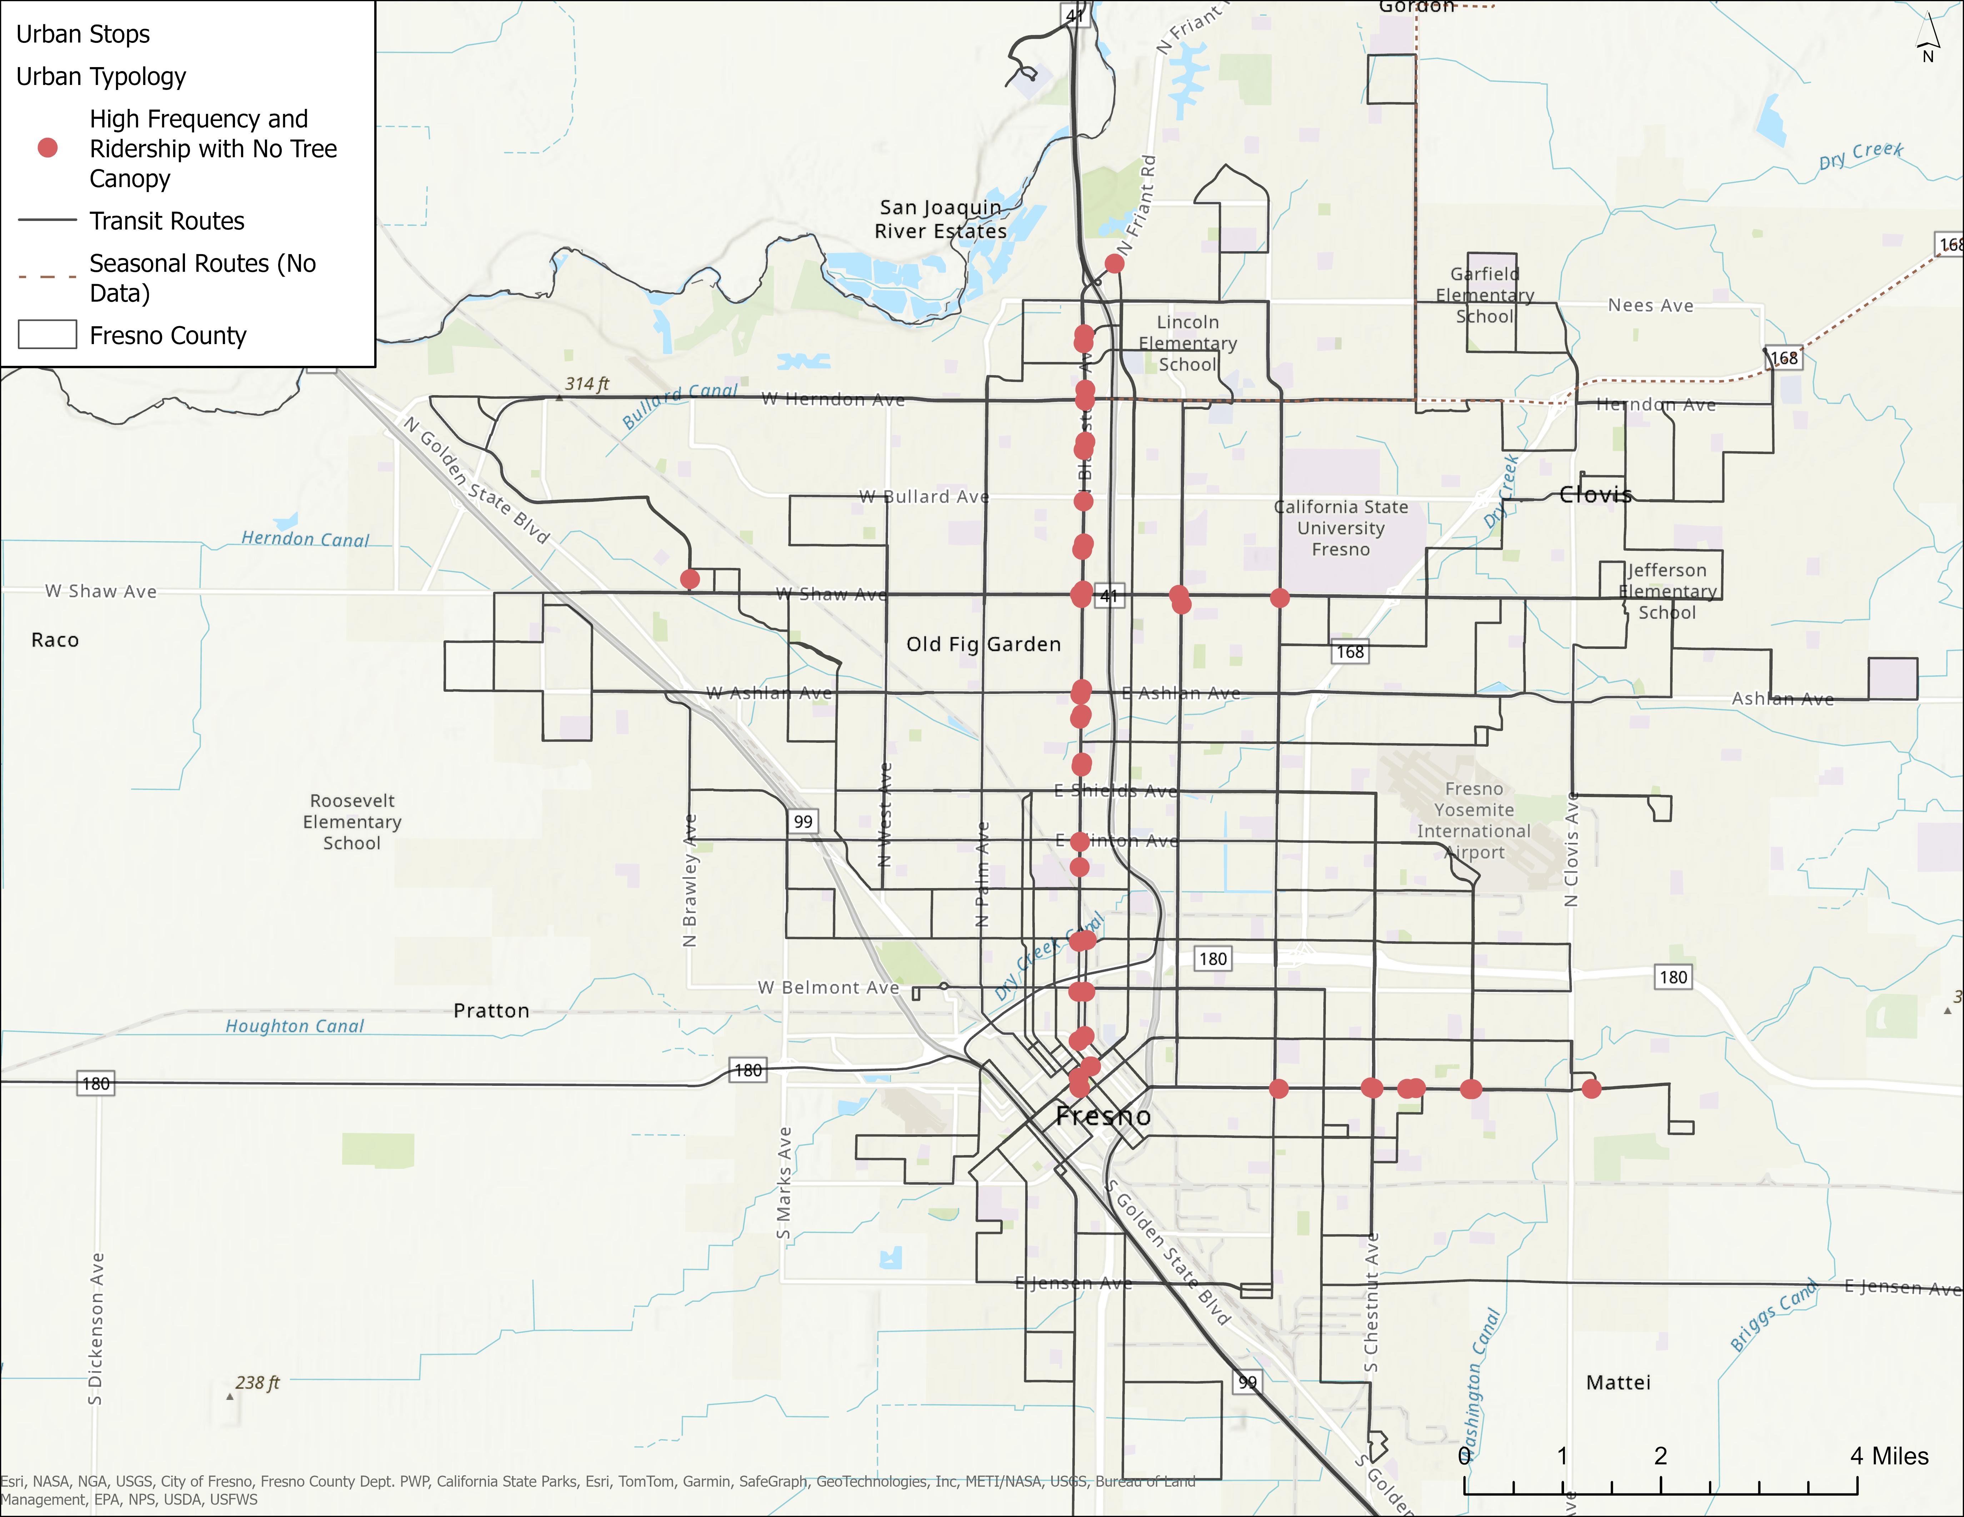
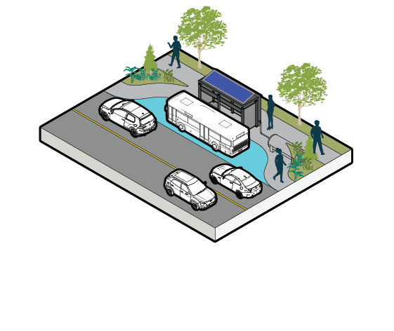
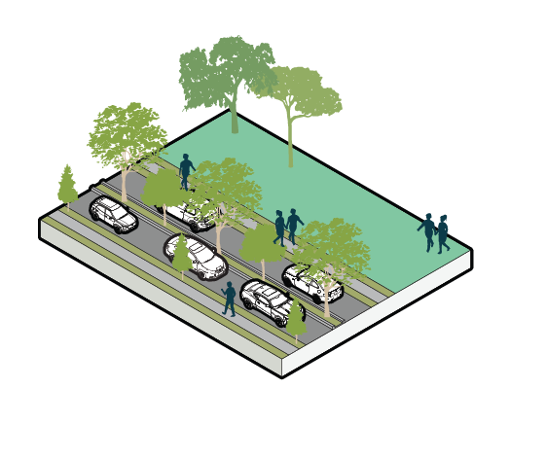
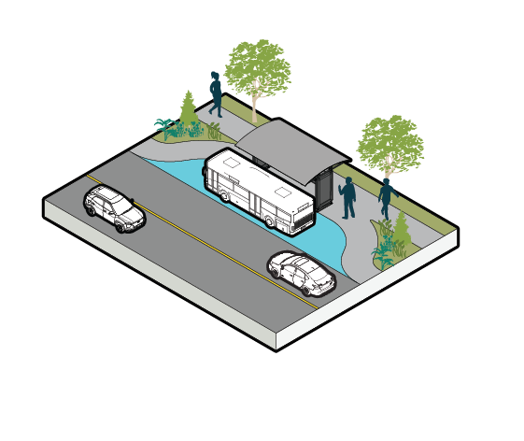
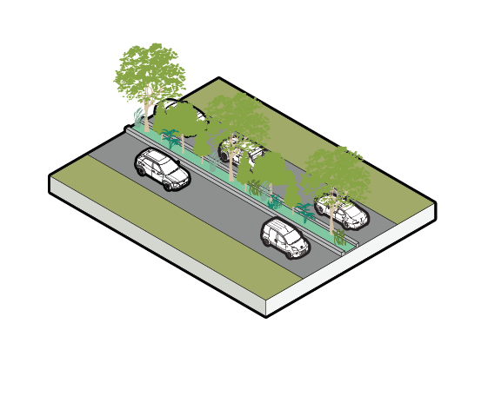
Priority Project 3
Mitigate Extreme Heat at Urban Transit Stops
Radiant cooling / air-conditioned bus shelters
Tree canopies / Water Sensitive Urban Design
Shaded bus shelters / tree canopies
Median Vegetation Strip /
Green Corridors
High Frequency/Ridership Stops with No Tree Canopy
Notes:
High Priority Recommendations
Develop a comprehensive inventory of bus shelters to identify candidate locations for future investment.
Install bus shelters where absent around high frequency/ridership stops.
Develop a shade tree and landscaping planting plan for:
Blackstone Avenue
Eastern end of the Cesar Chavez/ Kings Canyon Road
Prioritize radiant cooling/air-conditioning at major transit hubs such as:
Downtown Transit Center
Manchester Transit Center
Major stops that serve Cal State Fresno
Future High Speed Rail Station

Slide 32
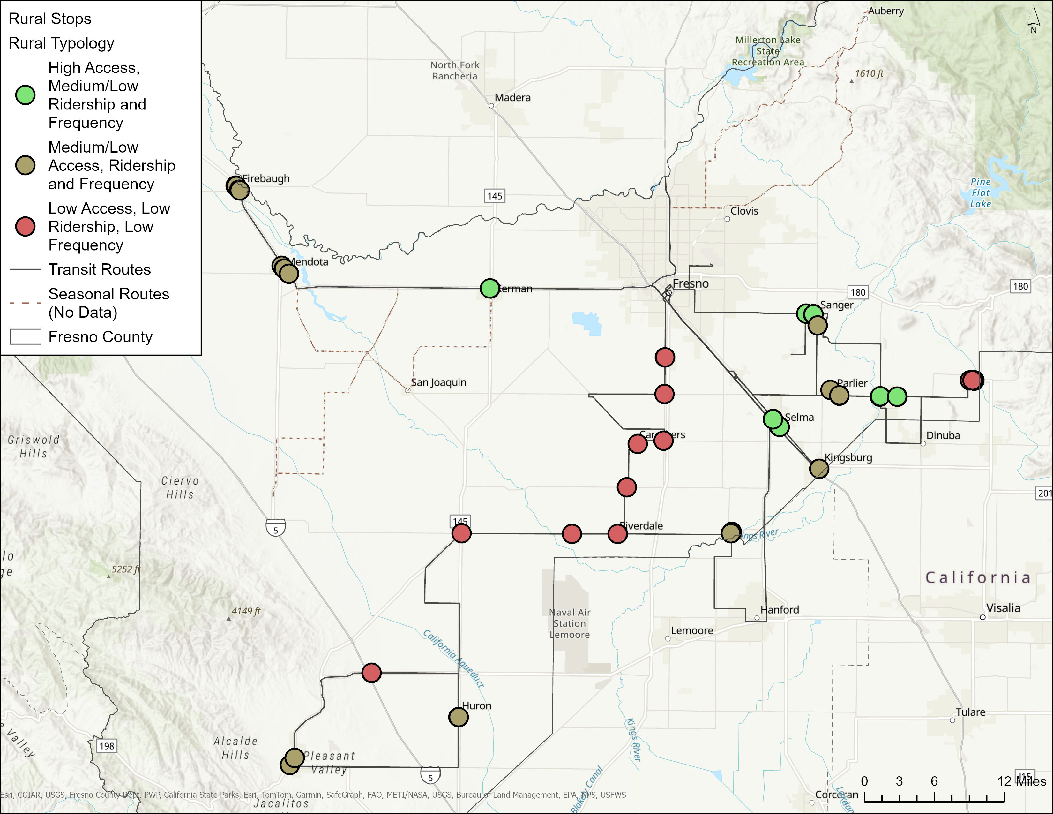
Priority Project 4
Mitigate Extreme Heat at FCRTA Transit Stops
Tree canopies / Water Sensitive Urban Design
Shaded bus shelters / tree canopies
Median Vegetation Strip /
Green Corridors
Notes:
High Priority Locations
Sanger: Jensen Ave at S. Bethel Ave
Sanger: 7th Street and De Witt Ave
Selma: Whitson Street
Kerman
Reedley
Medium Priority Locations
- Stops in Firebaugh, Mendota, Parlier, Kingsburg, and Laton
Opportunistic/ Longer Term Locations
- Stops along Coalinga Intercity Transit

Slide 33
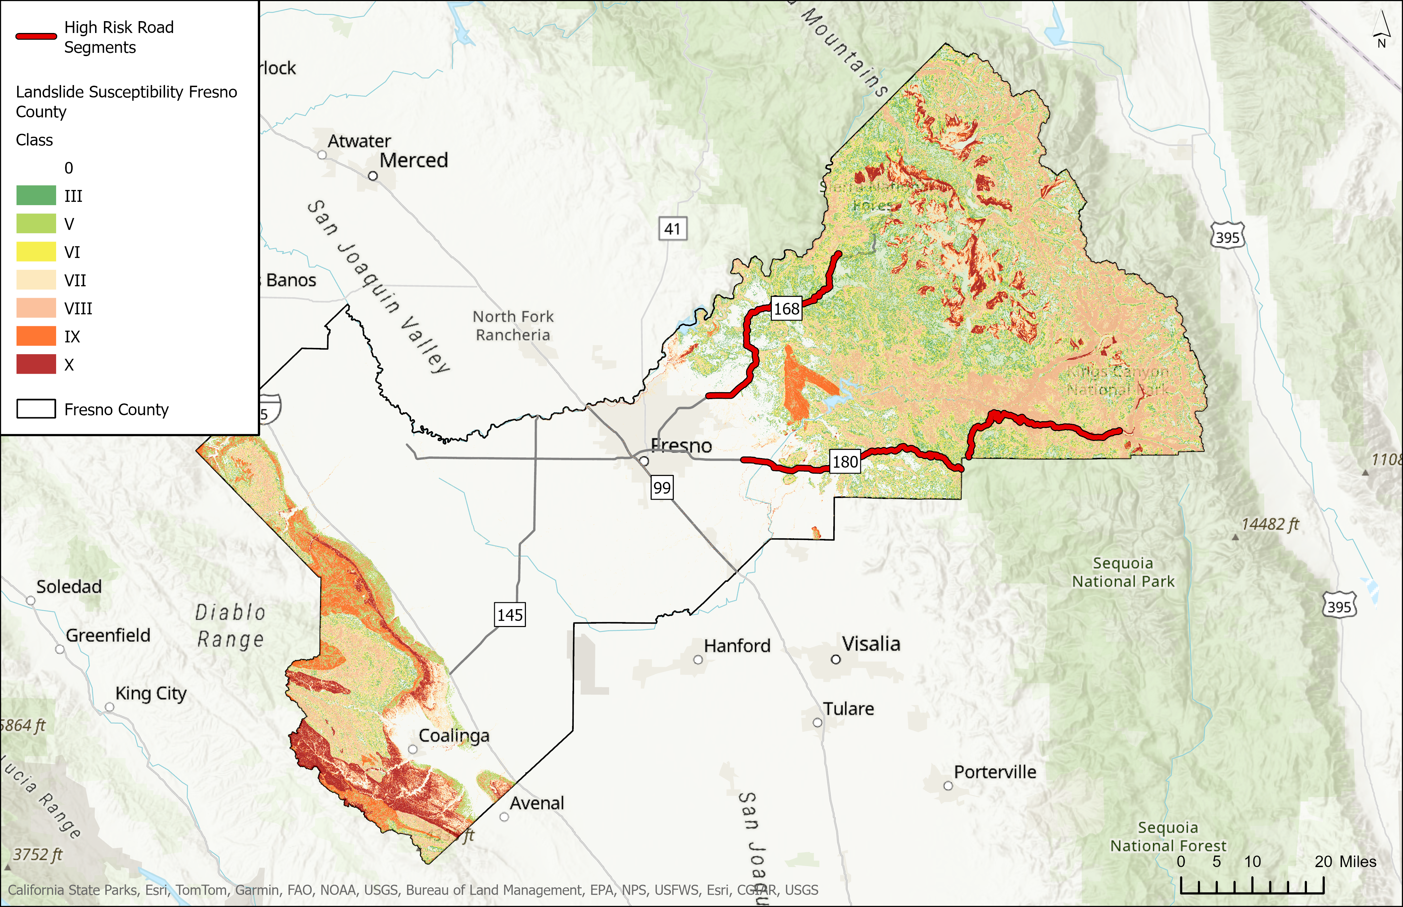
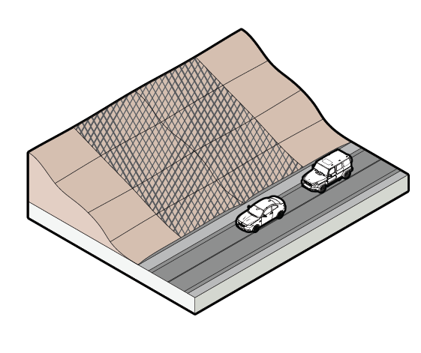
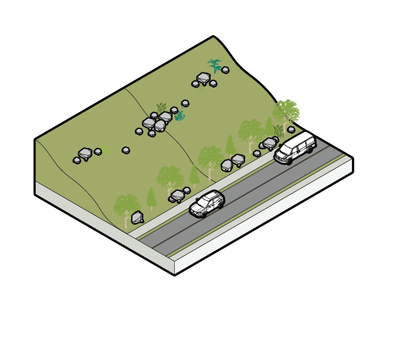
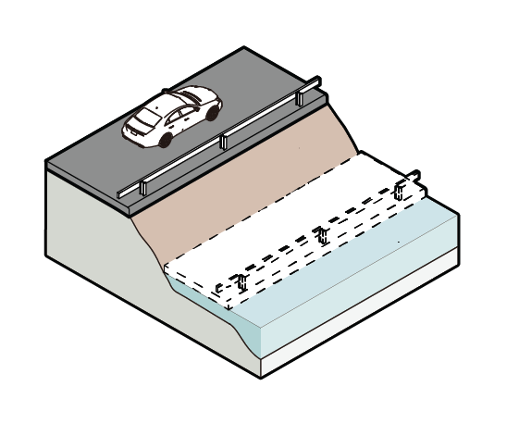
Priority Project 5
Mitigate Landslides Along SR-168 and SR-180
Landslide Retention
Erosion Stabilization
Realignment

Slide 34
Climate Resiliency Plan: Final Report
Approach
Notes:
Brooke

Slide 35
This Plan includes:
Why a Climate Resiliency Plan?
Climate Projections in Fresno County
Risk Assessment Findings
Project Opportunities
Priority Projects
Next Steps
Notes:
Why a Climate Resiliency Plan?: The background and context for the Plan
Climate Projections in Fresno County: An overview of how climate is projected to change in the county
Risk Assessment Findings: a summary of the most at risk transportations assets
Project Opportunities: a long list of 31 transportation project opportunities to improve resilience across Fresno County
Priority Projects: a short-list of five priority projects, including a detailed assessment of the risk and potential solutions for each, and planning-level costs
Next steps

Slide 36
Review Period
Community-based organizations and TWG member agencies are invited to review between April 22 – May 2
Report document is attached to the calendar invite
Send comments to:
Karen.Barns@arup.com and mshimizu@fresnocog.org

Slide 37
What’s Next?
May 5 – May 30
Board Adoption
Publication
Publish to Fresno COG website in July
Review period
Final Plan & Board Adoption June 26
Plan Revisions
April 22 – May 2

Slide 38
Questions
Notes:
Brooke to facilitate
Does this resonate?
Does anything surprise you?
Is there anything missing?

Slide 39
Thank you for your time and input today!

Slide 40

Risk
Key Findings
Flooding has the greatest impact on the county’s transportation assets. The Cities of Fresno and Clovis, and western Fresno County face the highest risk.
Wildfire primarily impacts rural and mountainous communities, many of which are also isolated.
Extreme heat is already a major issue across the county and has the largest impact on people walking, bicycling, and taking transit, many of whom are low income.
The risk of all climate hazards is expected to increase in the county in the future.

Slide 41
Transportation Impacts
Key Findings
Roads and bridges: The impacts of flood and wildfire are similar but impact different regions; wildfire and landslides impact mountainous roads while flooding impacts the inland valley.
Transit network: Flooding primarily impacts urban transit service served by FAX (such as Routes 1, 28, and 38), while rural transit service (such as Coalinga Intercity Transit and Westside Transit Routes) is more susceptible to wildfire risk.
Bus yards: Flooding has the potential to impact about 25 percent of bus yards, with the highest risk at Firebaugh Bus Yard 1, Coalinga Bus Yard, and Orange Cove Bus Yard. Wildfire does not impact any bus yards that were evaluated in this study.
Rail network: Flood impacts are concentrated along the main lines through the City of Fresno and the branch lines in western Fresno County.
Airports: Flooding could impact five of the nine airports in the county included in the study. These include Fresno Yosemite International Fresno Chandler Executive, Selma, William R. Johnston, and Firebaugh Airport. Wildfire does not impact any airports that were considered in this study.

Slide 42
Priority Projects
Descriptions
Priority Project | Description
Mitigate flooding along CA-99 | Mitigate flooding along CA-99 through stormwater infrastructure improvements and effective flood management to reduce the impacts of stormwater runoff.
Mitigate wildfire impact to Fresno County’s mountain road network | Mitigate the impact of countywide wildfires on the county’s mountain road network through partnering with other agencies to clear ground fuels from forested areas along the high wildfire risk road network, supporting innovative financing approaches for healthy forest management, and enhancing evacuation planning.
Mitigate extreme heat at urban transit stops | Identify urban bus stops served by FAX, Clovis Transit, and FCRTA throughout Fresno and Clovis that need bus shelters, better shading, and tree canopies to provide critical health benefits to those who are transit dependent.
Mitigate extreme heat at FCRTA transit stops | Identify rural bus stops served by FCRTA transit stops that need bus shelters, better shading, and tree canopies to provide critical health benefits to those who are transit dependent.
Mitigate landslides along CA-168 and CA-180 | Mitigate landslide risk along 112 road miles of CA-168 and CA-180 through interventions like landslide retention measures, erosion stabilization, and road realignment if needed. CA-168 is specifically a priority as it serves as a vital FCRTA transit route serving Auberry and other isolated mountain communities.​

Slide 43
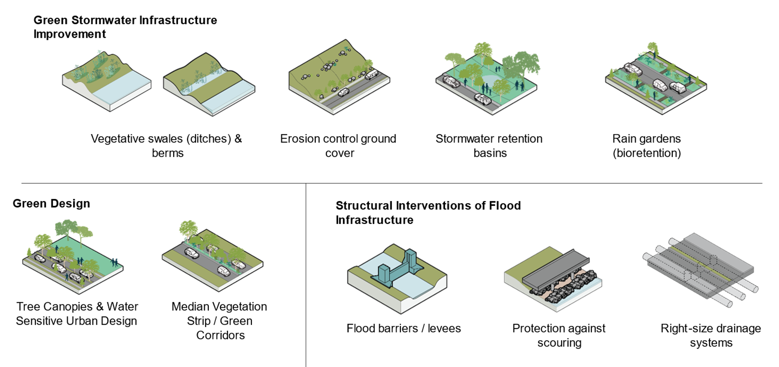
Solutions Toolkit
Flood

Slide 44
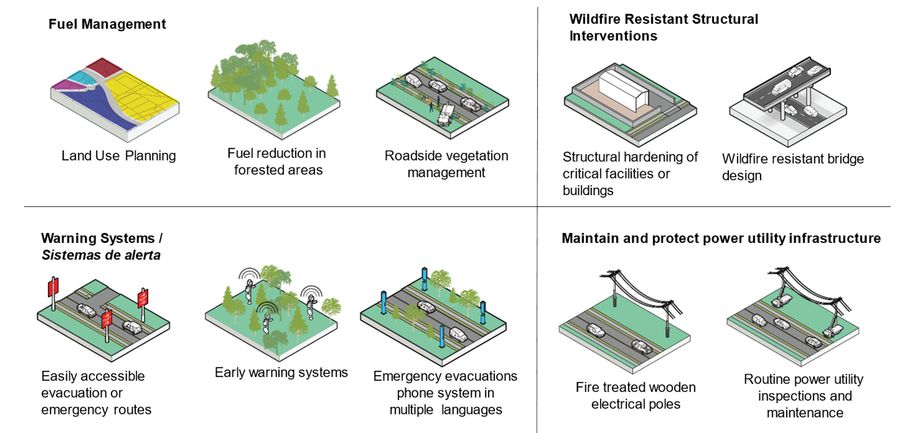
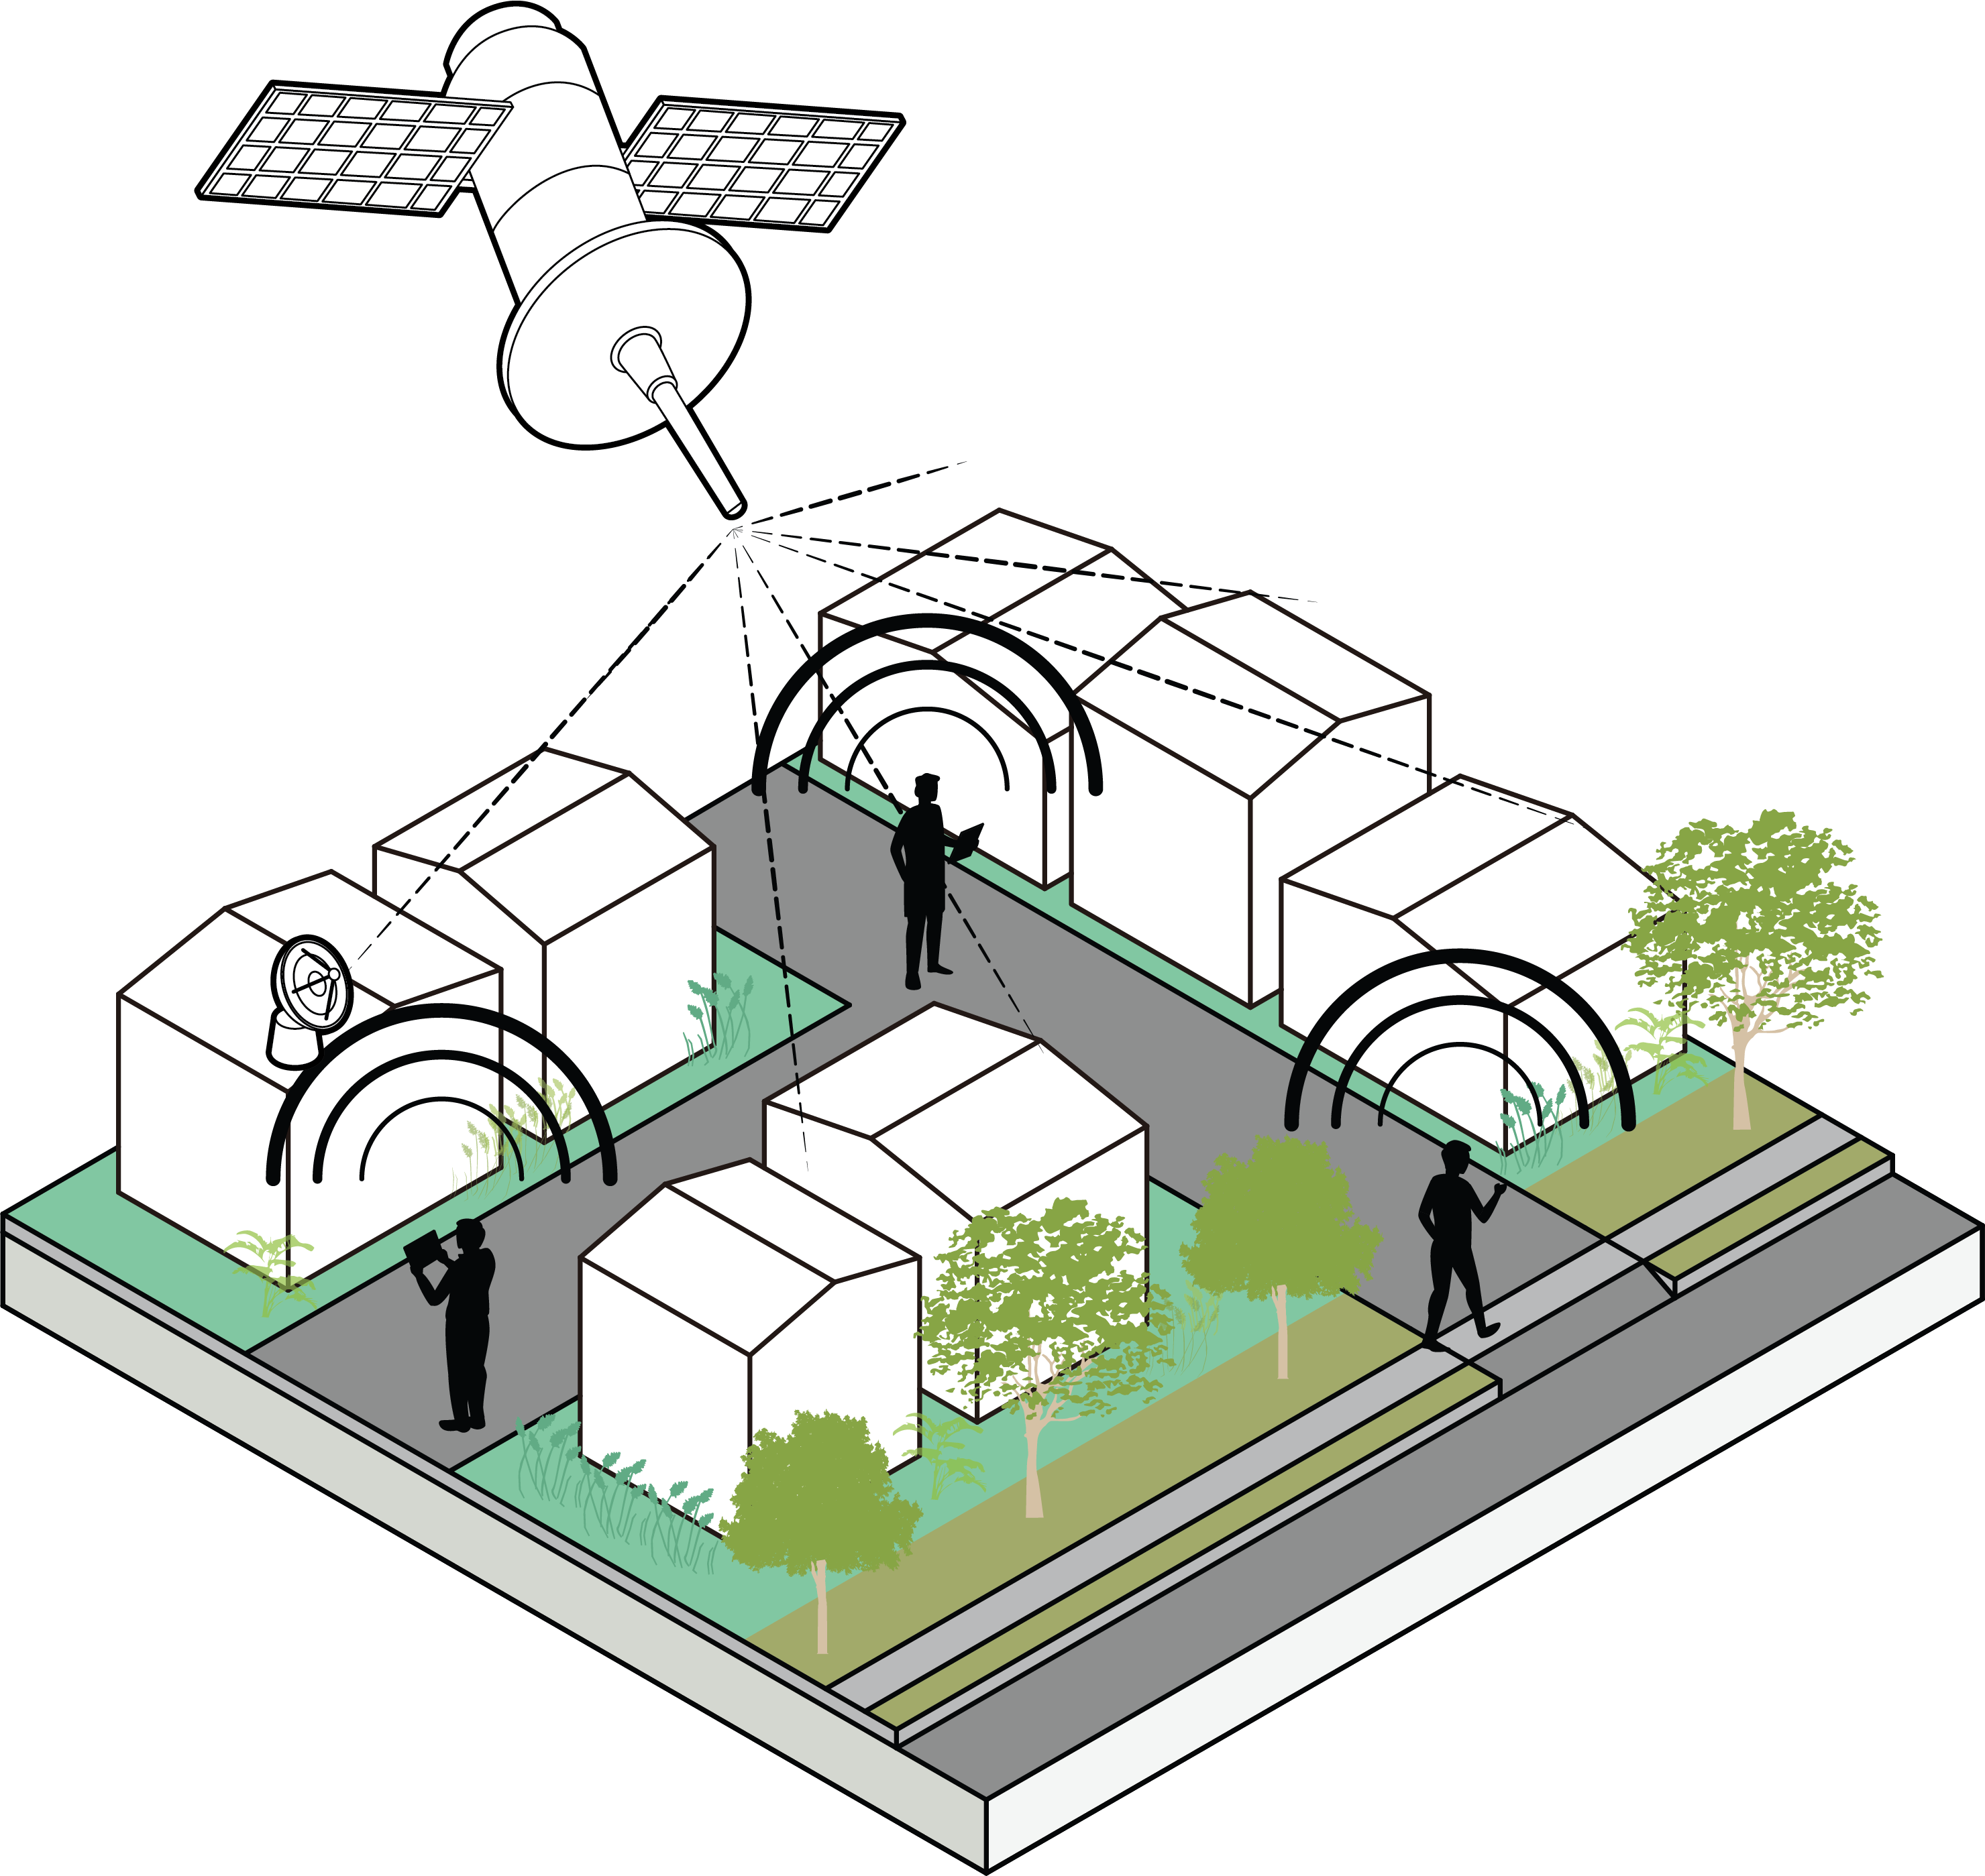
Solutions
Wildfire

Slide 45
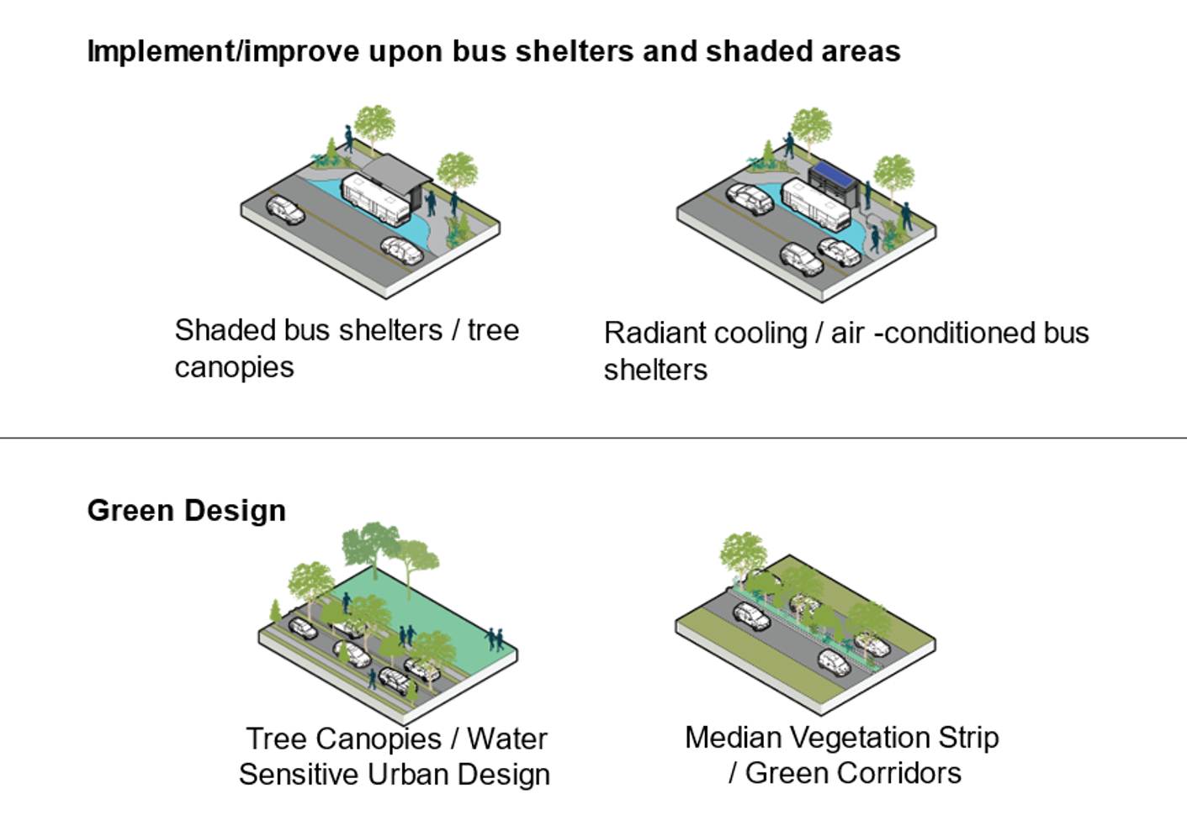
Solutions
Heat

Slide 46
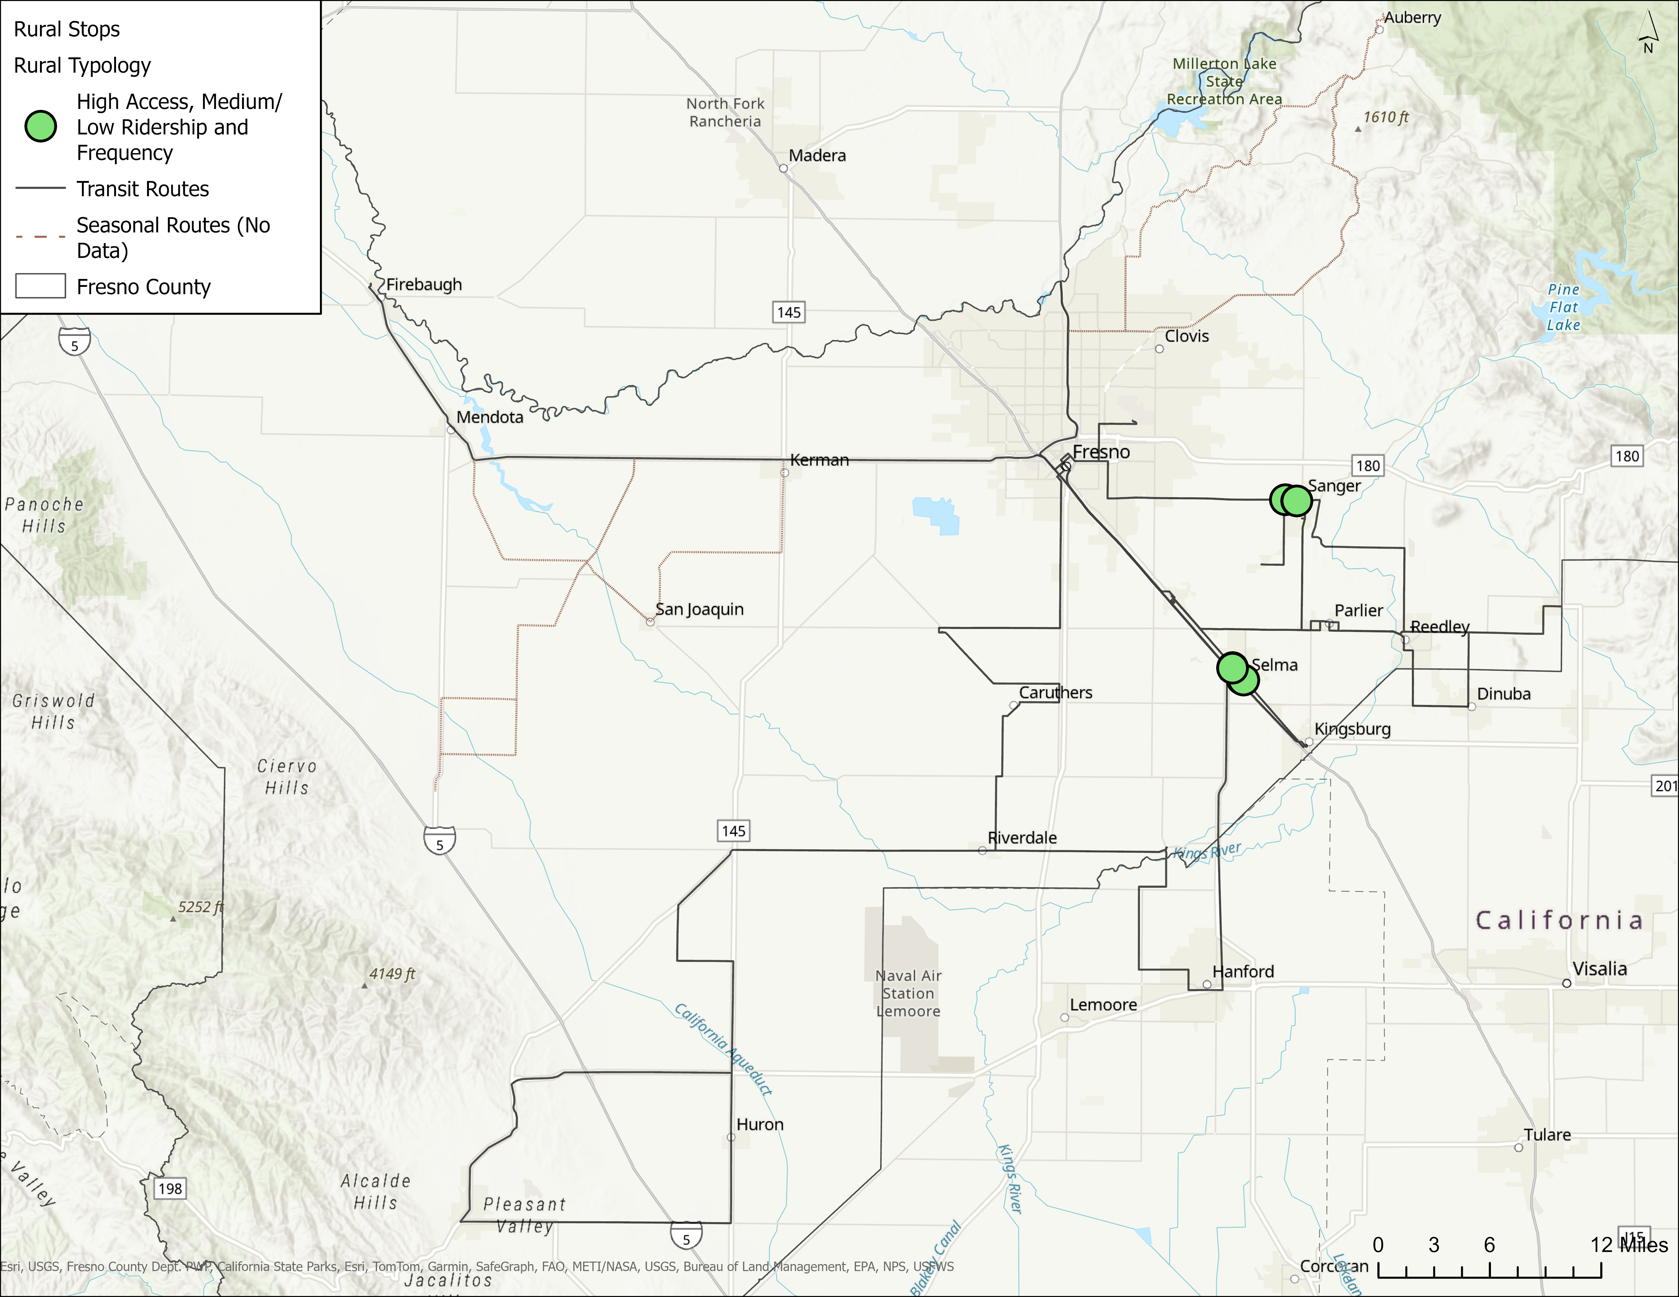
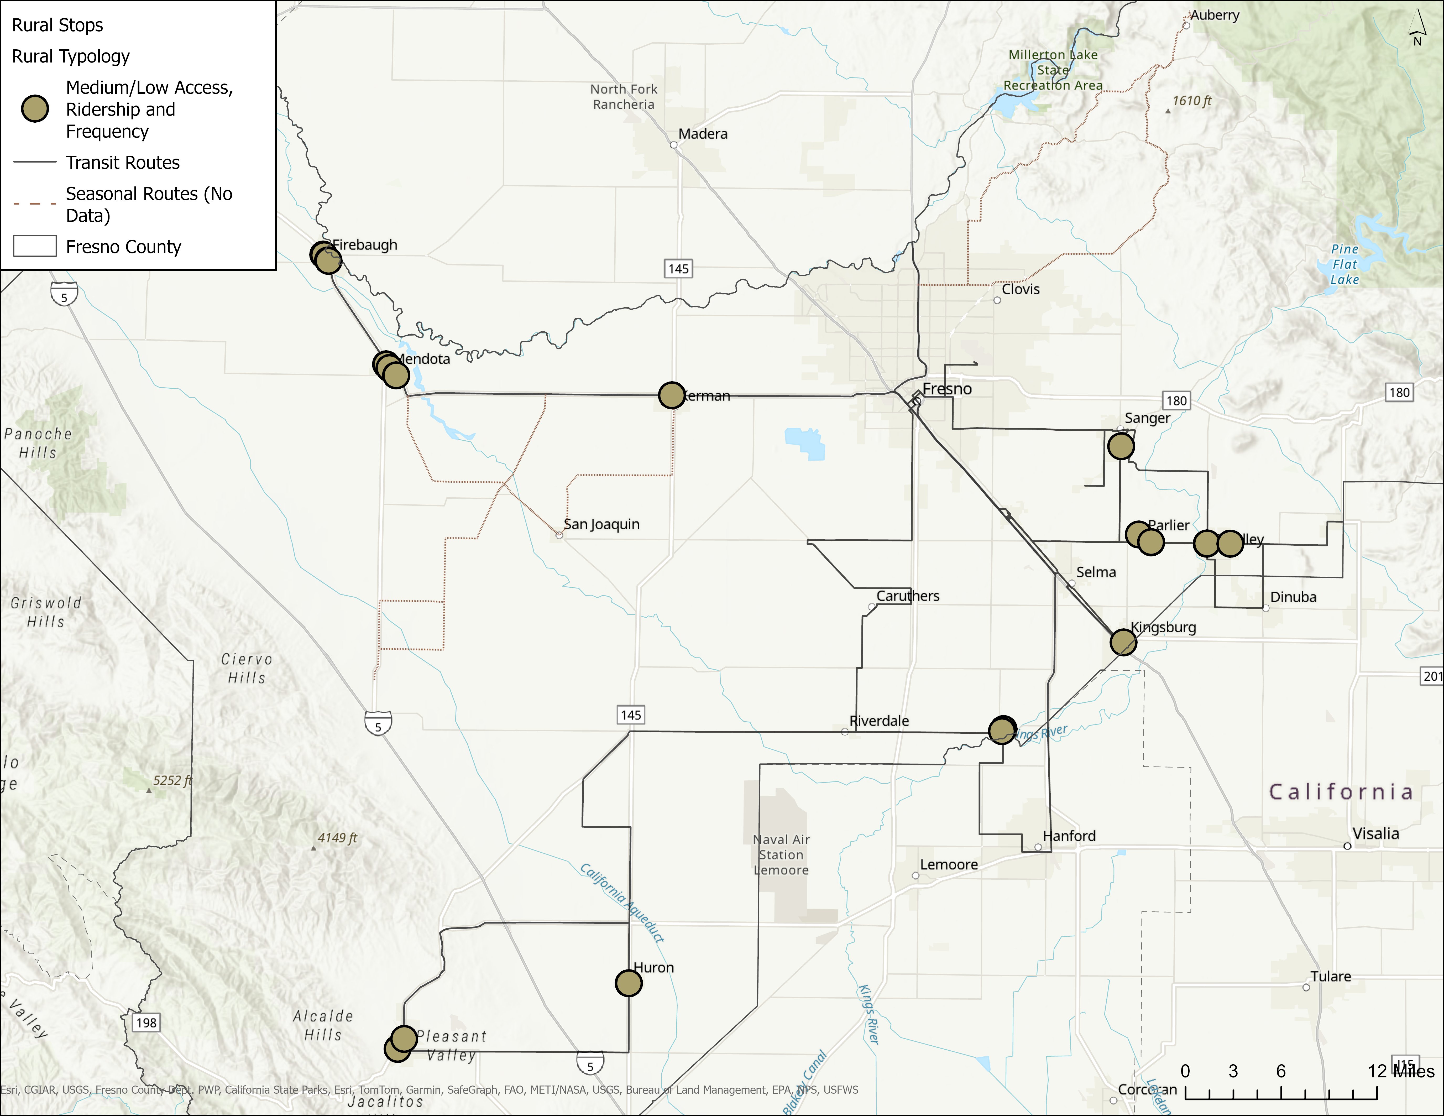
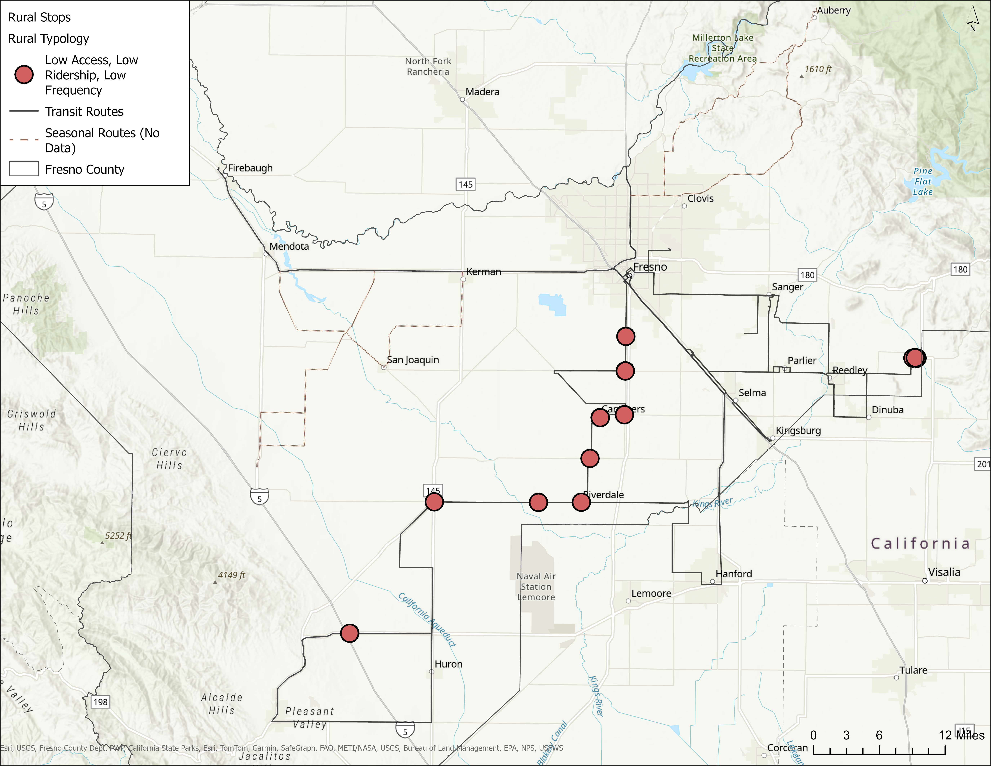
Recommended Treatment
Mitigate Extreme Heat at FCRTA Transit Stops
Routes with the Highest Frequency and Access to Critical Services
Routes with Moderate Frequency and Access to Critical Services
Routes with the Lowest Frequency and Access to Critical Services
Notes:
High Priority Locations
Sanger: Jensen Ave at S. Bethel Ave
Sanger: 7th Street and De Witt Ave
Selma: Whitson Street
Reedley
Kerman
Medium Priority Locations
- Stops in Firebaugh, Mendota, Kingsburg,
Parlier, and Laton
Opportunistic/ Longer Term Locations
- Stops along Coalinga Intercity Transit
Other next steps to support this recommendation include:
Develop a comprehensive inventory of bus shelters to identify candidate locations for future investment.
Install bus shelters where absent
Develop a shade tree and landscaping planting plan

Slide 47
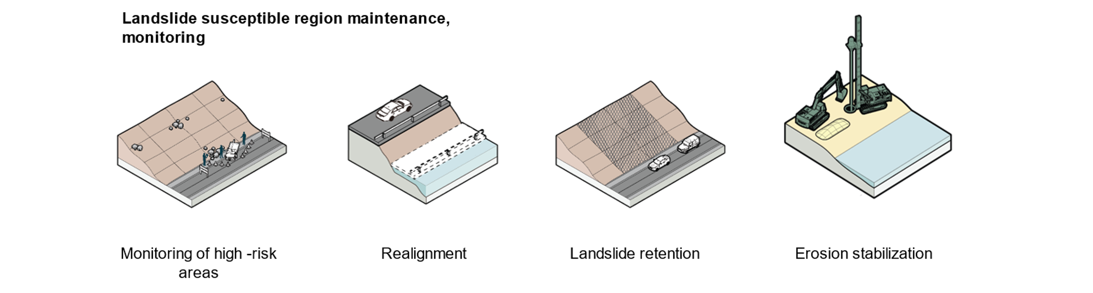
Solutions
Landslide

Slide 48
Identify Solutions
Criteria
Climate Adaptation and Resilience
Equity and Community Well-being
Infrastructure Criticality
Multi-Benefit Solutions
Strengthening transportation infrastructure to withstand changes
Focusing on projects that benefit underserved communities and improve access to services
Fixing weaknesses in key transportation assets for economic and emergency needs
Creating projects that enhance safety, cut costs, and support sustainability
ID high risk locations
Project typologies
Select solutions
Score & prioritize projects

Slide 49
Recommended Treatment
Mitigate Landslides Along CA-168 and CA-180
Treatment | Description | Application
Landslide retention | Rock bolts, rock meshes, and rock catch pits | Steep Slopes – Landslide susceptibility classes VI-X, such as those along Highway 180 in Kings Canyon
Erosion stabilization | Drainage improvements and vegetation | Moderate Slopes – Moderate slopes comprised of soil or weathered rock, such as those along the Highway 168 / Auberry Transit Line
Realignment | Realignment and/or abandonment of current road | Worst-case scenarios, where maintenance is continuously problematic

Slide 50
Recommended Treatment
Mitigate Flooding at CA-99 Highway

Slide 51
Project Opportunities
Methodology
Identify high risk and critical areas
Develop project typologies
Score and prioritize project needs locations
Identify solutions for project areas

Slide 52
Recommended Treatment
Mitigate Wildfire Impacts to the Countywide Road Network
Complement Projects to Clear Ground Fuels
Partner with CalFIRE, USFS, and SRCD to clear ground fuels from forested areas along the high wildfire risk road network and create fuel breaks, prioritizing those areas that have been impacted by beetles, including along Highway 168.
Support Unfunded Priority Areas & Seek Innovative Financing
Identify innovative financing approaches to healthy forest management and fuels reduction
Evacuation Planning
support efforts like those led by SRCD to improve alternative emergency routes, to mitigate risks along evacuation corridors, strengthen route redundancy, and routinely assess emergency management systems to ensure seamless communication between emergency responders, isolated communities, and road network managers

Slide 53
We want to hear from you
Does this resonate?
Does anything surprise you?
Is there anything missing?

Slide 54
Climate Projections + Risk
Key Findings
Flooding: Flooding has the greatest impact on the county’s transportation assets, especially in cities of Fresno, Clovis and western Fresno County.
Extreme Heat: Extreme heat across the county is already a serious concern, it’s getting even hotter, and has the largest impact on people walking, bicycling, and taking transit, many of whom are low income.
Wildfires: Wildfire likelihood and severity is expected to increase with climate change, and predominantly impact rural and mountainous regions, many of which are also isolated.
Notes:
Flooding is an issue in multiple locations across the county, though certain areas are more prone to extreme flooding such as the cities of Fresno, Clovis and western Fresno County. In the future, extreme rainfall events are projected to become more frequent.
Similarly, temperatures are anticipated to increase, as well, causing more stress on the county’s road network, which may soften and buckle with the heat. The county’s heat index is projected to rise on average by 5°F to 11°F by 2050 and 2085, respectively.
Wildfires predominantly impact rural and mountainous regions in the county due to the availability of wildland fuel (trees, brush, etc.). Some projections show that the chance of a wildfire occurring in heavily forested areas of the county will triple by end of century.

