Slide 1
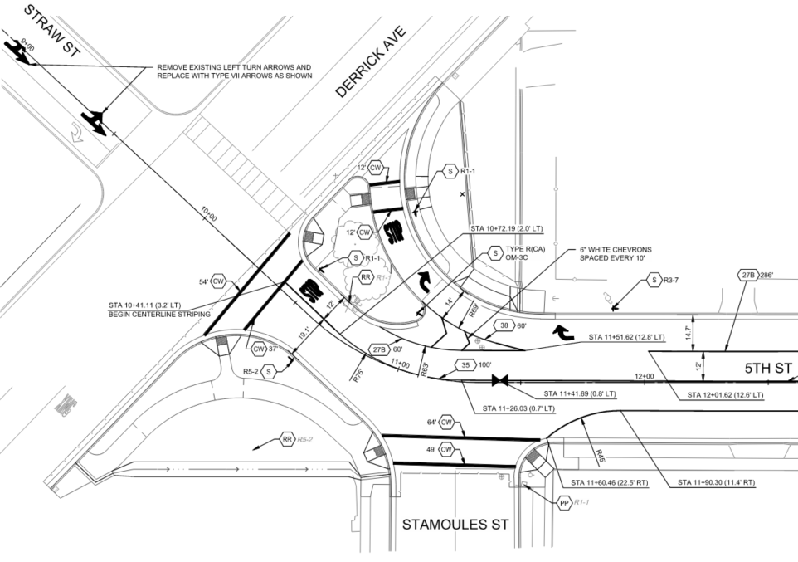









5th & Quince Street Reconstruction Federal Project No.: STPL-5285(027) FTIP: LSTMP604
San Joaquin Valley Project Level Conformity Group Presentation
February 25, 2026
Proposed Project

Slide 2
Project Overview
Project Description
Location and Other Background Information
Purpose and Need
Project Listing in the FTIP/CTIPS¹
Project Build Scenario Features
Traffic Data & Findings
Project Schedule
Project-level Conformity Summary
¹FTIP: Federal Transportation Improvement Program; CTIPS: California Transportation Improvement Program System.

Slide 3
Project Description
Overall Project:
Rehabilitate pavement on 5th Street from Quince St to Derrick Ave (SR 33) and Quince Street from 5th St to 6th St including upgrades to curb ramps and alley approaches.
Intersection Channelization:
The project includes horizontal modifications to the stop-controlled intersection of 5th Street at SR 33/Derrick Ave.
The project was not exempt under 40 CFR 93.126 or 93.128

Slide 4
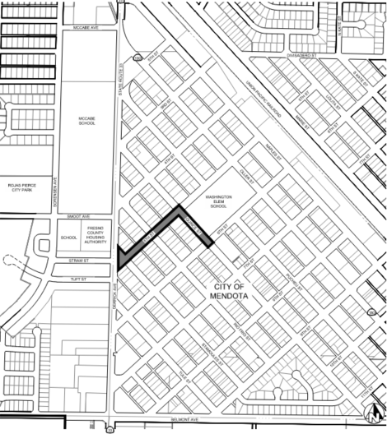
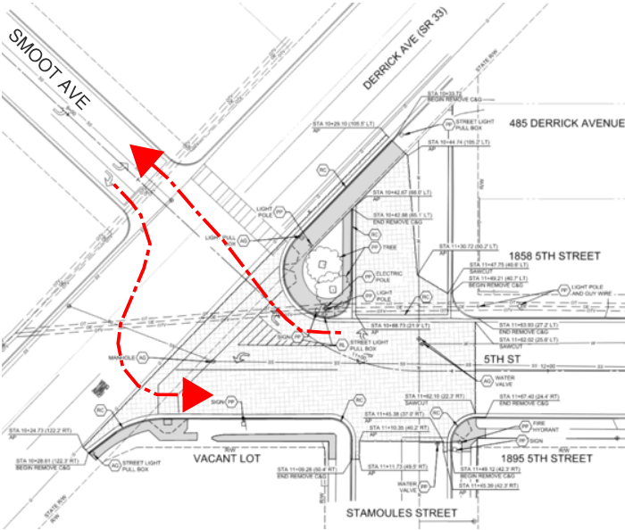
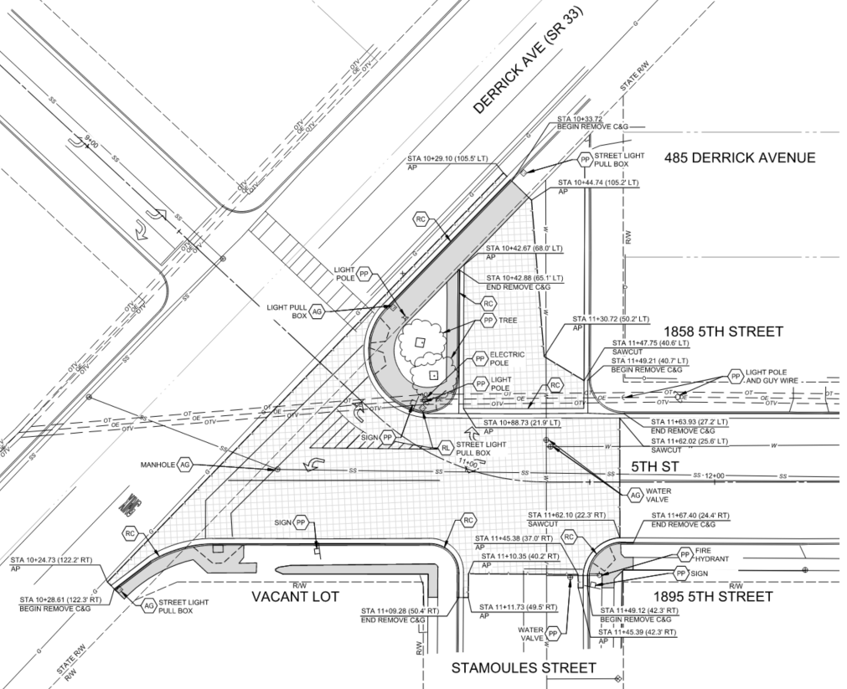
Project Location
Project Location
Existing Intersection

Slide 5
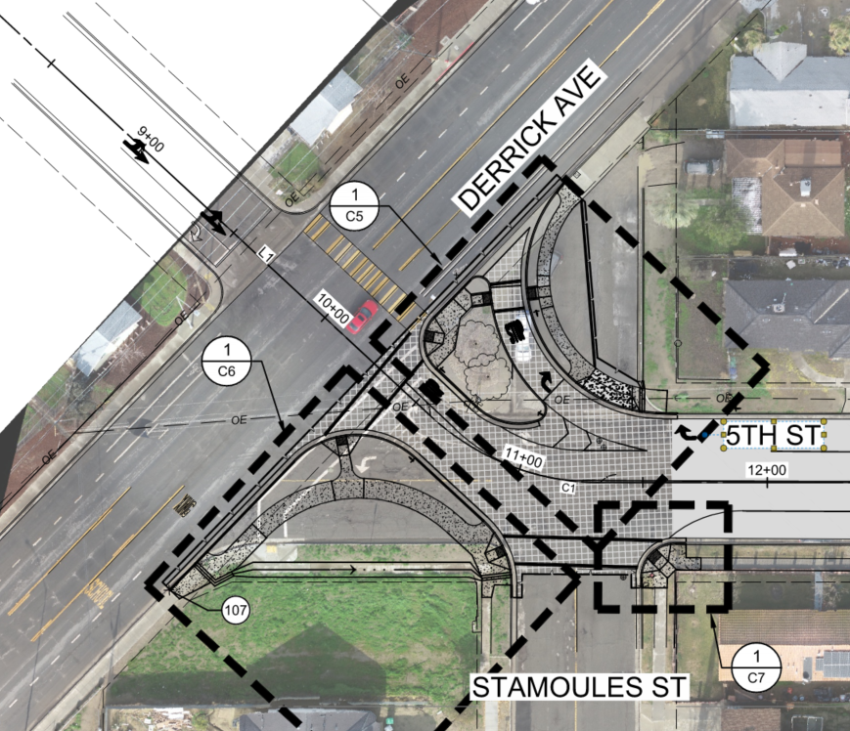
Project Location
SMOOT AVE.
Proposed Intersection

Slide 6
Project Purpose and Need
The primary purpose of this project is to:
Rehabilitate poor pavement;
Improve the road profile at gutter crossing at 5th & Quince; and
Realign the skewed intersection of 5th Street & Derrick Ave.

Slide 7
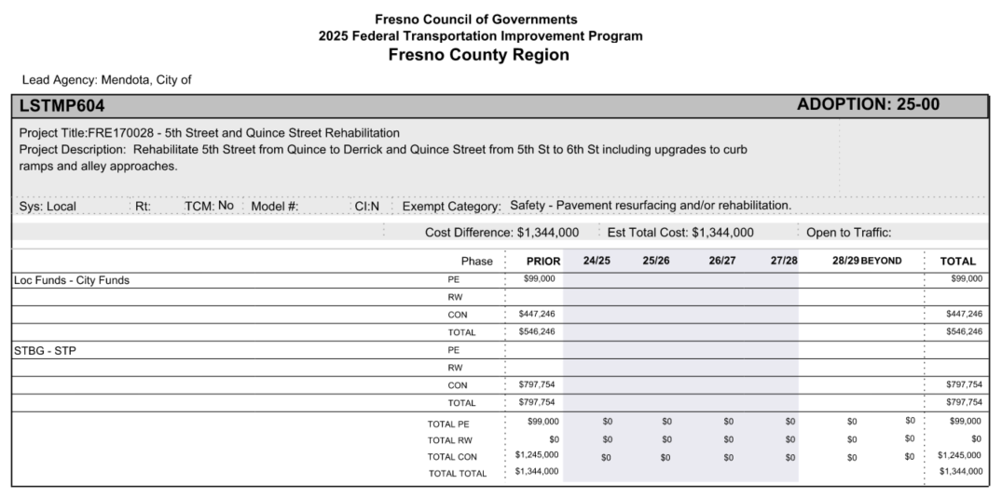
Project Listing in the TIP
Federal Transportation Improvement Program (FTIP) - Fresno Council of Governments

Slide 8
Project Features
Realign the intersection of 5th Street & SR33/Derrick Avenue
From a wide, skewed alignment to a narrower and perpendicular alignment to improve safety of motorists and pedestrians in this school zone crossing.
Pedestrian crossing distance/time reduced by 50%
The right turn only lane from WB 5th to NB Derrick Avenue is being realigned
Reduce vehicle conflict point from SB SR 33 LT onto EB 5th w/ WB vehicle
Better visibility for WB 5th LT onto SB SR 33
Straighter and safer Smoot Ave to 5th Street crossing of SR 33
The number of lanes does not change

Slide 9
Traffic Data & Findings
5th Street
Year | No Build | Build
2026 | 1,026 AADT (0% Trucks) | 1,026 AADT (0% Trucks)
2046 | 1,100 AADT (0% Trucks) | 1,100 AADT (0% Trucks)
Years Selected for Analysis
Existing Year | 2024
Opened to Traffic | 2026
Analysis Year | 2046 (last year of RTP)
Cross Street (SR 33/Derrick Ave)
Year | No Build | Build
2026 | 4,500 AADT (13.85% Trucks) | 4,500 AADT (13.85% Trucks)
2046 | 4,951 AADT (13.85% Trucks) | 4,951 AADT (13.85% Trucks)

Slide 10
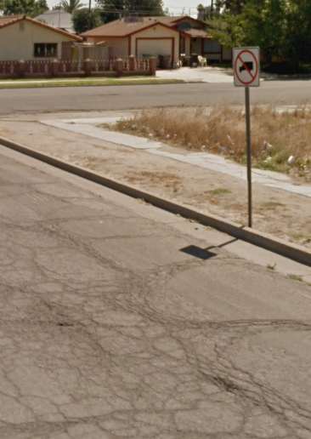
Traffic Data & Findings
This is a Non-Capacity Adding project
No change to AADT between build/no-build
Only a realignment with new right turn lane onto NB SR 33
AADT increase over 20 years is due to population growth, not project
No intersecting roads or surrounding land use will be impacted post construction
Trucks are not allowed on 5th Street
Traffic on Intersecting SR 33/Derrick Avenue does not change
No impacts to adjacent streets or landuses.

Slide 11
Project Schedule
PSE (design) ………………………….. Complete
ROW Certification ………………….. Complete
NEPA Clearance ……………………… pending IAC
Bid Advertisement …………………. Spring 2026
Construction ………………………….. Summer 2026

Slide 12
Project-level Conformity Conclusion
This project does not meet the criteria for not being a “project of air quality concern” (POAQC) as is it not:
A new highway project with a significant number of diesel vehicles or an expanded highway project with a significant increase in the number of diesel vehicles.
A project that affects or changes a LOS D/E/F intersection with a significant number of diesel vehicles
A new bus or rail terminal or transfer point
An expansion to a bus and rail terminal or transfer point
In or affecting locations, areas, or categories of sites identified as sites of violation or possible violation

Slide 13
Project-level Conformity Conclusion
Project does not meet the criteria for a POAQC as defined in the final rule by 40 CFR 93.123(b)(1). The project is listed as one of the non-exempt project examples that are not a local air quality concern under 40 CFR 93.123(b)(1)(i) and (ii) stated as:
“Intersection channelization projects, traffic circles or roundabouts, intersection signalization projects at individual intersections, and interchange reconfiguration projects that are designed to improve traffic flow and vehicle speeds, and do not involve any increases in idling. Thus, they would be expected to have a neutral or positive influence on PM emissions”
Additional reasons why the project is not a POAQC are:
Project with increase visibility of motorists turning onto SR 33 from 5th Street which will improve safety and reduce idle time at intersection.
Project will not increase AADT in the build vs. no-build scenarios. Increase in AADT is the result of population growth and not this project.
Trucks are not allowed on 5th Street.

Slide 14
Questions?
Contact Information
Michael Osborn, City Engineer
559-449-2700
mosborn@ppeng.com

