Slide 1
San Joaquin Valley VisionEval Training
December 19, 2025
1

Slide 2
Introductions
Presented by: Nick Fisher
RSG and MPO Staff
Format for the session
Presentation with informal Q&A throughout
Set aside Q&A time
Breaks
Screen sharing for demos

Slide 3
Training Overview
Presented by: Nick Fisher
Part 1 (8:00am-10:45am)
Introduction
What is VisionEval?
Documentation & Resources
VisionEval Basics
Overall workflow
Geography structure
Inputs
Packages & Modules
VisionEval Model Framework
Break (10:45am – 11:00am)
Part 2 (11:00am – 12:30pm)
Overview of provided models
Model folder structure
How to run a base model
How to test a future scenario
Lunch Break (12:30am – 1:00pm)
Part 3 (1:00pm – 3:00pm)
Querying outputs
How to run multiple future scenarios
Input/output visualizer guide
Notes:
Part 1:
Slides 1 – 60
165 min: 2.75 min per slide avg.

Slide 4
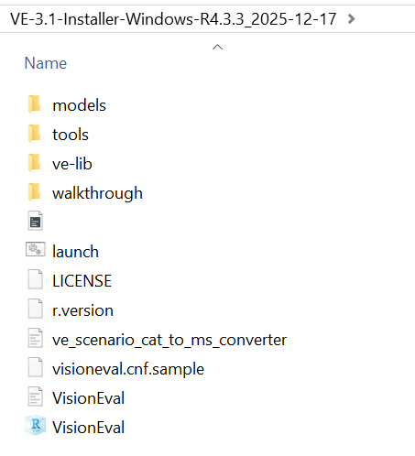

Getting Setup
Presented by: Nick Fisher
Confirm Version of R available on your machine = 4.3.3.
Download and confirm Rstudio is available
Ideally, although not necessary today, is to have Rtools 4.3 installed
Install the pre-built version of VisionEval for SJV

Slide 5
Part 1
Presented by: Jon Slason
8:00 am – 10:45 am
1. Introduction to VisionEval
2. VisionEval Basics
5

Slide 6
1. Introduction to VisionEval
Presented by: Jon Slason
1.1 What is VisionEval?
1.2 Documentation & Resources
Notes:
Jon

Slide 7
What is VisionEval?
Presented by: Jon Slason
An econometric travel demand model that uses disaggregate demand and an aggregate supply to forecast travel behavior for households within its model region
A tool used for scenario planning
Estimated on readily available data including National data such as the National Household Travel Survey (NHTS) then calibrated to local conditions (PUMS, HPMS, travel surveys, travel models).
Econometric framework for monetized costs (time & out of pocket) via a household travel budget. (e.g., congestion charges, fuel taxes, electrification effects)
Sensitive to land use, operational tactics, and policy tactics (e.g., TDM, induced travel, signal coordination, teleworking).
Runs quickly (run hundreds of scenarios in a short timeframe) because it lacks a specific network to assign trips. It is a daily travel model rather than a trip model.
Results can be viewed in an interactive visualizer and are available in output files (CSVs, SQL, Excel, etc.).
Open Source. Runs in R Studio

Slide 8
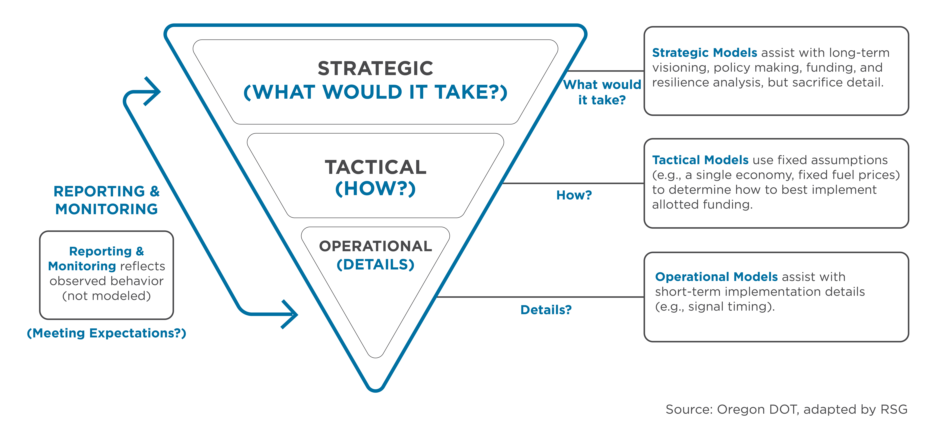

Answering the Important Questions First How Does VisionEval Fit in the Process?
Presented by: Jon Slason
Notes:
Originally developed in Oregon when they were struggling to better understand the travel behavior / land use nexus – combined with questions around energy, GHG, and uncertainty around pricing, demographics, etc.

Slide 9
Connecting to Performance Measures How is VisionEval Used?
Presented by: Jon Slason
Used to Support:
Long-Range Planning Initiatives
Land-Use and Zoning Analyses
Climate Action, Resiliency, & EV Plans
Scenario Planning
To Understand Impacts On…
Strategic investment & policy priorities
VMT targets
Zoning changes
Comprehensive plan priorities
Density, diversity of uses
Vehicle choice and availability
GHG targets and reduction pathways
Fuel tax revenues
Energy and fuel consumption
Community trade-off decisions Long-term investments

Slide 10

Open Source Tools Need Support
Presented by: Jon Slason
Members of the now disbanded Pooled Fund managed by FHWA are reorganized and will be pursuing a VisionEval pooled fund managed by Virgina DOT.
The tasks are primarily around the maintenance of the tool, updates to packages and sub-modules, external data, code development, extensions and enhancements, and supporting agencies apply the tool.
Contact Tara Weidner at Oregon DOT at
tara.j.weidner@odot.oregon.gov
If you would like to learn more about how to be involved in the Pooled Fund effort.

Slide 11



Quantitative Exploratory modeling
Presented by: Jon Slason
VisionEval can run hundreds (& thousands) of possible future options. Using exported data (SQL databases and CSVs) we can 'goal seek’ for desired performance results and identify the types of investment and policy inputs which produced desirable outcomes.
Individual runs can be analyzed.
Visualizers and other tools can help cut through the noise to identify relationships between specific inputs and outputs.
Identify particular policy objective(s) i.e., lowest VMT per capita and high transit use
Define the conditions i.e., high population growth, greater urban intensity, and high consumer adoption of shared AVs
Set the constraints i.e., acceptable level of user revenues & minimize travel cost burden on lower income households
Identify the best mix of investments and policies

Slide 12
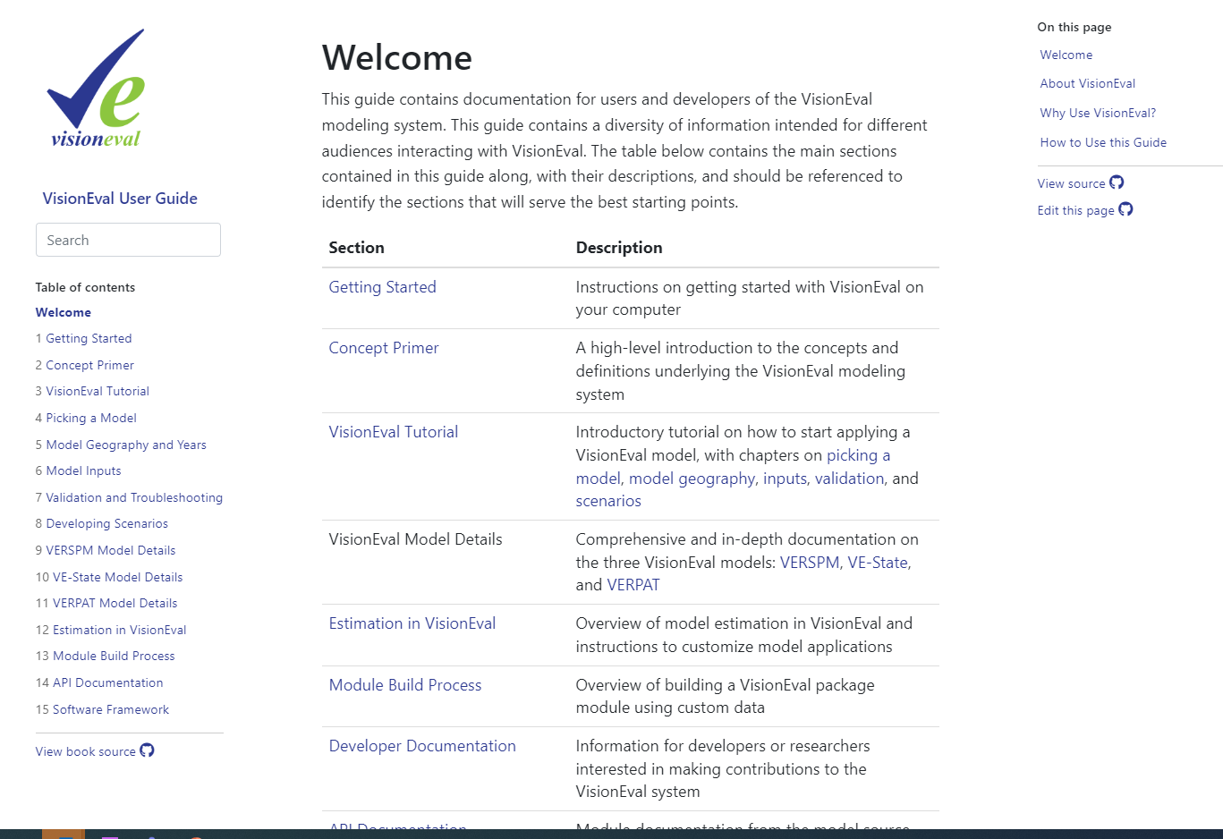
Documentation and Resources
Presented by: Jon Slason
The home for VisionEval documentation
Website for VisionEval documentation: https://visioneval.org/docs/
However, this site is also managed by FHWA and Volpe. Local cloned repo’s can be managed to push changes that will be reviewed by Volpe staff.
https://github.com/VisionEval/VisionEval-Docs
Notes:
Jump to a live demo of the documentation. This would be helpful for show the users the type and amount of information.

Slide 13
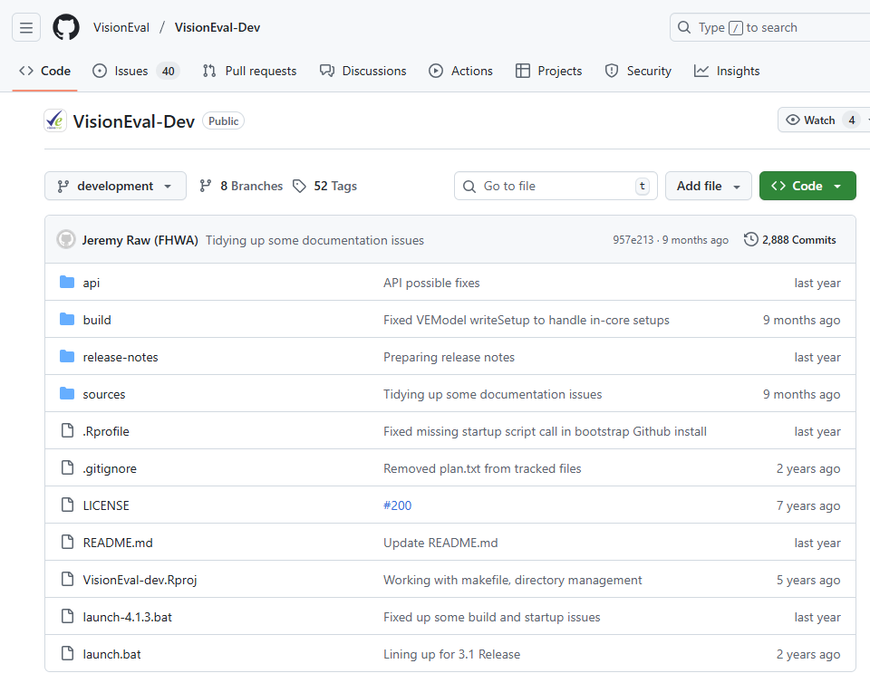
Relevant Repos & VisionEval Versions
Presented by: Jon Slason
FHWA GitHub site for VisonEval: https://github.com/VisionEval/VisionEval-Dev
RSG uses the RSG fork of the –Dev repo for the SJV installation.
https://github.com/RSGInc/VisionEval-Dev
The SJV VisionEval uses VE 3.1.2
Note: VE 4.0 is now available but was not used for this implementation. VE 4.0 beta became available more than halfway through the project. The models used here should be able to be run with the latest framework. The key changes involve installation and installation of custom packages.
The VE versions should be compatible for running models. Key differences include some functions for exporting results, queries, building the R environment, and installing packages.

Slide 14
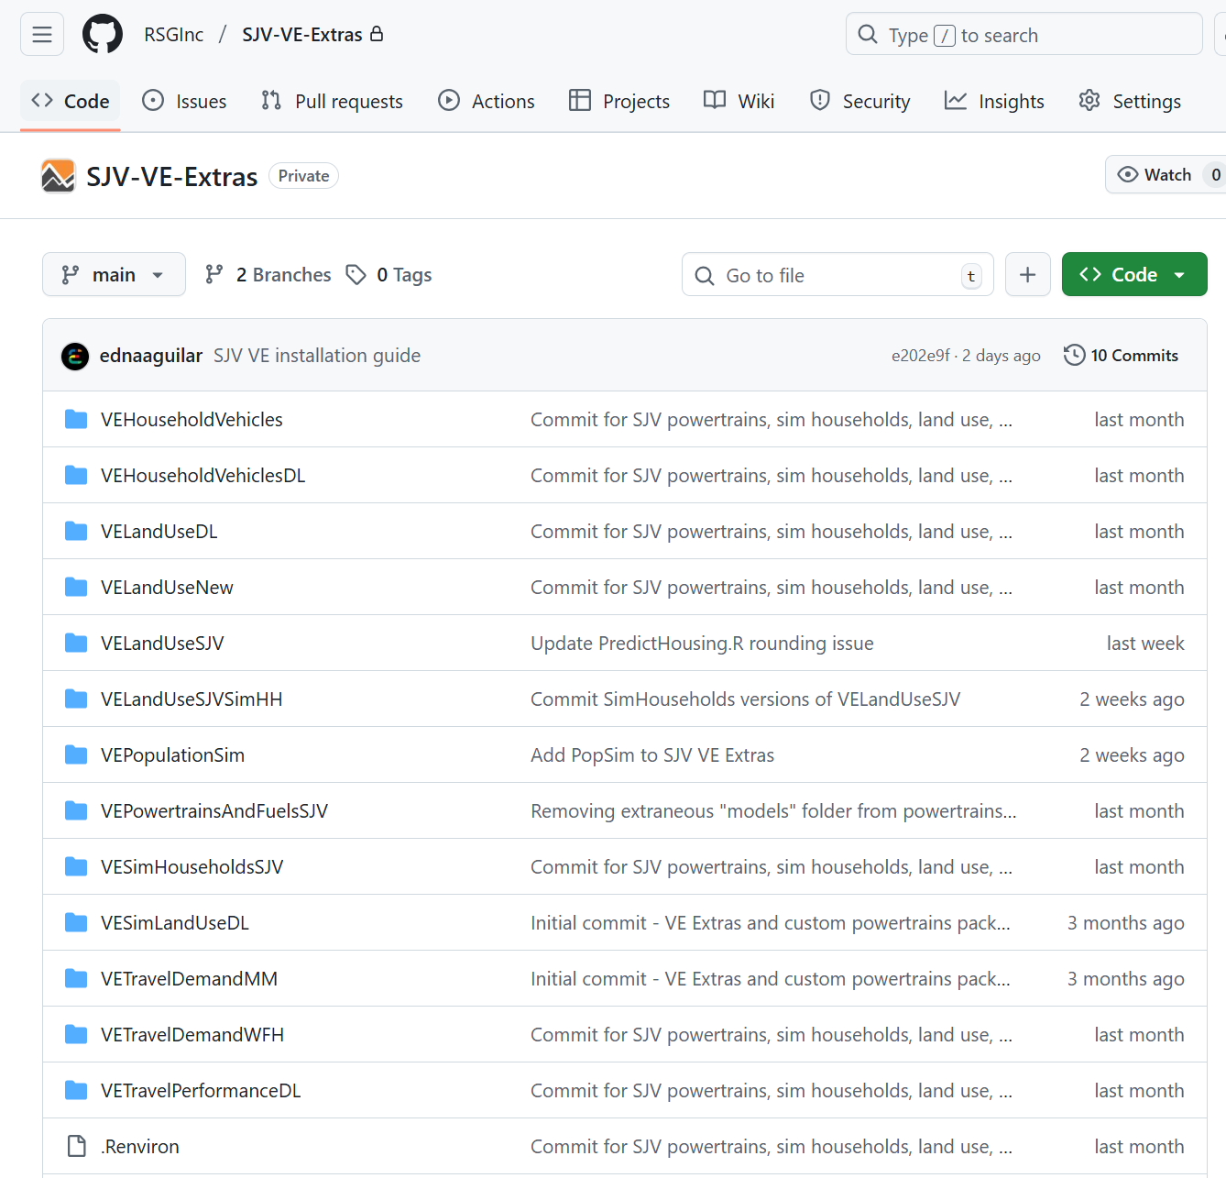
Relevant Repos & VisionEval Versions
Presented by: Jon Slason
The SJV VisionEval lives in the SJV-VE-Extras repo: https://github.com/RSGInc/SJV-VE-Extras
FresnoCOG will be given access to the repo to then share as appropriate with other agencies.

Slide 15
2. VisionEval Basics
Presented by: Jon Slason
2.1 Overall workflow
2.2 Geography Structure
2.3 Inputs
2.4 Packages and modules
2.5 VisionEval Model Framework
15

Slide 16
2.1 Overall “Big Picture” Workflow
Presented by: Jon Slason
Step 1: Install the VisionEval model
Step 2: Develop a Base Model for the region. The Base Model:
Defines the model geography (select zone structure and region boundary)
Defines the base and scenario years (e.g., 2020 and 2046)
Contains local input files calibrated to Base Scenario conditions in the region (including both observed base year data and estimates of future year conditions with no scenario policies applied.)
Estimates household and population data
Creates the reference Base Scenario and Future Scenario
Step 3: Develop Future Scenarios by adjusting specific input files for future years.
Update all the Step 2 inputs.
Future Scenarios are specific model runs. Possibilities exist for running hundreds of scenarios by creating unique inputs and running models are each unique combination of inputs.
Step 4: Run the models and extract and visualize results

Slide 17
2.2 VE Geography Structure
Presented by: Nick Fisher
17
Notes:
Edna

Slide 18
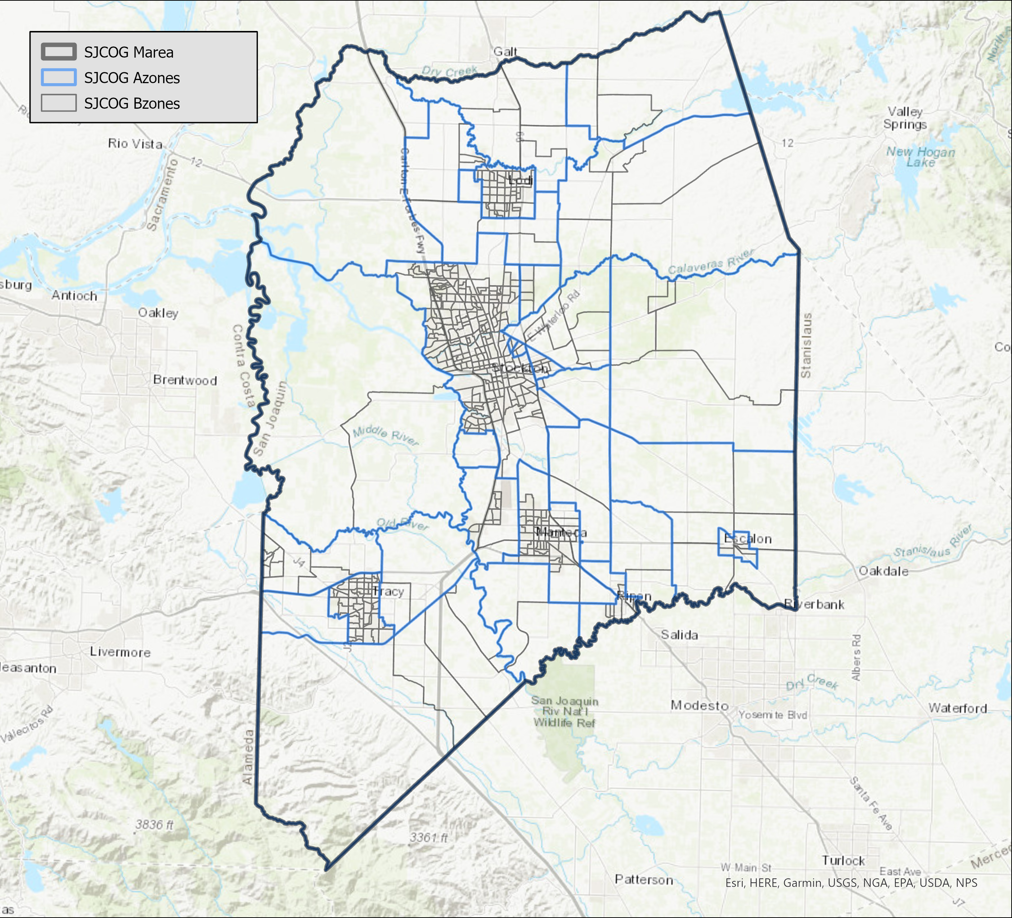
SJV Geography Structure
Presented by: Nick Fisher
The SJV VisionEval uses the following geographies which are perfectly nested within each other:
Region: The entire model area (8 MPOs + 17 bordering counties)
Mareas: Metropolitan areas within the model SJV, defined by the MPO boundaries
Azones: Larger geographic areas such as cities or tracts. SJV uses a combination of urbanized areas and 2020 Census Tracts.
Bzones: Subdivision of Azones that represent individual neighborhoods. SJV uses 2020 Census Block Groups
Additional categorical levels:
Location type (urban/town/rural)
SJCOG Marea VE geography structure

Slide 19
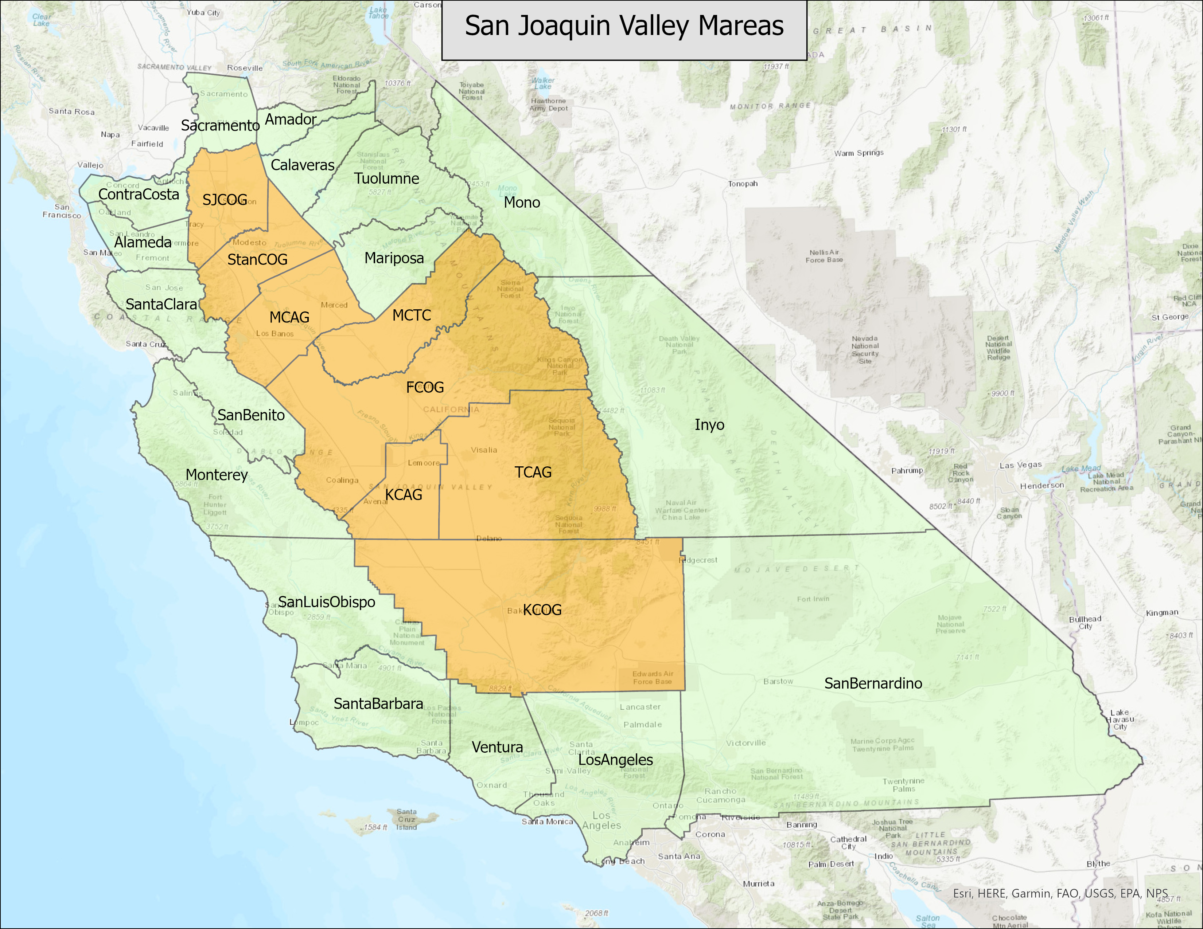
Presented by: Nick Fisher
Interactive Session: showing the SJV model geographies

Slide 20
External Zones
Presented by: Nick Fisher
SJV VisionEval includes 17 external zones to represent all 17 bordering counties
External zones are included to capture commuter travel into/out of the model region
External zone inputs need to be provided to run the model
Households and jobs in the external zones are designed only to include sufficient numbers to capture travel effects for those who travel to jobs in SJV or those who travel outside the Valley.
These are estimated using an analysis of LEHD data.
SJV VE’s geography includes external zones

Slide 21
2.3 Inputs
Presented by: Nick Fisher
Notes:
Nick

Slide 22
Inputs
azone_fuel_power_cost.csv
Presented by: Nick Fisher
There are 65 inputs including ~300 input parameters, and can be classified into these general categories:
Setup files: Required as basic parameters for VisionEval. These values do not change.
Demographics inputs: Population and job demographics and composition for the model region.
Land use inputs: Housing and developable land inputs to inform potential transit demand growth.
System operations/ITS inputs: Inputs that define the level of system efficiencies and ITS technology deployment
Transportation options inputs: Policy inputs that impact transportation option available to households
Vehicles and fuels inputs: Inputs that later the vehicle fleet and fuel mix available
Pricing inputs: Inputs that create additional costs for system users such as congestion charges, parking costs, or vehicle fees/taxes
Examples of Input Files
Input File | Description
bzone_dwelling_units.csv | Number of Dwelling Units by type (SF, MF, GQ) by Year by Bzone
azone_hhsize_targets.csv | Average household size & share of 1-person households by year by Azone
marea_congestion_charges.csv | Congestion Charges ($/mile) coverage of daily VMT by road type (Fwy, Arterial) by 5 congestion levels by year by Marea
region_hvytrk_powertrain_prop.csv | HD Truck powertrain (ICE, HEV, EV) shares by stock year
Notes:
Nick

Slide 23
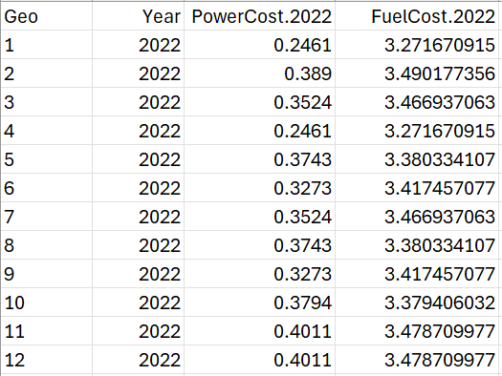
Types of Inputs
Presented by: Nick Fisher
All inputs are defined at a geography level. The name of the input file indicates the geography level of the input data. (e.g., azone_hh_pop_by_age, marea_lane_miles).
The majority of input files are CSV and each input file will have:
Year field when inputs vary by model year
Geo field when inputs vary by geography
Field names identifying dataset names
Inputs are provided for:
Base model (Inputs included in the out-of-the-box VisionEval model)
SJV model (Inputs customized for the SJV model)
azone_fuel_power_cost.csv
Inputs must be provided for SJV counties AND external zones
Notes:
Nick

Slide 24
Input Sources & Methodologies
Presented by: Nick Fisher
For more details on model inputs, refer to the User Guide chapter on Model Inputs (https://visioneval.org/docs/model-inputs.html) or search the source code for specification data for a given input
Common sources for inputs include:
MPO travel demand model network
HPMS
EPA SmartLocationDatabase
US Census
EPA
GTFS feeds
Caltrans
CARB
National Transit Database
California DMV
Federal, state, and county regulation websites
The full list of inputs with their description and sources will be provided in the model documentation
Methodology examples
Input File | Methodology
bzone_dwelling_units.csv | Travel model data was used to calculate total dwelling units by type. Travel model data was used as a distribution of households by type for and official household forecast numbers were applied to the distribution
azone_hhsize_targets.csv | Used synthetic household and population data provided to determine the average household size and the number of single-person households.
marea_congestion_charges.csv | No congestion charges were assigned to the San Joaquin Valley Mareas.
region_hvytrk_powertrain_prop.csv | This input was developed using California vehicle registration data, and matches the heavy truck powertrain goals set in CARB’s Advanced Clean Trucks and Advanced Clean Fleets goals
Notes:
Nick

Slide 25
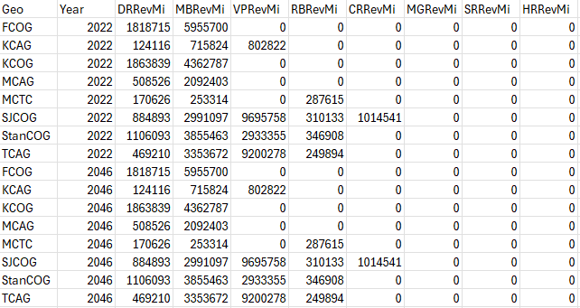
Example input: marea_transit_service.csv
Presented by: Nick Fisher
Definition: The file contains the annual revenue-miles for different transportation modes in the Marea, including demand response, van-pool, rapid bus/BRT, commuter rail, monorail, streetcar, and heavy and light rail.
Methodology: Revenue miles were calculated from the National Transit Database for 2024, accounting for all service providers within each respective MPO region. No changes were assumed for 2046.
Notes:
Nick

Slide 26
2.4 Packages & Modules
Presented by: Jon Slason

Slide 27
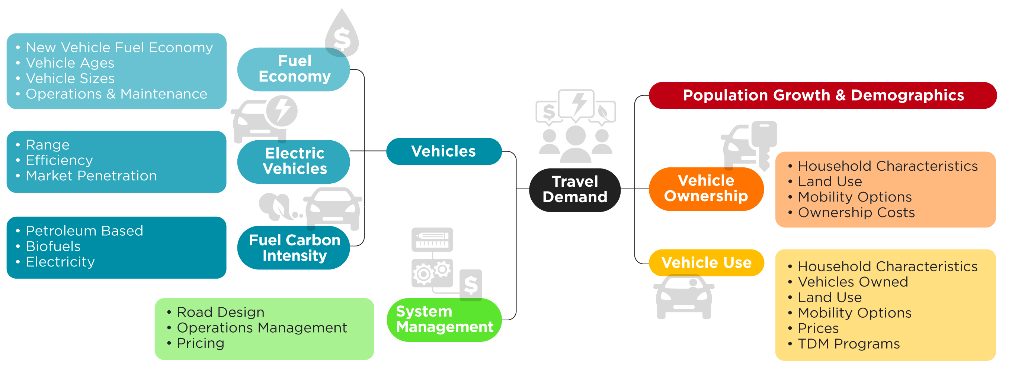
Elements Considered in the Strategic Model
Presented by: Jon Slason
Source: ODOT (adapted by RSG)

Slide 28














Presented by: Jon Slason
Fundamental Design of the Econometric Demand Model
Travel Demand
Household Composition
Built Form Factors (“D’s”)
Vehicles & Drivers & Fuels
Inputs - Policies
Notes:
Future Scenario Development: a handful of specific inputs to test. – toll pricing, a specific amount of transit or roadway miles, a land use scenario
Future Scenario Development: Identifying a range of investments and policies. Using low and high, or several specific input values. 75% to 150% of transit service, 50%-150% of parking costs, 75%-150% of pricing…
Strategic Modeling that explores hundreds and thousands of scenarios
Identify the scenarios which produced desirable results which support the Vision & Goals. Identify the inputs which lead to desired outcomes.

Slide 29
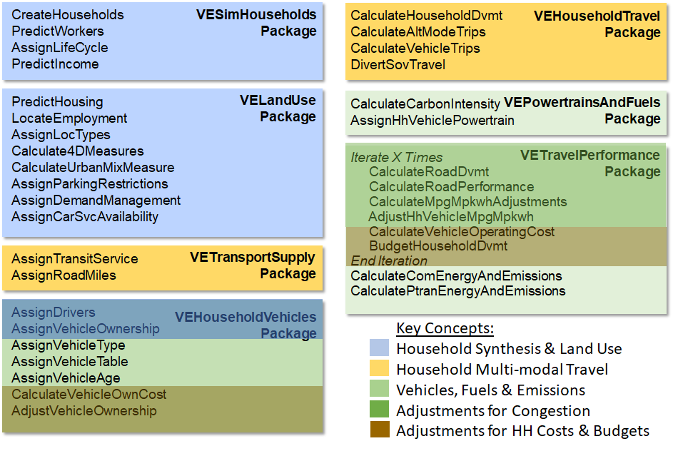
Packages and Modules
Presented by: Jon Slason
VisionEval is built from packages, each containing specific modules
VisionEval works by running a sequence of modules (steps) which are defined in the run_model.R script
The default VisionEval model comes with the following base packages which are run roughly in the order shown →
Information on these packages can be found at: https://visioneval.github.io/docs/ve-estimation.html#ve-estimation
Module
Package
Module
Package

Slide 30
SJV VE Packages
Presented by: Jon Slason
The SJV VE model uses a mix of default and custom packages
Custom packages are VE default packages that have been re-estimated using local data and updated to reflect the model region
The following packages are used in SJV VE:
Package | Description
VEPopulationSimSJV (custom) | Uses PopulationSim to create synthetic population
VESimHouseholdsSJV (custom) | Uses VE’s household synthesizer
VELandUseSVJ (custom) | Assigns employment, households, and land use types
VEPowertrainsAndFuelsSJV (custom) | Calculates energy consumption and emissions from transportation
VETransportSupply (default) | Calculates per capita roadway and transit supply
VETravelDemandWFH (default) | Includes the Multimodal Module estimated with 2017 NHTS data
VEHouseholdVehiclesDL, VELandUseDL and VETravelPerfromanceDL | Packages that reflect driverless and car service modules.

Slide 31
Custom Package: VESimHouseholdsSJV
Presented by: Jon Slason
Contains modules to simulate households and their characteristics within model Azones. Household synthesis is estimated using 2020 PUMS data.
Modules include:
CreateHouseholds: creates a Household table in the datastore and populates the table with datasets characterizing simulated households. Estimates model parameters.
PredictWorkers: assigns workers by age to households and to noninstitutional group quarters population. It is a simple model which predicts workers as a function of the age composition of household members. Estimates model parameters.
AssignLifeCycle: assigns a life cycle category to each household. The life cycle categories are similar, but not the same as, those established for the NHTS. Does not estimate model parameters.
PredictIncome: predicts the income for each simulated household given the number of workers in each age group and the average per capita income for the Azone where the household resides. Estimates model parameters.

Slide 32
Custom Package: VEPopulationSim
Presented by: Jon Slason
Household synthesis is done using PopulationSim and is an alternative to VESimHouseholds.
PopulationSim is an open-source platform that generates synthetic populations from PUMS data and user-defined control variables.
Control totals are flexible and can be applied at various geographic levels, e.g. household size, number of workers in household, income ranges, and age distribution bins.
PopulationSim documentation: https://activitysim.github.io/populationsim/
The main differences between the PopulationSim and VESimHousehold are:
PopulationSim uses iterative fitting (IPF/IPU) to reweight Census PUMS microdata, ensuring household and person characteristics explicitly match local demographic control totals (by geography, age, income, etc.), producing outputs that are highly sensitive to data quality and geographic inputs.
VESimHouseholds generates households using fixed probability tables and regression models estimated once from Census PUMS, assigning life cycle, household type, workers, and income without any iterative fitting or matching to control totals.
Bzone-level control totals are used as input to PopulationSim, and the synthetic households and persons it generates are used in the VEPopulationSim model

Slide 33
Custom Packages: VELandUseSJV
Presented by: Jon Slason
New package being used in the SJV VE model. Based on research on land use conducted by Portland State by Professor Liming Wang and the creator VisionEval Brian Gregor.
This package assigns employment, households, and land use types across the model region.
The package has two implementations:
Where Bzone controls are provided:
Default VE method.
Uses asserted targets based on number of single- and multi-family dwelling units and number of jobs in each Bzone
Households are allocated to housing types and Bzones based on their characteristics, e.g. income
Where land use type controls are provided:
New implementation approach
Uses simpler, more aggregate dwelling and employment targets which are then allocated to Bzones
Dwelling unit and employment targets are described in terms of land use types.

Slide 34
Custom Packages: VELandUseSJV
Presented by: Jon Slason
Population
Household synthesized by Azone based on forecasts of People by Age Group
Dwelling Units
Allocation households to Single Family, Multi Family and Group Quarters Dwelling Units By Bzone
Employment
Predict workers by Bzone based on forecasts of Total Employment, Retail Employment and Service Employment
Connect workers to households
Bzone Controls
Dwelling Units
Allocation households to Single Family, Multi Family and Group Quarters Dwelling Units By Bzone based on land use type controls and transportation accessibility
Population
Household synthesized by Azone based on forecasts of People by Age Group
Land Use Types
Set employment and dwelling type controls by land use types: area type (fringe, outer, inner, center), diversity type (residential, mixed, or employment), and location type (urban, rural)
Land Use Type
Controls
Employment
Predict workers by Bzone based on forecasts of Total Employment, Retail Employment and Service Employment and Land use type controls and transportation accessibility
Connect workers to households

Slide 35
Custom Package: VEPowertrainsAndFuelsSJV
Presented by: Jon Slason
This package calculates energy consumption and emissions from transportation.
It adjusts the proportion of household vehicle sales by powertrain (internal combustion, hybrid, battery electric, and plug-in hybrids) and fuel type (gasoline, diesel, and CNG) for household vehicles, commercial vehicles, car service or ride-hailing, and heavy trucks.
It includes modules for inputting energy consumption characteristics of different vehicle technologies, carbon intensities of different fuels, functions for calculating energy consumption and emissions from household, commercial and public travel.
This package was customized for SJV VE using California DMV vehicle registration data and CARB zero-emission sales goals for 2046.
Year 2022 | Total Veh | BEV Vehicles | Share (%)
KCAG | 104153 | 849 | 0.82
MCTC | 125986 | 1001 | 0.79
StanCOG | 449514 | 3247 | 0.72
TCAG | 376771 | 2479 | 0.66
KCOG | 694250 | 4590 | 0.66
MCAG | 229261 | 1490 | 0.65
FCOG | 830439 | 5235 | 0.63
SJCOG | 633092 | 3663 | 0.58
Year 2046 | Total Veh | BEV Vehicles | Share (%)
MCTC | 144162 | 95567 | 66.29
KCAG | 128225 | 76444 | 59.62
StanCOG | 493717 | 288036 | 58.34
MCAG | 283326 | 157783 | 55.69
KCOG | 856408 | 476249 | 55.61
TCAG | 410326 | 226206 | 55.13
FCOG | 913668 | 473034 | 51.77
SJCOG | 836360 | 374387 | 44.76

Slide 36
2.5 VisionEval Model Framework
Presented by: Jon Slason
36

Slide 37
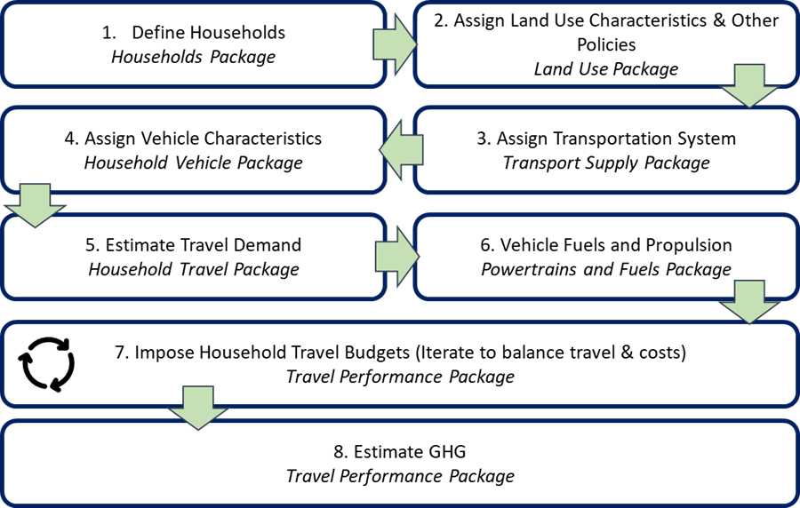
Model Steps
Presented by: Jon Slason
The VisionEval framework is composed of eight core modeling steps. Each of which has sub-activities and models.
Each step includes a set of calculations and models estimated using data from the National Household Travel Survey (NHTS) and the US Census that operate on the input data as well as the results of the previous calculation step.

Slide 38
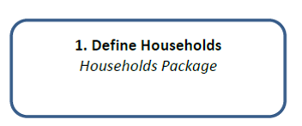
Step 1: Define Households
Presented by: Jon Slason
Description
Generate Synthetic Population using VESimHouseholds package or by loading PopulationSim outputs
Inputs
VESimHouseholds:
Census PUMS data provide marginal attributes
Model-wide population control totals constrain results
VEPopulationSim:
PopulationSim outputs. Pre-run model that is used in the VE model inputs.
Outputs
Household size & type (single family, multi-family, group quarters)
Household demographics (income, etc.)
How is it used?
Households with attributes are the basis of trip-making but also highly sensitive to cost & other policies

Slide 39



VE Concept #1: Household Synthesis & Land Use
Presented by: Jon Slason
LEGEND
Inputs
Model
AZone
Population by age (Regular & GQ)
Bzone
Dwelling Units by Location Type
Employment
Census PUMS
HH attributes
. Age mix
. Lifecycle
. Income
. Workers
. Drivers
. # Autos
BZone attributes
Urban Mixed Use
Built Form:
Density, Design, Diversity, Destination Accessibility
Employment (#, type)
BZone Policies
Travel Dmd Mgmt
- TDM (work)
- IMP (home)
Car Service (Hi/Lo)
Parking
- Res Pkg spaces
- Worker Pkg Pgms
- Non-Work parking
- Parking Rates
AZone Per Capita Income
Income model
Worker Rate
Work Location
Gravity Model
Licensure Rate
Non-Work Trips
Gravity Model
Auto Ownership model
Household Attributes
Place Type = function of Location Type, Area Type and 4Ds
Notes:
Note – Pooled Fund created a new VEPopulationSim package

Slide 40
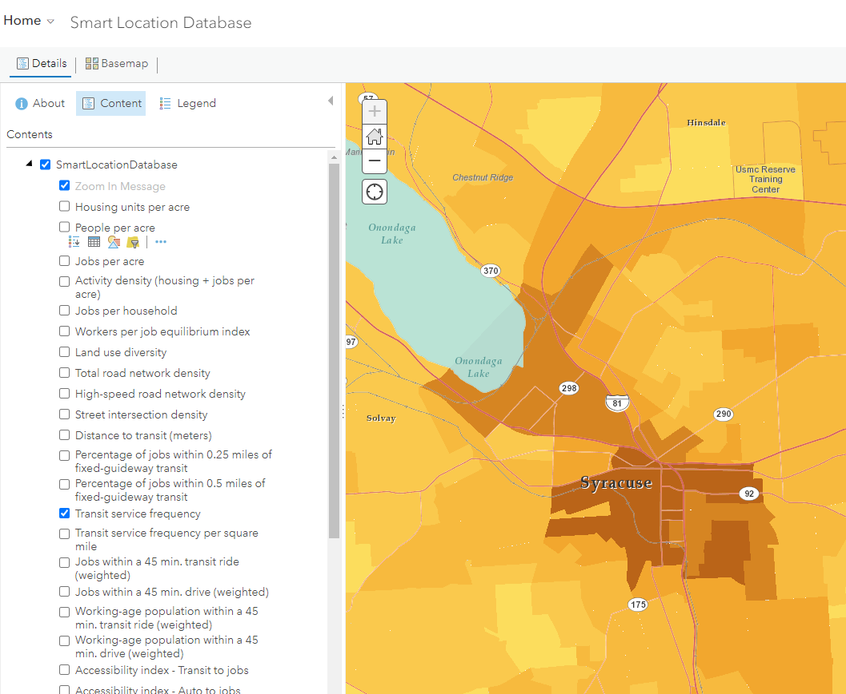
EPA Smart Location Database
Presented by: Jon Slason
https://www.epa.gov/smartgrowth/smart-location-mapping
Key Variables
D1B
D4C
D3bpo4
D5
EPA first released the Smart Location Database in 2011 and released version 2.0 in July 2013, and version 3.0 in 2021.
The Smart Location Database Technical Documentation and User Guide
Interactive Map Viewer: https://epa.maps.arcgis.com/home/webmap/viewer.html?webmap=137d4e512249480c980e00807562da10
Data: https://edg.epa.gov/EPADataCommons/public/OA/SLD/SmartLocationDatabaseV3.zip
Map Server: https://geodata.epa.gov/arcgis/rest/services/OA/SmartLocationDatabase/MapServer
Notes:
Note – Pooled Fund created a new VEPopulationSim package

Slide 41
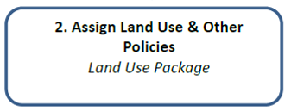
Step 2: Assign Land Use & Other Policies
Presented by: Jon Slason
Description
Assign land use and other policies by calculating land use attributes
Inputs
Local land use and zoning info or land use type controls
Population, employment, and dwelling units
Outputs
Land use density
Land use diversity
How is it used?
Much like ABMs, land use measures increase sensitivity to non-motorized trip-making

Slide 42
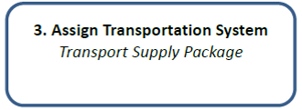
Step 3: Assign Transportation System
Presented by: Jon Slason
Description
Establish network information at the metropolitan area level
Inputs
Annual revenue miles by transit type
Peak period transit service frequency
Highway and arterial lane miles
Outputs
Ratio of highway & arterial lane miles to population (auto supply)
Total daily revenue miles traveled by transit type (supply)
How is it used?
Used as supply side; for Transit, think of this like skimming the transit network to establish supply characteristics
Demand equations use per capita supply of lane miles and transit to estimate demand for travel.

Slide 43
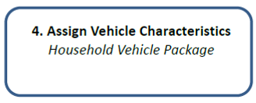
Step 4: Assign Vehicle Characteristics
Presented by: Jon Slason
Description
Establish vehicle characteristics at the household level using logit models
Inputs
Synthetic population (HH size, income, etc.)
Estimated logit parameters for choice models
Shared vehicle propensity model (changes demand for privately owned vehicle vs shared vehicles)
Outputs
Number and age of drivers in the household
Number and characteristics of vehicles in household
How is it used?
This is a combination of choice models like vehicle choice
Later used in demand calculations
Useful in determining fleet turnover (think electrification)

Slide 44





Vehicles, Fuels & Emissions
Presented by: Jon Slason
Vehicle Group | Vehicle Types
Household Vehicles | automobile, SUV/light truck
Car Service VMT | automobile, SUV/light truck
Commercial Service VMT | automobile, light truck
Heavy Truck VMT | heavy truck
Public Transit VMT | van, bus, rail

Slide 45
Driverless Vehicles
Presented by: Jon Slason
The DL packages are associated with a range of updates that were made to account for Driverless Vehicles.
The packages that RSG created include several updates
“Level 3” highly connected vehicles driven by humans. Cooperative Cruise Control, etc.
“Level 5” fully automated vehicles.
New household models:
propensity for sharing (reducing owned vehicles)
propensity for L5 vehicle ownership
Features include:
deadheading
shared vs unshared price differential on car sharing
changes in roadway capacity associated with different driving characteristics (both negative and positive on capacity)
changes in travel consumed by households (parking avoidance, utility cost of driving)
VEHouseholdVehiclesDL
VELandUseDL
VESimLandUseDL
VETravelPerformanceDL

Slide 46
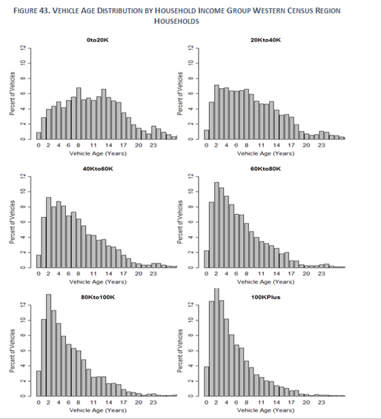
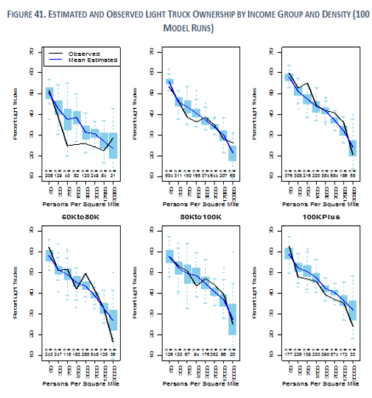
HH Vehicle Attribute Models
Light Truck & Vehicle Age relationships (NHTS2001)
Presented by: Jon Slason
Vehicle Age is a function of Income (table) Light Truck is a function of Income & Density (table) light truck/auto, mean veh age workers-to-drivers, dwelling type, kids, Azone ave, etc.

Slide 47
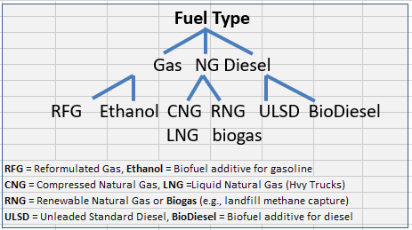
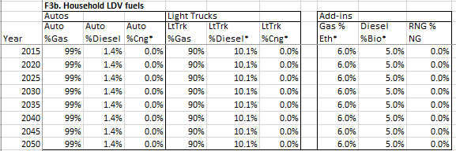
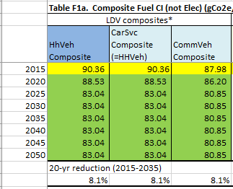
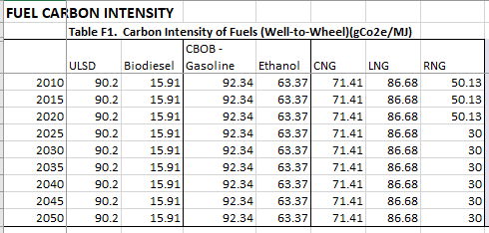
Fuel Mix-Carbon Intensity
Presented by: Jon Slason
Electric Carbon
Intensity (by AZone)
For each Vehicle Group, scenario year:
a) Default (use with caution)
b) Detailed: Base & Blend fuel shares & Fuel Carbon Intensity by type
c) Composite Carbon Intensity
DETAILED FUEL MIX OPTION
Base Fuels Blends
COMPOSITE CI INPUTS OPTION
* Fuel CI set Region-wide, except Transit optionally by MArea

Slide 48
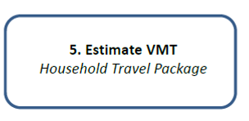
Step 5: Estimate VMT
Presented by: Jon Slason
Description
Estimate travel demand using a set of linear regression logit models
Inputs
Supply (highway, arterial, transit)
Synthetic population (demographics)
Land use attributes & vehicle ownership
Outputs
Daily Vehicle Miles of Travel and Trip Lengths
Walk, Bike, Ride-hailing and Transit Trips
Person miles (using Multimodal version)
How is it used?
Much of this is core model output

Slide 49
Household Travel
Presented by: Jon Slason
LEGEND
Inputs
Model
Household attributes
. Income
. Age mix (esp kids)
. Drivers
. Workers
. # Vehicles owned
. Parking Fees/Cash-out
...
BZone attributes
. Built Form:
Density, Design, Diversity,
Destinations Accessibility
Distance to Transit
. Urban Mixed Use
. Car Service Level
...
Transit “D”
PM peak transit stop visits within ¼ mile (Marea only)
MultiModal Module
The default assumption is that that ECO programs reduce the average commute DVMT of participating households by 5.4%. Users can modify this value but it requires rebuilding the VELandUse package for VERSPM or VESimLandUse for VE-State.
Travel Dmd Mgmt
(Home & Work based)
Calculate Household VMT*
(Owned & Car Service vehicles)
Estimate Household Vehicle Trips
2001 NHTS
Roadway Miles
Per Capita
Short Trip SOV Diversion
(trips < 20 mi round trip)
Transport Supply (Marea only)
Road lane-miles (Arterial & Fwy)
Transit Service miles (8 modes)
Overall
HH
VMT
SOV Diversion Model
. Identify HH SOV trips
by distance
. Which HHs divert trips
Bus-Equivalent Miles per Capita
Alternative Mode -- Miles & Trips
Transit
Bike/short trips (<20 miles round trip)
Walk
Biking trips are defined by the proportion of short-trip SOV diversion (20 miles or less round-trip).
* Budgets may affect owned vs. Car Service miles
Pricing (Cash-out worker parking, PAYD insurance) and (Car Service
reduction in) auto ownership costs may affect income
Notes:
Order of operations;
(1) CalculateHouseholdDvmt with adj (cashout-income change, payd--why matter?, carSvc-Auto ownership change)
Budget:(2) CalculateVehicleOperatingCost
Budget:(3) Adjust it to fit within BudgetHouseholdDvmt
(4) ApplyDvmtReductions due to TDM/IIMP and Short Trips SOV Diversion.
(5) CalculateVehicleTrips and
(6) CalculateAltModeTrips.

Slide 50
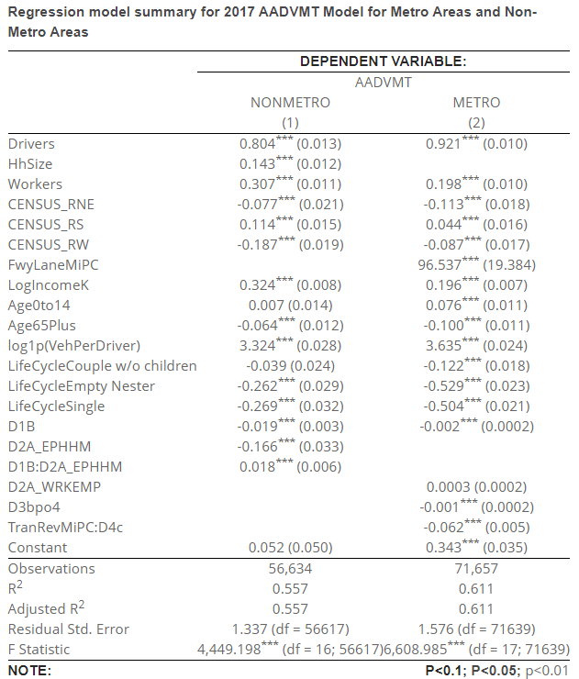
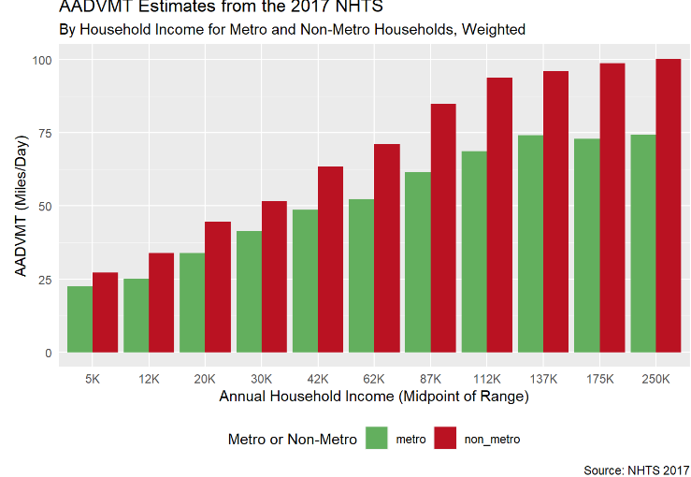
Vehicle Demand: VETravelDemand MM (VETravelDemand MM)
Presented by: Jon Slason
MULTI-MODAL MODULE MODEL ESTIMATION SUMMARY
The Module was re-estimated by RSG (Colin Smith) using the 2017 NHTS data. The SLD and confidential NHTS data.
Original MM – Developed by Liming Wang PSU
Research: A paper on the VETravelDemandMM models structure can be found [here] (https://www.dropbox.com/s/y594fz44achoqkq/jtlu_rspm.pdf?dl=0). Here is a summary of existing and selected model structures: A broader detail-oriented on all the models alongside performance and sensitivity test can be found [here] (https://www.oregon.gov/ODOT/Programs/ResearchDocuments/SPR788RSPMTool.pdf)
Original MM Multimodal Module was estimated by PSU on the 2009 NHTS.
Defined the explanatory Variables.
https://rsginc.github.io/ODOT_VEState/Model_Estimation_Summary.html
Notes:
Order of operations;
(1) CalculateHouseholdDvmt with adj (cashout-income change, payd--why matter?, carSvc-Auto ownership change)
Budget:(2) CalculateVehicleOperatingCost
Budget:(3) Adjust it to fit within BudgetHouseholdDvmt
(4) ApplyDvmtReductions due to TDM/IIMP and Short Trips SOV Diversion.
(5) CalculateVehicleTrips and
(6) CalculateAltModeTrips.

Slide 51
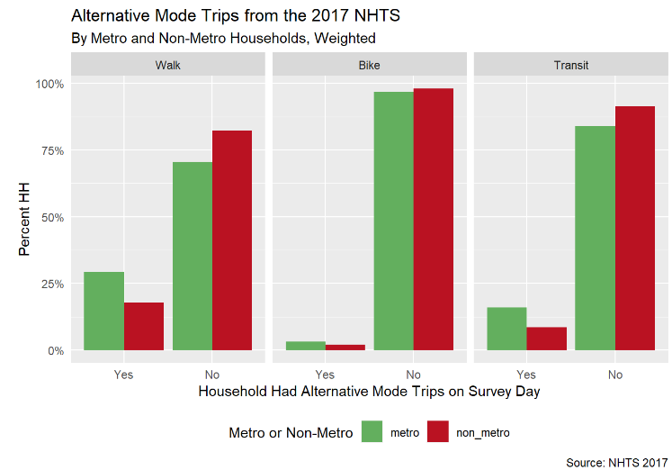
Alternative Modes: Travel Demand (VETravelDemand MM)
Presented by: Jon Slason
MULTI-MODAL MODULE MODEL ESTIMATION SUMMARY ALT MODES
The Module was re-estimated by RSG (Colin Smith) using the 2017 NHTS data. The SLD and confidential NHTS data.
Table 62: Transit Trips Hurdle Model for Metro Areas, Count Model, Comparison of Models Estimated Using 2009 and 2017 NHTS Data
Original MM – Developed by Liming Wang PSU
Research: A paper on the VETravelDemandMM models structure can be found [here] (https://www.dropbox.com/s/y594fz44achoqkq/jtlu_rspm.pdf?dl=0). Here is a summary of existing and selected model structures: A broader detail-oriented on all the models alongside performance and sensitivity test can be found [here] (https://www.oregon.gov/ODOT/Programs/ResearchDocuments/SPR788RSPMTool.pdf)
VarName | NHTS2009 | NHTS2017 | Ratio
(Intercept) | 0.062 | 0.264 | 4.252
AADVMT | -0.002 | -0.003 | 1.819
Age0to14 | 0.088 | 0.193 | 2.193
D1B | 0.000 | 0.001 | 1.879
D4c | 0.001 | 0.000 | -0.109
HhSize | 0.140 | 0.135 | 0.965
LifeCycleCouple w/o children | 0.000 | 0.254 | Inf
LifeCycleEmpty Nester | 0.040 | 0.159 | 4.030
LifeCycleParents w/ children | 0.072 | 0.000 | 0.000
LifeCycleSingle | -0.227 | 0.011 | -0.048
TranRevMiPC | 5.342 | 4.725 | 0.884
Original MM Multimodal Module was estimated by PSU on the 2009 NHTS.
Defined the explanatory Variables.
https://rsginc.github.io/ODOT_VEState/Model_Estimation_Summary_alt.html
Notes:
Order of operations;
(1) CalculateHouseholdDvmt with adj (cashout-income change, payd--why matter?, carSvc-Auto ownership change)
Budget:(2) CalculateVehicleOperatingCost
Budget:(3) Adjust it to fit within BudgetHouseholdDvmt
(4) ApplyDvmtReductions due to TDM/IIMP and Short Trips SOV Diversion.
(5) CalculateVehicleTrips and
(6) CalculateAltModeTrips.

Slide 52
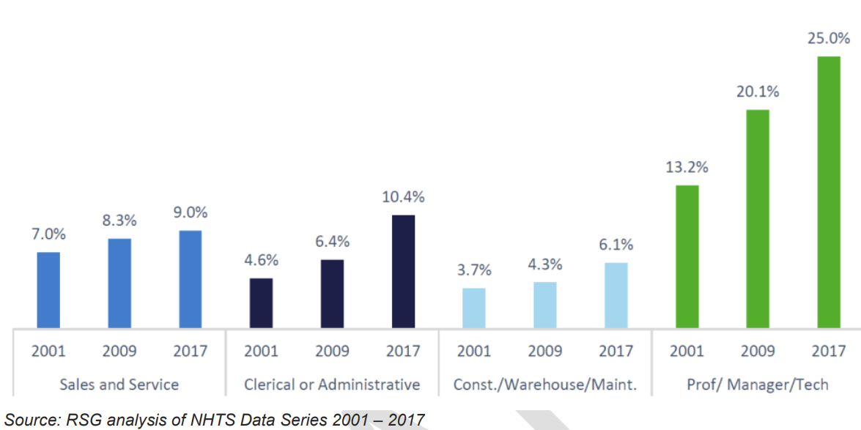
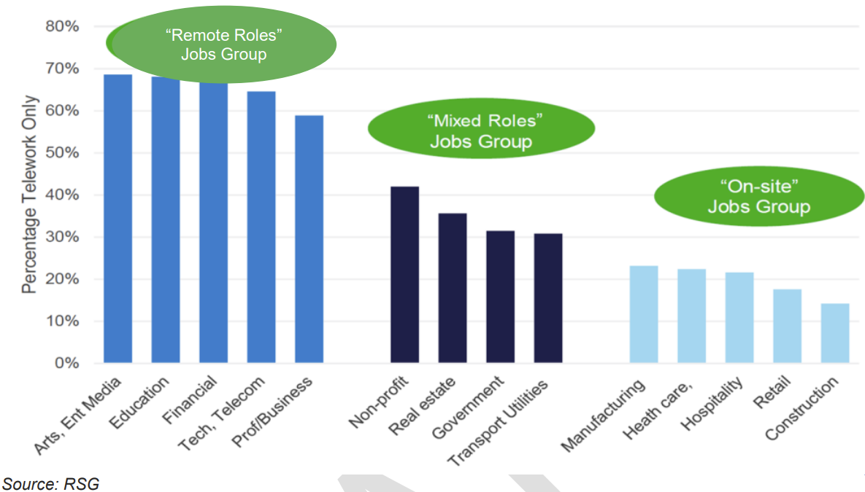
Teleworking Alternative: (VETravelDemandWFH)
Presented by: Jon Slason
Teleworking – peak rates (~late 2020)
Teleworking (pre-COVID 19) by Occupation
52
Notes:
2019 rMove Ohio survey. Employer survey and household survey in Massachusetts were conducted.

Slide 53
Step 6: Teleworking Alternative: (VETravelDemandWFH)
Presented by: Jon Slason
Survey data (rMove from RSG travel surveys*) was used to inform three teleworking models for the WFH Travel Demand model
Do you work outside of the home?
Yes
Do you telecommute at all?
Yes
How many days teleworking?
Model 1: Binary logit, 6.1% of workers work from home (n = 9,535 cases)
Model 2: Binary logit, if the person doesn’t work from home, do they telecommute at all during the week? (0 vs 1+) 16.6% telework at least once (n = 8,950 cases)
Model 3: Ordered logit, for those who telework, how many days?
*Ohio rMove data was able to provide detailed travel for those teleworking and those just working from home
53
Notes:
2019 rMove Ohio survey. Employer survey and household survey in Massachusetts were conducted.

Slide 54

Teleworking Alternative: (VETravelDemandWFH)
Presented by: Jon Slason
Each telework model relies on several variables, two key variables had to be added to the VisionEval code for the WFH Travel Demand model:
Occupation type (onsite, mixed, remote)
Commute distance
Model 1
(Work from Home)
Worker age
Household income group
Model 2
(Teleworking)
Worker age
Model 3
(Days teleworking)
Worker age
Occupation type
Density variables for residence Census block group from SLD data
Household life cycle
Household income group
Household life cycle
Occupation type
Commute distance
Household income group
Household life cycle
Occupation type
Density variables for residence Census block group from SLD data
Commute distance
~7% WFH in 2022 & 2046
RSPM this is included. VE-State needs additional data in the package estimation

Slide 55
Vehicles, Fuels & Emissions
Presented by: Jon Slason
Vehicle Group | Vehicle Types | Powertrain Options | Input Vehicle Adjustments | Inputs on Fuel Options
Household Vehicles | automobile, SUV/light truck | ICE, HEV, EV, PHEV | (veh sales mix) age,%LtTrk | gas/ethanol, diesel/biodiesel, CNG/RNG
Car Service VMT | automobile, SUV/light truck | ICE, HEV, EV | veh mix, age (%LtTrk same as HH) | gas/ethanol, diesel/biodiesel, CNG/RNG
Commercial Service VMT | automobile, light truck | ICE, HEV, EV | veh mix, age, %LtTrk | gas/ethanol, diesel/biodiesel, CNG/RNG
Heavy Truck VMT | heavy truck | ICE, HEV, EV | veh mix | gas/ethanol, diesel/biodiesel, LNG/RNG
Public Transit VMT | van, bus, rail | ICE, HEV, EV | veh mix | gas/ethanol, diesel/biodiesel, CNG/RNG

Slide 56
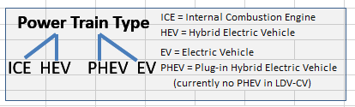
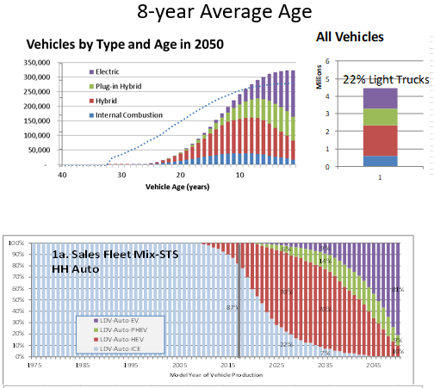
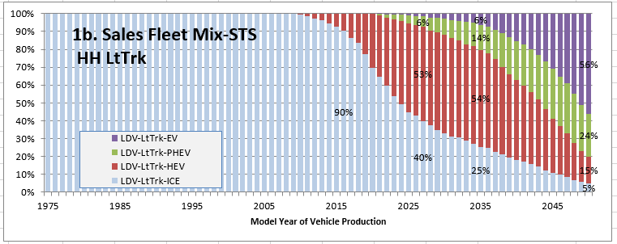
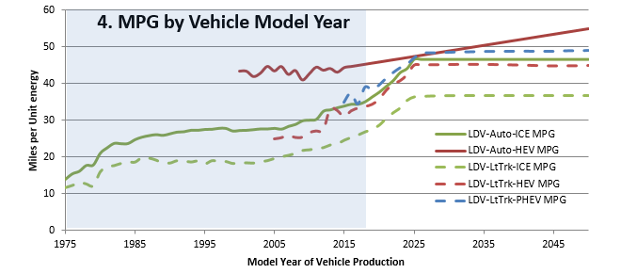
Household Vehicles
Presented by: Jon Slason
Vehicle Table: For each HH driving age person...
HH attributes
. Income
. Person Age mix
. #Vehicles owned
...
BZone attributes
Car Service Availability
Urban Mixed Use
Average %LtTrk & Age
by Azone
HHID | Veh# | Veh Attributes* | Lookup*
 |  | Own-or-CarService, Age, LtTrk-or-Auto | Powertrain, MPG, range,...
HHID | Veh# | Veh Attributes | Lookup
 |  | Own-or-CarService, Age, LtTrk-or-Auto
Daily Trip Length model
Residential EV charging by DU type (SF, MF, GQ) , AZone
2001 NHTS
* EV may switch to PHEV if range/charging limited
Concept #4: Congestion may affect MPG
Concept #5: Budgets may affect auto ownership
Veh age & LtTrk models
Separate tables for Autos & Light Trucks
For non-HH Vehicles
simpler approach
(on-road VMT not sales vehicles + inputs on powertrain mix, veh age, vehicle type)
ICE HEV PHEV EV
On-Road Mix of Vehicles (mix of ages)
Notes:
This module assigns drivers by age group to each household as a function of the numbers of persons and workers by age group, the household income, land use characteristics, and public transit availability. Users may specify the relative driver licensing rate relative to the model estimation data year in order to account for observed or projected changes in licensing rates.
Vehicle Range compared to 95th percentile VMT

Slide 57
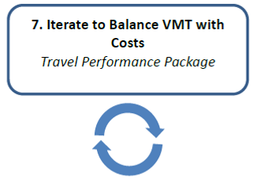
Step 7: Iterate to Balance VMT with Costs
Presented by: Jon Slason
Description
Vehicle Miles of Travel iteratively calculated to balance with household cost
Inputs
Initial Daily Vehicle Miles of Travel
Network and household characteristics
Pricing Policies
Outputs
Converged VMT
Household costs and Supply-side costs
How is it used?
A bit like a network assignment this iterates to a converged solution; but this also takes household cost into account

Slide 58
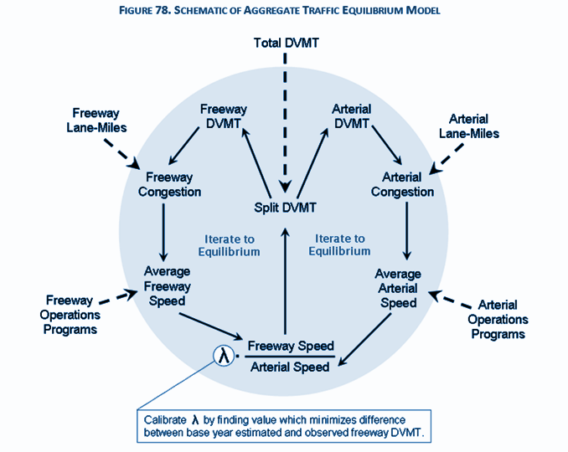
Adjust for Congestion
Presented by: Jon Slason
LEGEND
Inputs
Model
Sum VMT for all Vehicle Groups on the Road:
(urbanized portion of the Metropolitan Area)
Household & Car Service vehicles
Transit Vehicles
Local Delivery Commercial Vehicles
Long Haul Heavy Trucks
Allocate among Road Classes
2009 TTI Urban Mobility Dataset
HH VMT
Initial Conditions
}
Baseyear VMT Growth Basis
Freeway
Lane-Miles
Arterial
Lane-Miles
Initial “Split DVMT”
Calculate Speeds by Road Class
Adjust road capacity for ITS-Ops Policies
Allow re-allocation to balance speeds+Cong Fees (HH LDV only)
Split DVMT
Balance
ITS-Ops Programs
Congestion Fees
($/mi by Road Class & Cong Level)
Freeway
ITS-Ops
Programs
Arterial
ITS-Ops
Programs
Apply Fuel Efficiency Changes to Vehicles:
(fuel-speed curves vary by powertrain)
. due to congested speeds
. due to Speed-Smoothing policies
Adjust
ITS-Speed Smoothing &
Eco-driving policies
HH Vehicle Table

Slide 59
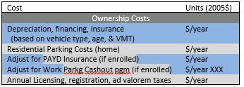
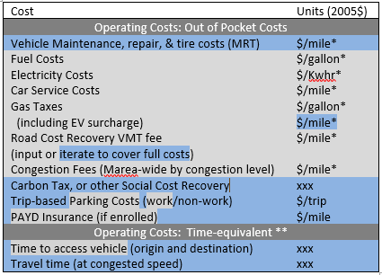
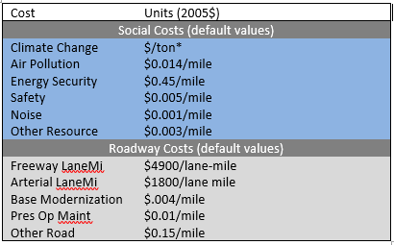
Adjust for HH Costs & Budgets
Presented by: Jon Slason
LEGEND
Inputs
Model
Auto Ownership Cost Adjustment
-- Substitute CarService for Owned Vehicles --
Auto Operating Cost Adjustment
-- Limit VMT to fit HH’s Transport budget --
Auto Ownership Costs
Auto OperatingCosts
Vehicle Cost model
2011 ODOT Social Costs White Paper
VMT-based
Social Costs (or just Carbon)
2011 ODOT Road Cost Estimates
(Optional) Calc VMT fee to fully recover
HH share of Road Costs
* Indicates fee varies by year. Social costs & Roadway costs can vary but defaults do not.
** Estimated as Time (hrs) multiplied by value of time ($/hr) input.

Slide 60
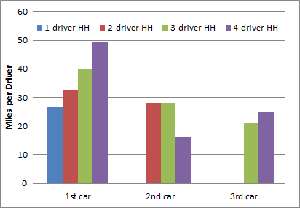
Adjust Auto Ownership for Car Service
Presented by: Jon Slason
LEGEND
Inputs
Model
Since each additional vehicle has less marginal value to the household (lower VMT/person, as shown in chart below),
Could the HH save money by substituting CarService for owned autos?
2001 NHTS data
(illustrative only,
not used in VisionEval)
Adjust HH autos owned given Car Service option
Compare vehicle ownership cost to Car Service($/mile).
(“High” Level CarService only, subject to input limitations on substitutability by vehicle type)
HH Vehicle Table
Notes:
New model adjusts vehicle ownership by comparing the cost of owning each household vehicle per mile of travel with the cost of using car-services where the car-service level is 'High'. The cost of car-services is a user input. The user also inputs values for the assumed likelihood that a household would substitute car service use for a household vehicle where the cost is lower (separate values are specified for autos and light trucks).
Modeling Shared Vehicle Use and Automated Vehicle Ownership
The overall approach to determining which households use car services is to compare the marginal per-mile ownership of each vehicle the household owns with the per-mile cost of using a car service for an equivalent value car. For each household, the increase in VMT with each added car owned is calculated. This is divided into the cost of owning a car to calculate the marginal per-mile ownership cost. This cost for each vehicle is compared with the equivalent per-mile cost of using a car service. The household retains vehicles that have lower marginal ownership costs and eliminates vehicles that have higher marginal costs. Typically when a household gets the first vehicle, their VMT increases much more than when they add subsequent vehicles to their household fleet.
This marginal cost approach is more valid than an average cost approach because households make choices at the margin (to own one more car or one less car), and because vehicle travel and vehicle ownership costs don't scale uniformly. For example, doubling the number of cars owned does not double the miles driven. This can be seen in Table 1 which shows how the average daily vehicle miles per driving age person varies with the number of driving age persons in the household and number of household vehicles. The values are tabulated from a metropolitan area household dataset derived from the 2001 National Household Travel Survey. It can be seen that in most cases the additional miles driven per person increase at a declining rate as the number of household vehicles increases from zero to the same number of vehicles as driving age persons. For example, in the case of 2-driver households, going from one vehicle to two increases miles per driver from 16.2 to 30.2, not to 32.4. In the case of 3-driver households, going from one vehicle to three increases miles per driver from 13.3 to 29.8, not to 39.9. Consequently, the cost per mile traveled of owning an additional car increases as the number of cars owned increases.

Slide 61
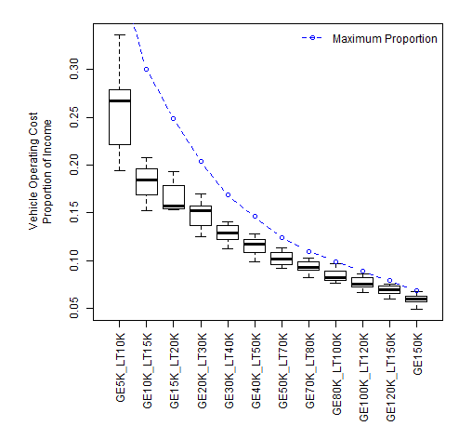
Adjust VMT for Household budget limit
Presented by: Jon Slason
LEGEND
Inputs
Model
Enables response to pricing policies and energy costs that increase vehicle operating costs.
Given observations that high vehicle operating costs curtail VMT,
Apply historic transportation budget portion of household income
(see chart per )
as a limit on annual vehicle operating costs.
Transport Budget Share by Income
30% for low incomes
down to
7-10% for high
incomes
Consumer Expenditure Survey 2003-2015
Adjust VMT for HH Budget Limit
Calculate for each household:
COSTS = Annual Vehicle Operating costs
(out-of-pocket & time-equivalent costs)
Annual HH VMT * Vehicle Operating Costs
BUDGET = Max share of Annual HH income
Transport Budget share * Annual HH Income
Reduce VMT, as needed so
COSTS stay within BUDGET.
HH VMT
(& Alt Mode Travel)
Notes:
Additionally, in order to respond to pricing policies and energy costs, VisionEval imposes a budget limitation. Household VMT is constrained such that annual vehicle operating costs must stay below a maximum share of annual household income, or budget limit. A household-specific average annual vehicle operating costs is first calculated, including out-of-pocket per mile costs for each household owned and Car Service vehicles used by the household, as well as time-equivalent cost (input access times, estimates of VMT at congested speeds, and value-of-time input). Vehicle operating costs determine the proportional split of VMT among household vehicles. Out-of-pocket costs include the energy, [Maintnance, Rxxx, Tires], road use taxes (including EV surcharge and optional calculation of fee to fully recover road costs), work/non-work parking, PAYD insurance, input share of carbon and other social costs, as well as CarService fees by the household.

Slide 62
Resume at 11am See you soon!
Presented by: Jon Slason

Slide 63
Part 2
Presented by: Nick Fisher
11:00 am – 12:30 pm
1. Overview of provided models
2. Model folder structure
3. How to run a base model
4. How to test a future scenario
63

Slide 64
1. Overview of Provided Models
Presented by: Nick Fisher
Used in this Analysis
Provided but not being Used
SJV Reference Model
SJV Reference Model with PopulationSim
SJV Scenarios Cat (Categorical) Model
Uses a custom version of VESimHouseholds to generate households and population
Generates reference Base and Future Scenarios
Used to check Base and Future model outputs
Uses PopulationSim to generate households and population
Generates reference Base and Future Scenarios
Used to check Base and Future model outputs
Uses PopulationSim
Used to create all 109 Future Scenarios
Output allows comparing of future scenarios
Output allows to goal-seek

Slide 65
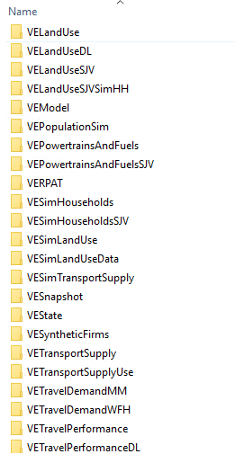
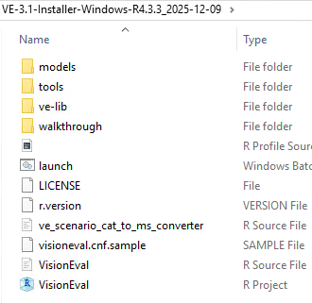
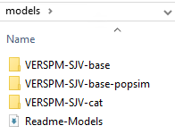
Installer Structure
Presented by: Nick Fisher
ve-lib folder
Zip folder
RSG provided the following zip file which contains the following folders:
models: contains all 3 models
ve-lib: contains all the R and VE packages needed to run the models. If custom packages are updated, they must be installed here (see slide 103)
Before trying to run any models – open the VisionEval R project and run the command install.packages(“sn”)
models folder

Slide 66
2. Model Folder Structure
Presented by: Nick Fisher

Slide 67
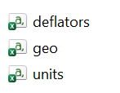
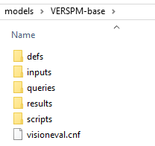
Folder Structure
Presented by: Nick Fisher
defs:
Directory contains the following model definition files:
geo.csv is required at setup to be custom to the particular model. However, once built these files are infrequently manipulated.
deflators.csv defines the annual deflator values, such as consumer price index, that are used to convert currency values between different years for currency denomination. This file does not need to be modified unless the years for which the dollar values used in the dataset is not contains in this file
units.csv defines the units to be used for storing complex data types in the model. This files should NOT be modified.
VisionEval models have the following folders and files:

Slide 68
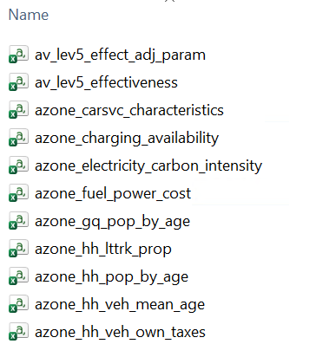
Folder Structure
Presented by: Nick Fisher
inputs:
Directory contains all the inputs for running VE models
Most of these files are CSV’s with one .json (model_parameters.json for Value of Time)
See slides 20-22 for more information about inputs
Note: “azone_ave_veh_per_hh.csv” and “reigion_hh_driver_adjust_prop.csv” are optional legacy files that do not need to be included in a customized model but are present if you install a default VE base model. Recommend deleting these files if building a custom model.

Slide 69
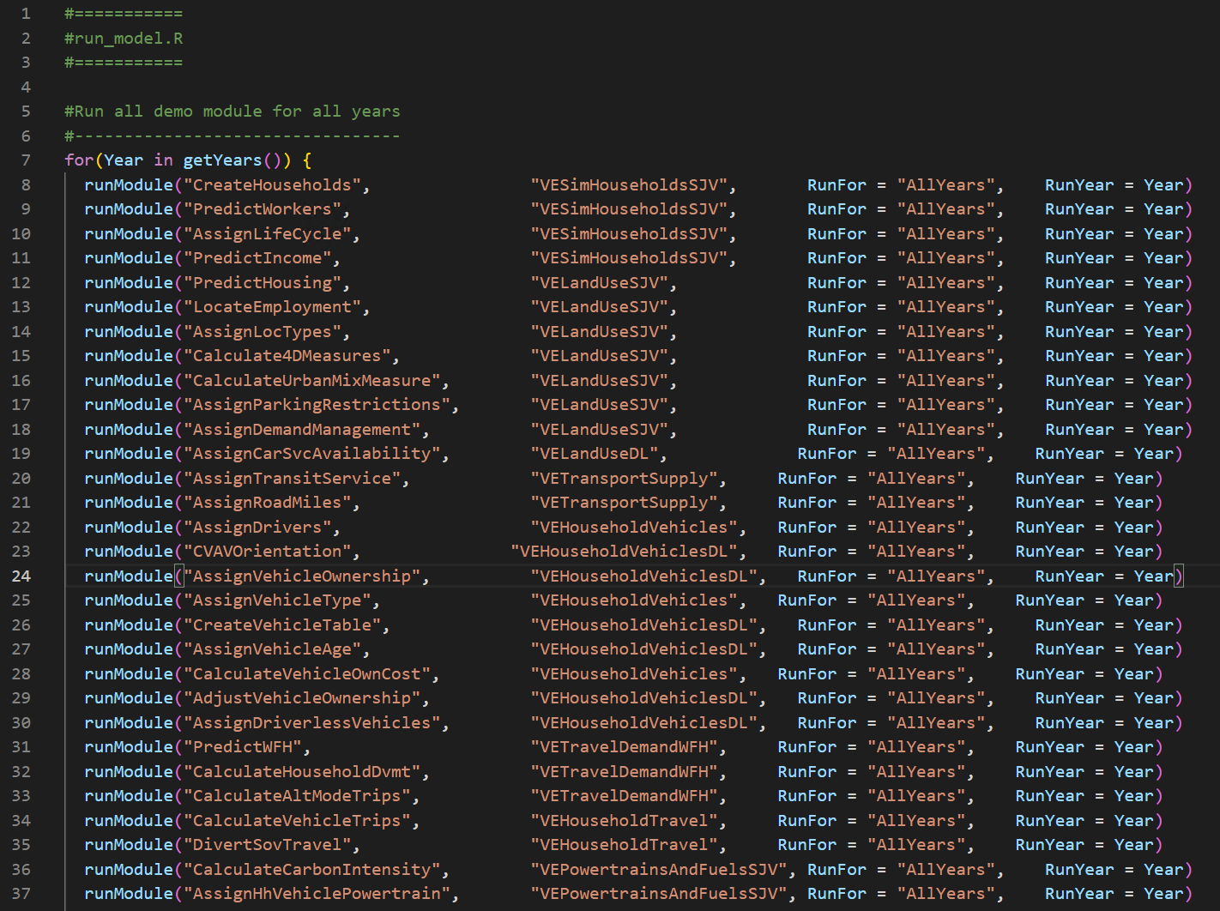
Folder Structure
Presented by: Nick Fisher
results:
Folder gets created when results are saved after a model run (see slide 73)
Results can be saved as a CSV or SQLite database
Also the location of log and model state files
scripts:
run_model.R specifies the modules (steps) to be run and the packages from which they come from.
It defines the sequence of VE modules that the model will run to generate its outputs
All packages listed in this file must exist in the ve-lib folder

Slide 70
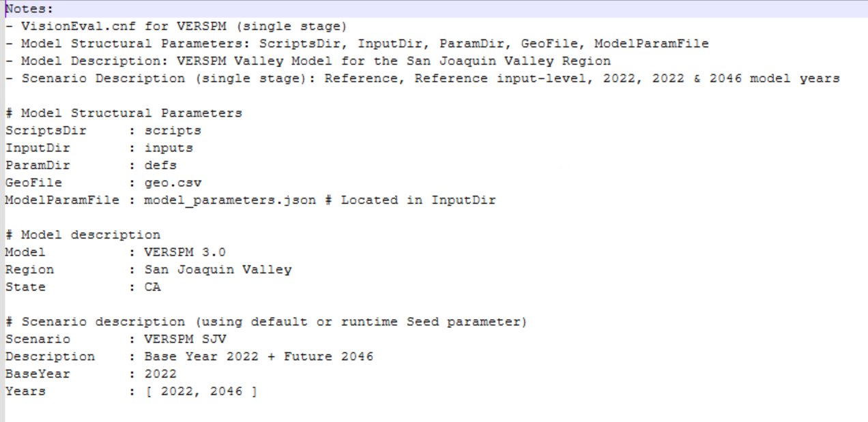
Folder Structure
Presented by: Nick Fisher
visioneval.cnf:
visioneval.cnf:
Defines the model’s structure and key attributes of the model and its computation stages and scenarios
BaseYear: must match base year in input files
Years: must match base and future year(s) in input files
queries
Contains .VEqry files to run query output data (see slide 75-83)
More information later in the training.

Slide 71
3. How to run a base model
Presented by: Edna Aguilar

Slide 72
Prerequisites
Presented by: Edna Aguilar
The following are needed to run a model:
SJV Base Model:
RSG has provided an installer with the SJV base model with PopulationSim
R:
The R version must match the R version of the installer, e.g 4.3.3
R IDE:
RStudio: https://posit.co/download/rstudio-desktop/

Slide 73
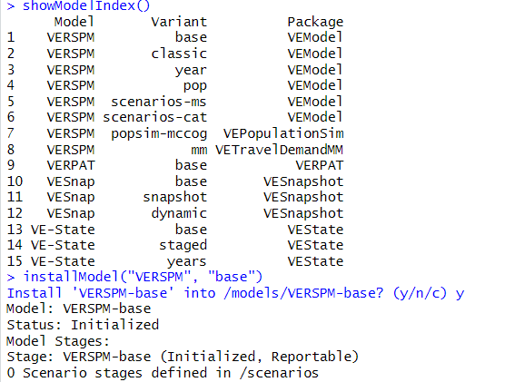
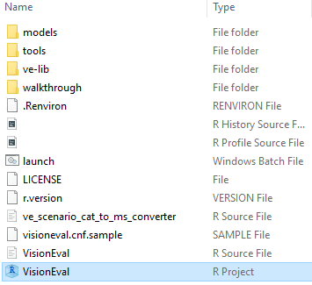

Install a VE Model
Presented by: Edna Aguilar
To practice how to run a model we are going to use a pre-installed model for Rogue Valley, OR.
To install the model:
Step 1: Open the R project in the root folder
Step 2: Install a default model by using the command installModel(“VERSPM”, “base”). Note: you can use the showModelIndex() function to view a list of ready-to-install models
Step 3: Confirm the model was installed in the models folder
2
3
1

Slide 74


Run a VE Model
Presented by: Edna Aguilar
Step 1: Open the VisionEval R project in the root folder
Step 2: Open a model and save it as an object. The name of the model must match the name of the folder:
Step 3: Enter model$run() and ensure the model initializes. VisionEval uses this process to validate that the inputs are all in the anticipated format and there are no missing values across the various geographic levels.
Note: To re-run a model the ModelState.Rda file in the results folder must be deleted.

Slide 75


Run a VE Model
Presented by: Edna Aguilar
Step 4: Extract model results
Once the model has finished running, use the built-in VE export function to export the model data as CSV outputs using the following code:
This will export the results as CSV files to the results/output folder. Depending on the number of years in the model, this process could take 15-20 minutes.
Results can also be exported into an SQLite database by using the following command. Results will also be saved in results/output.
> results$export(“sql”)
List of output tables (csv files)

Slide 76



Model Outputs
Presented by: Edna Aguilar
Refer to the Metadata for variable descriptions:
Marea 25 table
Household table

Slide 77
4. How to test a future scenario
Presented by: Edna Aguilar

Slide 78



DIY: Test future scenarios
Presented by: Edna Aguilar
Imagine you want to test different policies to reduce dvmt. Test policy changes separately and/or combined.
Step 1: Create a new model with a modified future scenario. Depending on the changes you want to implement you can install a new base model or copy another model and renaming the folder.
Step 2: Update relevant inputs to reflect the change in the future scenarios, for example:
2.1 Open the marea_congestion_charges.csv to increase congestion charge for 2038 in the high-congestion-charge and combined model
2.2 Open the azone_veh_use_taxes.csv to add vmt taxes for 2038 in the high-taxes and combined model
azone_veh_use_taxes.csv
marea_congestion_charges.csv

Slide 79
DIY: Test future scenarios
Presented by: Edna Aguilar
Imagine you want to test different policies to reduce dvmt. Test separately or combined.
Step 3: Run all the models
Step 4: Extract results (explained in Part 3) and compare dvmt:
Scenario | DVMT
Base model | 4,980,908
High congestion charge | 4,873,635
High VMT tax | 2,668,548
High congestion charge + VMT tax (combined) | 2,606,251

Slide 80
Part 3
Presented by: Edna Aguilar
1:00pm – 3:00pm
1. Querying outputs
2. Visualize Inputs/Outputs
3. How to run multiple future scenarios
4. Multiscenario viewer

Slide 81
1. Querying Outputs
Presented by: Edna Aguilar

Slide 82


Background
Presented by: Edna Aguilar
VisionEval has a built-in query function that allows you to query the sql outputs
(To export model outputs into a sql format follow instructions in slide 73)
To query output data, a .VEqry file must be created. This file specifies the parameters of the query and follows a particular format
The “Full-Query.Veqry” file found in the queries folder explains how to specify a query and provides examples

Slide 83

Anatomy of a Query
Presented by: Edna Aguilar
A query object is comprised of a list of queries
Each individual query is a list with the following elements:
Name: name of measure
Summarize or Function
If using Function, define a string containing an R expression
If using summarize, must define:
Expr (required): the summarize variable expression
Units (required): for each variable referred to in Expr or By, the units of the corresponding dataset
By: A vector of variables along which to break out a Measure
Table: A vector of one or more tables that will be joined
Breaks (optional): used to turn numeric variables into categories
BreakNames (optional): Nice names to append to the Breaks
Key (optional): (if Table contains more than one Table) – the Dataset or field in all listed Tables to join by
Units: The output units in which the measure is expressed
Description: description of this measure

Slide 84

Defining a .VEqry file
Presented by: Edna Aguilar
Look at the Metadata table for a list of variables that you could query.
Define the list of queries with all the required parameters. Look at Metadata for information about the units.
Save the .VEqry file in the queries folder
The query is run for all the model years

Slide 85



How to Run a Query
Note:
Presented by: Edna Aguilar
Step 1: Create a .VEqry file with desired queries and save it in the queries folder
Step 2: Open R project if not already open
Step 3: Load model if not already loaded
Step 4: Load the query and run it using the query function
Step 5: Export results. Results are exported as an R Data File (.Rda) in the results folder.
Note that the .Rda file must be deleted to re-run the query.
5
3
4
1
5

Slide 86


Query Results
Presented by: Edna Aguilar
Results are exported as a .Rda file that can be loaded in R using:
Three lists are created with each query run:
BaseYear
Specifications
Values
Values contains the results of the query which can be view printing the list elements, e.g.
> load(file = “models/VERSPM-base/results/Query_Dvmt-Query.Rda”)

Slide 87


Example query
Presented by: Edna Aguilar
Returning to the Part 2 example where we tested policies to reduce dvmt...
Run query on all models and compare results
Example query:

Slide 88
DIY: Test future scenarios
Presented by: Edna Aguilar
Going back to the previous examples where we test measures to reduce dvmt:
Scenario | 2038 DVMT
Base model | 4,980,908
High congestion charge | 4,873,635
High VMT tax | 2,668,548
High congestion charge + VMT tax | 2,606,251
Demo

Slide 89
2. Visualizer Guide
Presented by: Edna Aguilar

Slide 90

Input/Output Visualizer
Presented by: Edna Aguilar
RSG provided a Visualizer tool to visualize input and outputs for base models and to view results of the multiscenario

Slide 91

Inputs Viewer
Presented by: Edna Aguilar
Switch between tabs
Select the base year and the year to compare it to
Input description
Select the input and the variables you want to view. Filter by Marea to focus on one Marea.
Define map (classification method) and summary chart (aggregation) settings
Input viewer: depending on the type of input, the input be summarized on a map or chart. All Marea inputs are presented in a summary table + a map or chart.

Slide 92

Outputs Viewer
Presented by: Edna Aguilar
Select the output variable to view and the geographic scale at which to summarize
Select the base year and the year to compare it to
Filter data based on Marea and values
When you make changes to any of the above, you must hit go to update the output viewer
Output viewer: outputs are summarized

Slide 93
3. How to run multiple future scenarios
Presented by: Nick Fisher

Slide 94
SJV VE Scenarios
Presented by: Nick Fisher
Category | Level | Description | 2046 Varied Inputs
Population (P) | 1 | 2023 DOF forecast, hold household sizes fixed (reference land use inputs) | VEPopulationSimInputs
 | 2 | 20% employment growth | bzone_employment.csv
 | 3 | 2023 DOF forecast, let household sizes vary (use with reference land use inputs) | VEPopulationSimInputs
 | 4 | 2023 DOF forecast, hold household sizes fixed (run with level 1 land use inputs) | VEPopulationSimInputs
 | 5 | 2023 DOF forecast, hold household sizes fixed (run with level 2 land use inputs) | VEPopulationSimInputs
 | 6 | 2023 DOF forecast, hold household sizes fixed (run with level 3 land use inputs) | VEPopulationSimInputs
Land use (L) | 1 | Housing mix and TOD: TOD and 50% increase of multifamily shares in urban areas, 20% elsewhere | bzone_dwelling_units.csv, VEPopulationSimInputs
 | 2 | Compact growth: All growth in urbanized areas | bzone_dwelling_units.csv, VEPopulationSimInputs
 | 3 | Job-housing balance: Job to housing ratio of 1 | bzone_dwelling_units.csv, VEPopulationSimInputs
Fees / Costs (F) | 1 | 50 cents per mile congestion fee during severe and extreme congestion | marea_congestion_charges.csv
 | 2 | Congestion fees and 2.5 cents per mile VMT fee | marea_congestion_charges.csv, azone_veh_use_taxes.csv
Travel Demand Management (D) | 1 | Daily parking cost of $2 in urbanized Bzones | bzone_parking.csv
Transportation Infrastructure (T) | 1 | 2x Bus and demand response transit service | marea_transit_service.csv, bzone_transit_service.csv
 | 2 | 50% increase in bike and pedestrian facilities in urban areas | azone_prop_sov_dvmt_diverted.csv
 | 3 | 50% increase in arterial lane miles (1 scenario only) | marea_lane_miles.csv

Slide 95
SJV VE Scenarios – Combinations Matrix
Presented by: Nick Fisher
POPULATION AND LAND USE | Fees / Costs | Travel Demand Management | Transportation Infrastructure
P1 + L0 | F0 | D0 | T0
P2 + L0 | F1 | D1 | T1
P4 + L1 | F2 |  | T2
P5 + L2 |  |  | T3
P6 + L3
P3 + L0
Level 0 represents the reference level inputs (no scenario variation)
The matrix shows the combinations of elements that were run to create the scenarios. It includes:
6 Population and Land Use scenarios
3 Fees / Costs scenarios
2 Travel Demand Management scenarios
3 Transportation Infrastructure scenarios
1 unique scenario using T3
1 reference scenario for the base year (produces only 1 scenario)
1 reference scenario for the future (produces only 1 scenario)
Sums to:
(6 * 3 * 2 * 3) + 1 + 1 + 1 = 111 models being run in total

Slide 96




The VERSPM-SJV-Cat model
Presented by: Nick Fisher
This model provides the capability to quickly set up and run hundreds of models that combine unique changes to specific inputs (multiscenario design)
Model scenarios are defined in terms of combinations of individual model inputs. Inputs are defined in the scenarios folder.
SJV VE scenario inputs consist of 4 folders, each for a particular category of inputs:
D: Travel demand management
L: Land use
F: Fees
T: Transportation infrastructure
Population sim variants are stored in the “inputs” folder
Within each category (D, L, F, T), numbered subfolders (1, 2, 3…) represent different levels of change to test for that category.
The “cat” model runs all possible combinations of categories and their levels. For example, with 3 categories each containing 3 levels, 27 unique scenario combinations are produced.
Inputs not specified in a scenario folder default to the reference model values

Slide 97

Future Scenario Configuration files – Model root
Presented by: Nick Fisher
The VERSPM-SJV-Cat model has two config files:
visioneval.cnf (in the root model directory), and
scenarios/visioneval.cnf
This file is used just to define the model stages
“stage-2022” is the reference model for 2022
“stage-2046” is the reference model for 2046

Slide 98


Future Scenario Configuration files – “scenarios”
Presented by: Nick Fisher
The scenarios/visioneval.cnf is a configuration file that defines the scenario elements, their levels, and the combinations in which they are run.
This file directs the model towards specific inputs for a single model run
The “Scenario Elements” define the inputs that are changing and the magnitude of change – ex. L2 represents Compact Growth inputs.
These elements are mirrored in the scenario folder structure
The scenario categories represent the unique combinations of scenario elements that are used – Ex. PLU 3 uses scenario elements L1 and P4.
These categories are combined to create a single unique scenario.

Slide 99

Running multiple future scenarios
Presented by: Nick Fisher
VisionEval treats each future scenario as a unique model that is a copy of the base model with modified inputs.
When calling model$run() on VERSPM-SJV-cat, VisionEval executes scenarios sequentially. This is computationally inefficient. RSG has provided a script that splits the models into batches to run models in parallel.
The ve_scenario_cat_to_ms_converter.R script creates new model folders (containing a batch of models) than can be run in parallel. The scenario folders are pictured here

Slide 100


Converting the “cat” model to multiscenario
Presented by: Nick Fisher
The ve_scenario_cat_to_ms_converter.R script creates multiscenario model setup that can be run using parallel processors. This script must be run in “VisionEval.Rproj”
The modelName (name of model to break up) – this is the “cat” model.
Models can be divided into batches using the code snippet below. The numbers can be adjusted to divide the models into batches (in this case, RSG used batches of 30 models).

Slide 101
Running multiple future scenarios
Presented by: Nick Fisher
To run a batch, simply open the VisionEval R project in the “runtime” folder and run a batch by typing the name of the right model folder, for example:
> options(future.globals.maxSize = 8.0 * 1024^3) ← Set the available RAM
> model = openModel(“VERSPM-SJV-ms-model-name”) ← Open the model folder
> model$plan(“multisession”, workers = 12) ← Set to parallel processing and the number of processors
> model$run() ← Run all of the models, this will run the “stage-2022” – or the base year – then run the scenarios in parallel (12 at a time)

Slide 102
4. Multiscenario viewer
Presented by: Nick Fisher

Slide 103
Wrapping Up
Presented by: Jon Slason

Slide 104
What Have We Covered?
Presented by: Jon Slason
Intro to VE
What is VE
VisionEval Basics
Inputs
Geography structure
Packages & Modules
VisionEval Model Framework
Setting up Model Runs
Default and basic models
How to run a base model
How to design a future scenario
Summarizing Outputs
Querying outputs
How to run multiple future scenarios
Input/output visualizer guide
Notes:
Part 1:
Slides 1 – 60
165 min: 2.75 min per slide avg.

Slide 105

Tools and Resources
Presented by: Jon Slason
Metadata descriptions
List of inputs and outputs from VE
Description, Location within VE model
Shapefile
Used along with Geos file in the “Defs” folder to create a crosswalk.
Bzones nested within Azones nested within Mareas
Metadata description

Slide 106
Tools and Resources
Presented by: Jon Slason
Documentation: https://visioneval.github.io/docs/
Pre-Built VE Model for the SJV Region
Version 3.1
GitHub management
VE core model can be enhanced with package upgrades and updates
VisionEval – Extras
Custom SJV VisionEval packages for land use, PopulationSim, Vehicles and Powertrains
Forked from RSG-VE-Extras which is forked from VE Pooled Fund VisionEval-Extras
Contribute to GitHub resources
https://github.com/VisionEval
https://github.com/RSGInc/RSG_VE_Extras

Slide 107

Outputs and Analysis
Presented by: Jon Slason
Query methods for analyzing results for specific model runs.
Geographic specific filters,
database produced by VE Export function allows for users to gain access to full VE results
Web-based Visualizer to host model run data
RSG will continue to host this resource for partners to be able to share the VE inputs, outputs, etc.
It will continue to be enhanced over time
RSG hosting this level of visualization as a SaaS model
https://rsginc.shinyapps.io/visioneval-explorer-sjv/

Slide 108

Where do you go from here
Presented by: Jon Slason
Opportunities for collaboration. VE Pooled Fund is restarting outside of FHWA leadership. RSG will continue to periodically send along updates, news and announcements to current and past users of VE
Agencies around the country are using VE. For long-range plans, land use analysis, scenario planning, upstream analysis of policies prior to more detailed network modeling.
Capability to continue to refine inputs and improve model results.
Expansion – using EMAT, continuing to explore new LandUse module, ITHIM, Driverless, WFH
Develop additional model variants by changing inputs or policies of interest to you.

Slide 109
Jonathan Slason
Nick Fisher
Project Manager
Deputy Project Manager
jonathan.slason@rsginc.com
nicholas.fisher@rsginc.com

Slide 111
Advanced Topics
Installing a Custom Package

Slide 112
Step 1: Clone the SJV-VE-Extras repository
The SJV VE model can be customized by modifying packages. For example, the PowertrainsAndFuelsSJV package can be changed to reflect new technology or sale projections.
Modifications to packages must happen in the source code and then installed in the appropriate ve-lib folder
1.1 Use the RSG GitHub page to clone the SJV-VE-Extras repository using your Git-compatible software of choice.
SJV-VE-Extras:
Contains all the SJV custom packages
Link for cloning: https://github.com/RSGInc/SJV-VE-Extras.git

Slide 113


Step 2: Modify the package
2.1 Make your adjustments to the package files where necessary

Slide 114

Step 3: Document the package
3.1 Open the R project in the SJV-Extras folder
3.2 Set the package folder as the working directory
3.3 Install devtools + dependencies
3.4 Run the following command to document the package:
> setwd("c:/Documents/SJV-VE-Extras/VEPowertrainsAndFuelsSJV")
> install.packages(“devtools”)
> devtools::document()

Slide 115

Step 4: Install Packages to the VE Library
4.1 In the SJV-VE-Extras R project, add the absolute path to the ve-lib folder your model uses (e.g. installer/ve-lib). Use the “.libPaths” command:
> .libPaths(“E:/installer/ve-lib”)
4.2 Set the working directory to the SJV-VE-Extras folder
> setwd("c:/Documents/SJV-VE-Extras")
4.3 Use the “install.packages” command to install the desired VE packages (the additional commands “type” and “repos” are required as pictured).
4.4 The updated package should now appear in the ve-lib folder

Slide 116




Step 5: Update run_model.R, necessary
5.1 If necessary, update the run_model.R script of your model so that it points to the right packages and modules

