Slide 1
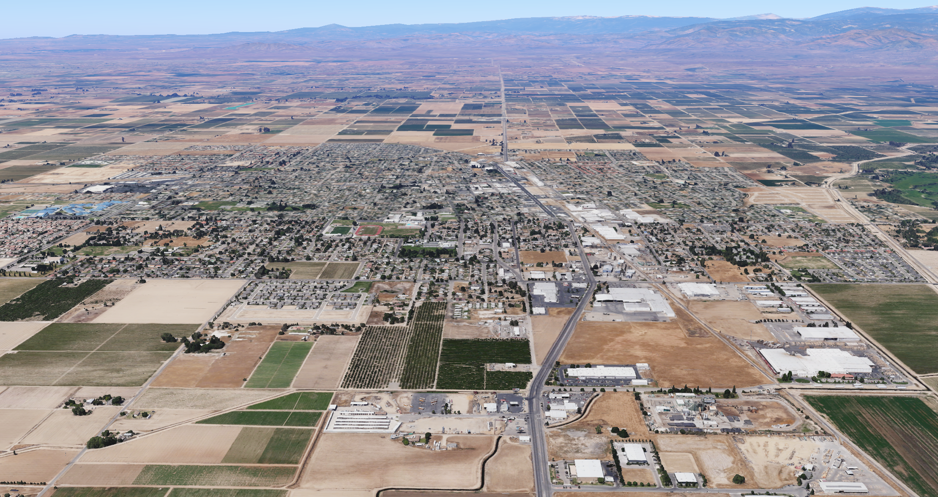
Jensen Avenue and Greenwood Avenue Intersection Improvements
San Joaquin Valley
Project Level Conformity Group Presentation
May 19, 2026

Slide 2
Project Overview
Project Description
Project Location
Purpose and Need
Project Listing in the FTIP/CTIPS¹
Traffic Data
Project Schedule
Project-level Conformity Summary
¹FTIP: Federal Transportation Improvement Program; CTIPS: California Transportation Improvement Program System.

Slide 3
Project Description
Jensen Avenue and Greenwood Avenue is located at a reverse curve controlled by an existing traffic signal with permissive/unprotected left turns in all directions.
The intersection experiences the second highest number of reported accidents along the Jensen Avenue Corridor within City limits. The majority of accidents are broadside and head-on accidents due to are left-turn right of way conflicts from Jensen Avenue onto Greenwood Avenue.
Roadway pavement within the Project limits will be rehabilitated to address block cracking, weathering and medium to high severity alligator cracking.
The Project will construct dedicated left turn lanes and modify the existing traffic signal system from permissive to protected left turn phasing for EB/WB Jensen Avenue approaches.
Project consists of a No-Build (no signal modifications) and One Build Scenario (with signal modifications).
Project does not meet the criteria for an exempt project under 40 CFR 93.126 or 93.128.

Slide 4
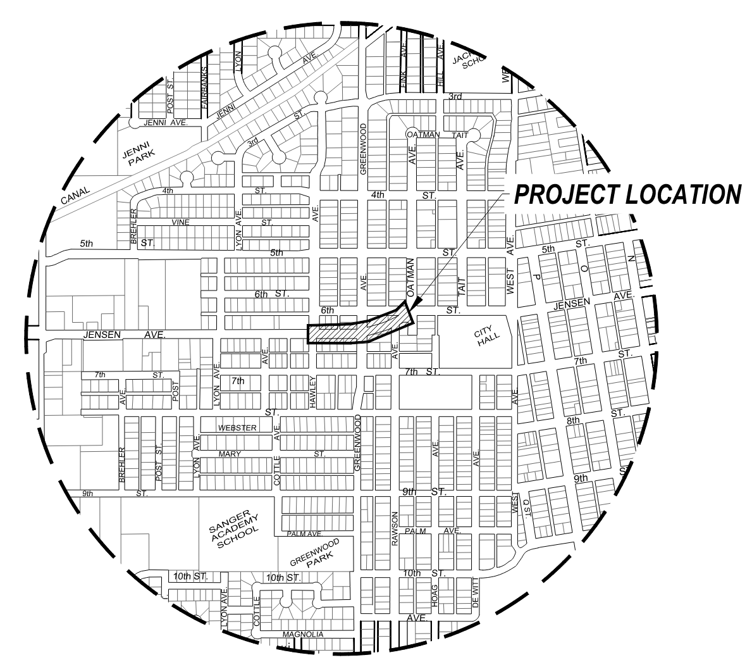
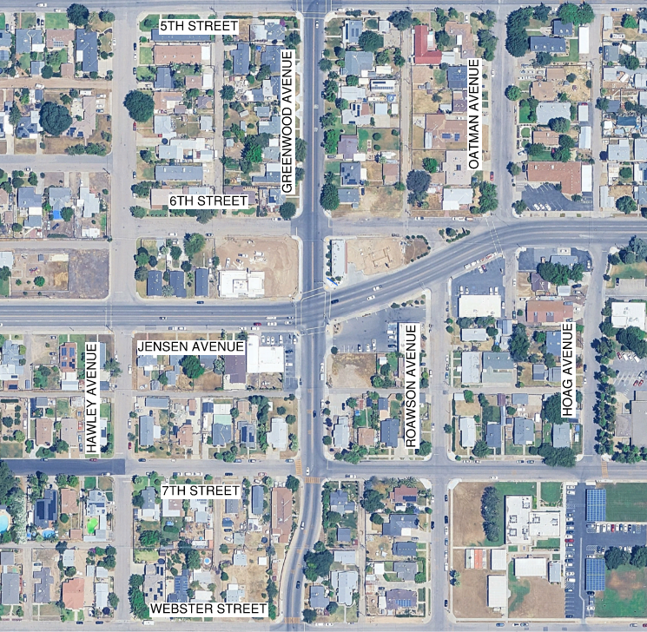
Location

Slide 5
Purpose and Need
Need
Permissive left turn lanes and phasing currently controls all approaches at Jensen Avenue and Greenwood Avenue.
High rate of head-on and broadside collisions due to right of way left turn conflicts from Jensen Avenue onto Greenwood Avenue.
Existing roadway pavement within the Project limits exhibits low to medium block cracking and areas of medium to high alligator cracking for an overall PCI of 45.
Purpose
Address right of way left turn conflicts by:
  Constructing dedicated left turn lanes for EB and WB Jensen Avenue.
  Modify existing traffic signal system to provide protected left turn phasing for EB and WB Jensen Avenue.
Rehabilitate the roadway: perform dig outs of alligator cracking, asphalt grind and overlay.

Slide 6
Project Listing in the TIP
The proposed project (FTIP ID: LSTMP894) is listed in the 2025 Fresno Transportation Improvement Program.
The scope of the proposed project is consistent with the project description in the 2025 FTIP.

Slide 7
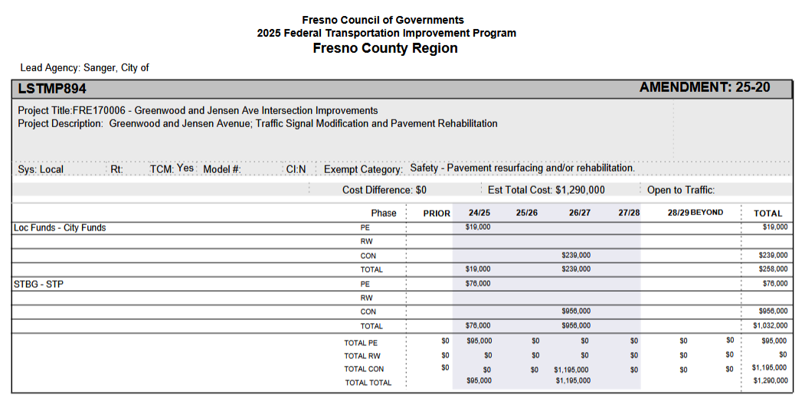
Project Listing in the TIP

Slide 8
Modeling and Tables
Intersection | Peak Hour | Opening Year No Build |  | Opening Year Build |  | Analysis Year No Build |  | Analysis Year Build
 |  | Delay (s) | LOS | Delay (s) | LOS | Delay (s) | LOS | Delay (s) | LOS
Jensen Avenue & Greenwood Avenue | AM | 11.4 | B | 17.4 | B | 12.4 | B | 17.6 | B
 | PM | 12.2 | B | 17.7 | B | 13.5 | B | 19.5 | B
AADT for 2026 and 2046 analysis years is the same for no-build and build (Project is not a trip generator).
Y&H coordinated with Fresno COG who provided traffic data from their travel demand model. Y&H then applied the incremental method to traffic counts conducted to get forecasted traffic and determine the level of service of the intersection for both 2026 and 2046 with and without protected left turn lanes and signal modifications.

Slide 9
Project Schedule
 | Preliminary Engineering | Engineering | Right-of-Way | Construction
Start | 2025 |  |  | 2026

Slide 10
Project-level Conformity Conclusion
Project does not meet the criteria for a POAQC as defined in the final rule by 40 CFR 93.123(b)(1). The project is listed as one of the non-exempt project examples that are not a local air quality concern under 40 CFR 93.123(b)(1)(i) and (ii) stated as
  “An intersection channelization project or interchange configuration project that involves either turn lanes or slots, or lanes or movements that are physically separated. These kinds of projects improve freeway operations by smoothing traffic flow and vehicle speeds by improving weave and merge operations, which would not be expected to create or worsen PM2.5 or PM10 violations”
Additional reasons why the project is not a POAQC are:
  The project is not developer driven and will not generate any additional trips. The traffic volumes between the build and no-build scenarios is the same for both 2026 and 2046. The additional traffic in 2046 is due to natural growth of the area and there is no correlation between additional traffic and this project.

Slide 11
Questions
Contact Information
Josh Rogers
City of Sanger
559-244-3123

