Slide 1
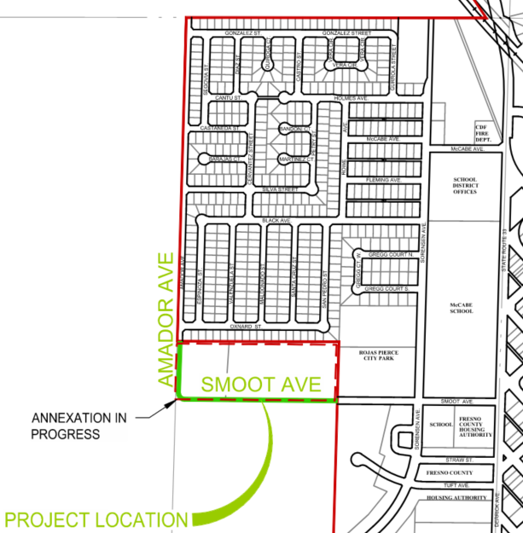









Extension of Amador Ave & Smoot Ave
Federal Project No.: CMLSTPL-5285(026)
FTIP: FRE230005
San Joaquin Valley Project Level Conformity Group Presentation
May 19, 2026

Slide 2
Project Overview
Project Description
Location and Other Background Information
Purpose and Need
Project Listing in the FTIP/CTIPS¹
Project Build Scenario Features
Traffic Data & Findings
Project Schedule
Project-level Conformity Summary
¹FTIP: Federal Transportation Improvement Program; CTIPS: California Transportation Improvement Program System.

Slide 3
Project Description
Overall Project:
  Connect Amador Avenue and Smoot Avenue be extending the existing streets from their current terminus to their intersection with asphalt pavement, striping and signage.
The project was not exempt under 40 CFR 93.126 or 93.128

Slide 4
Project Background
Las Palmas Residential Subdivision:
  428 single family residential homes
  Only two streets for ingress/egress: Black Avenue & Holmes Avenue
    Both designed as local streets
    Black Avenue functions as a Collector
    Both intersect with Sorensen Avenue on the west side of McCabe Elementary School

Slide 5
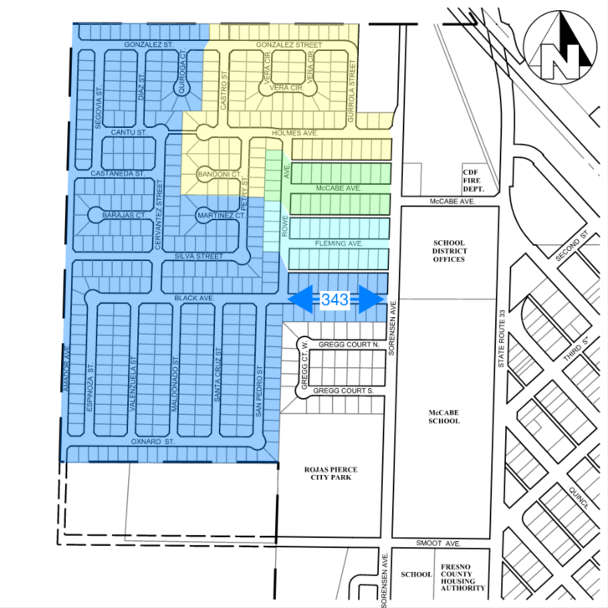
Project Background
Las Palmas Residential Subdivision:
  343 lots utilize Black Ave (blue shading)
  This equates to 3,144 AADT
  Black Avenue experiences 30-minute delays during morning commute hour

Slide 6
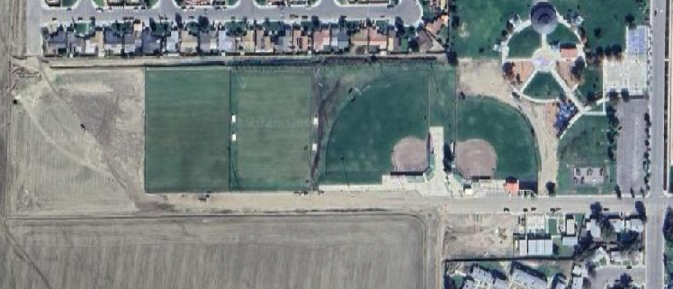
Project Location
Amador Avenue
Smoot Avenue

Slide 7
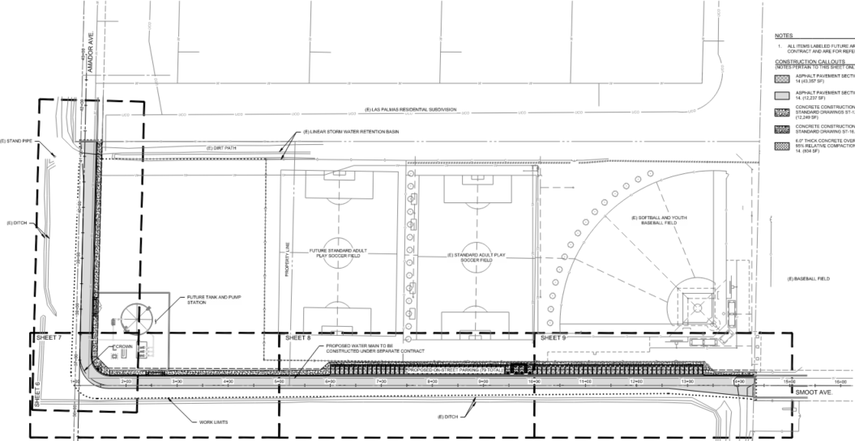
Project Location
Proposed Extension

Slide 8
Project Purpose and Need
The primary purpose of this project is to:
  Redistribute existing vehicular traffic
  Relieve congestion at the Black Avenue and Sorensen Avenue intersection
  Provide accessible sidewalks for access from Las Palmas to Rojas-Pierce Park
  Provide alternate route for quicker emergency response, trash collection, school buses and municipal vehicles

Slide 9
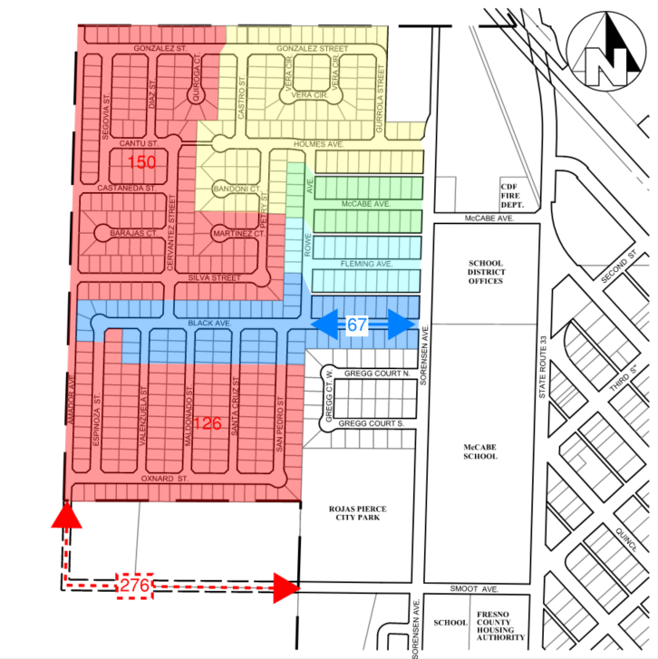
Project Purpose and Need
Las Palmas Residential Subdivision:
  Approximately 276 lots will be accessed by project (red shading)
    2,530 AADT on project
  Traffic on Black serving 67 lots (blue shading)
    reduced to 614 AADT

Slide 10
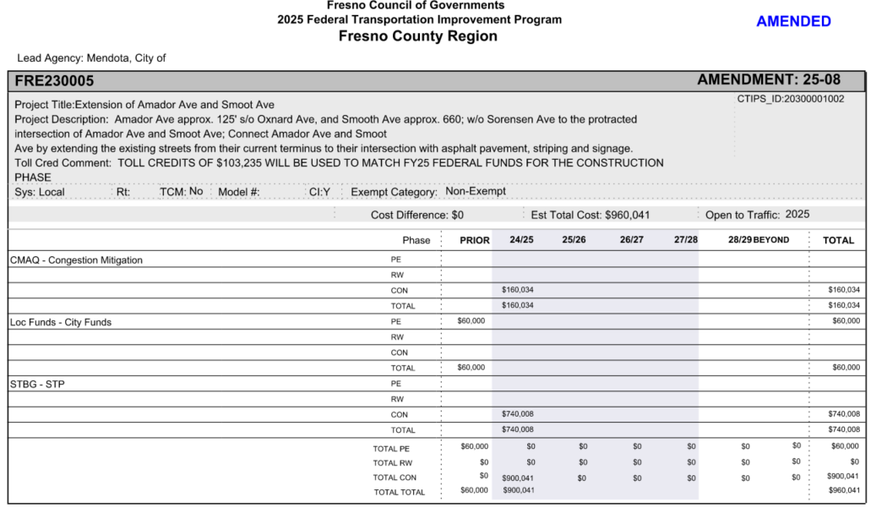
Project Listing in the TIP
Federal Transportation Improvement Program (FTIP) - Fresno Council of Governments

Slide 11
Project Features
Extension of Amador Avenue (550 linear feet) and Smoot Avenue (1,325 linear feet)
  Eliminates vehicle driving over dirt
  Provides safe, accessible pedestrian access
  Provide alternate route for ingress to and egress from Las Palmas residential subdivision
    Shorter Emergency Response Times
    More options for trash collection, school buses, municipal vehicles
    Relief of congestion at intersection of Black Avenue & Sorensen Avenue
  The number of lanes does not change

Slide 12
Traffic Data & Findings
Amador Avenue & Smoot Avenue
Year | No Build | Build
2026 | 0 AADT (0% Trucks) | 2,530 AADT (0% Trucks)
2046 | 0 AADT (0% Trucks) | 2,530 AADT (0% Trucks)
Years Selected for Analysis
Existing Year | 2026
Opened to Traffic | 2026
Analysis Year | 2046 (last year of RTP)
Black Avenue at Sorensen Avenue
Year | No Build | Build
2026 | 3,144 AADT (0% Trucks) | 614 AADT (0% Trucks)
2046 | 3,144 AADT (0% Trucks) | 614 AADT (0% Trucks)
New street segments so current traffic volume is zero.
Area is built-out so there is not an anticipated increase to total vehicles due to population or this project.
Traffic will be redistributed from Black Avenue & Sorensen Avenue to this project.

Slide 13
Traffic Data & Findings
  This is a Non-Capacity Adding project
    Change to AADT between build and no-build is redistribution of traffic
  Changes LOS of Black & Sorensen from F to A
  No surrounding land use will be impacted post construction
  These streets are not truck routes
  Traffic on nearby SR 33/Derrick Avenue does not change as a result of this project

Slide 14
Project Schedule
PSE (design) ………………………….. Complete
ROW Certification ………………….. Complete
NEPA Clearance ……………………… pending IAC & Noice Study
Bid Advertisement …………………. Summer 2026
Construction ………………………….. Fall 2026

Slide 15
Project-level Conformity Conclusion
This project does not meet the criteria for not being a “project of air quality concern” (POAQC) as is it not:
A new highway project with a significant number of diesel vehicles or an expanded highway project with a significant increase in the number of diesel vehicles.
A project that affects or changes a LOS D/E/F intersection with a significant number of diesel vehicles
A new bus or rail terminal or transfer point
An expansion to a bus and rail terminal or transfer point
In or affecting locations, areas, or categories of sites identified as sites of violation or possible violation

Slide 16
Project-level Conformity Conclusion
Project does not meet the criteria for a POAQC as defined in the final rule by 40 CFR 93.123(b)(1).
The project primarily serves passenger vehicles with no trucks expected, and the new extension is designed to redistribute traffic from Black Avenue, reducing congestion and improving traffic flow. As a result, no substantial increase in AADT or vehicle idling is expected.
Additional reasons why the project is not a POAQC are:
  Project will redistribute traffic from Black Avenue which was designed as a local street to Amador Avenue & Smoot Avenue, which are designed as collectors
  Project will provide safer bicycle and pedestrian access to Rojas-Pierce Park
  Project will eliminate vehicles from driving over dirt

Slide 17
Questions?
Contact Information
Michael Osborn, City Engineer
559-449-2700
mosborn@ppeng.com

